Slide 1
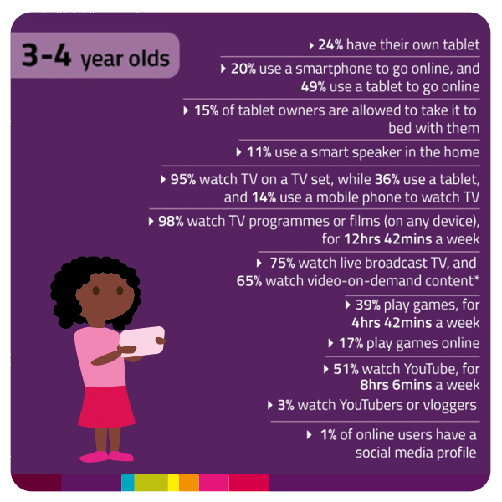
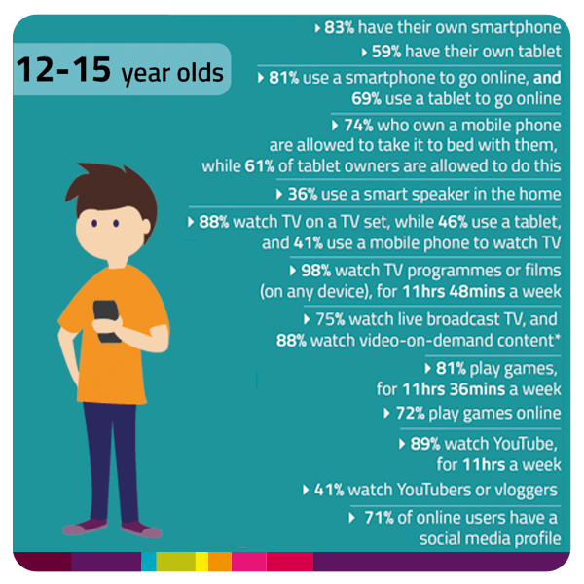
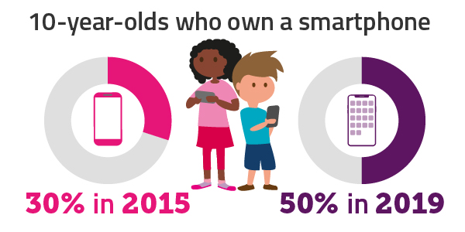
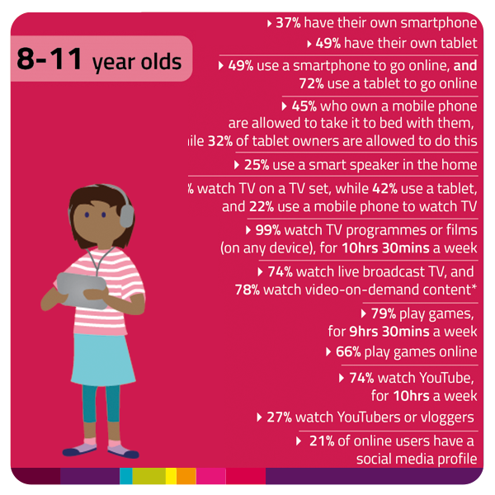
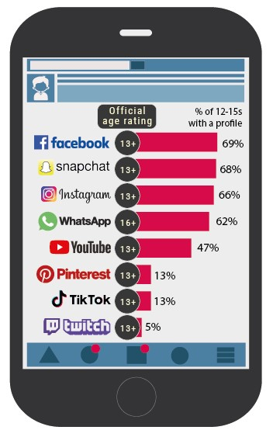
Parent Ofcom Starter activity from LGfL DigiSafe
Children’s Media Use and Attitudes report 2019

Slide 2
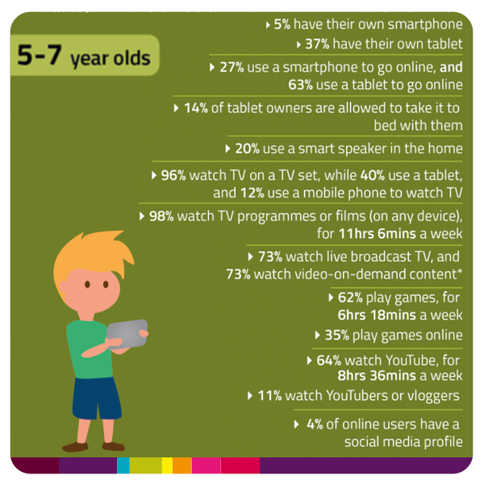
Do you allow your child to keep their device in the bedroom at night?
Go to screentime.lgfl.net for tips and ideas to manage screen time
Source: ofcom.in/msom2020 – Children’s
Media Use and Attitudes report 2019

Slide 3
Do you allow your child to keep their device in the bedroom at night?
Go to screentime.lgfl.net for tips and ideas to manage screen time
Source: ofcom.in/msom2020 – Children’s
Media Use and Attitudes report 2019

Slide 4
Are you familiar with the apps your child is on and if they are age appropriate?
Go to apps.lgfl.net for guidance on the latest apps and social media sites
Source: ofcom.in/msom2020 – Children’s
Media Use and Attitudes report 2019
Notes:
Social media use more fragmented
Today’s study finds that older children are using a wider range of social media platforms than ever before. WhatsApp in particular has grown in popularity among 12-15 year-olds since last year, despite having a minimum age limit of 16.
WhatsApp is now used by almost two thirds of older children (62%) – up from 43% in 2018. For the first time, it rivals Facebook (69%), Snapchat (68%) and Instagram (66%) as one of the top social media platforms for older children.
Newer platforms such as TikTok – which enables users to create 15-second lip-sync, comedy and talent videos – are also becoming more popular. Around one in seven older children use TikTok (13%) – up from 8% in 2018. One in 20 older children use Twitch – the live streaming platform for gamers.

Slide 5
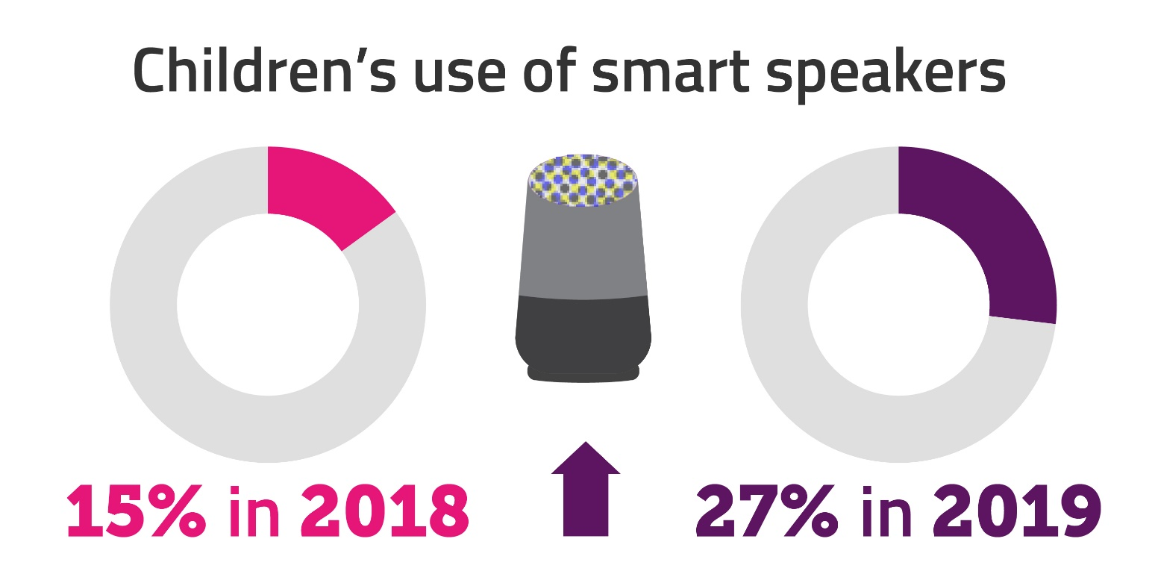
Have you set up parental controls and privacy settings for your smart devices?
Visit www.internetmatters.org/resources/smart-speakers-set-up-safe-guide/ to find out how
Source: ofcom.in/msom2020 – Children’s
Media Use and Attitudes report 2019
Notes:
Children are using more connected devices than ever before. Among these, smart speakers saw the biggest increase in use over the last year. More than a quarter of children now use them – up from 15% in 2018 – overtaking radios (22%) for the first time. Children’s use of smart TVs also rose from 61% to 67%.
When asked if they could pick only one to watch, children are more likely to pick YouTube (44%) over streaming services such as Netflix, Now TV and Amazon Prime Video (32%); or TV channels such the BBC and ITV (17%).

Slide 6
Do you talk to your child about the sites they use and who they chat with?
You can find conversation starters, ideas as well as tips to set up parental controls at parentsafe.lgfl.net
Source: ofcom.in/msom2020 – Children’s
Media Use and Attitudes report 2019

Slide 7
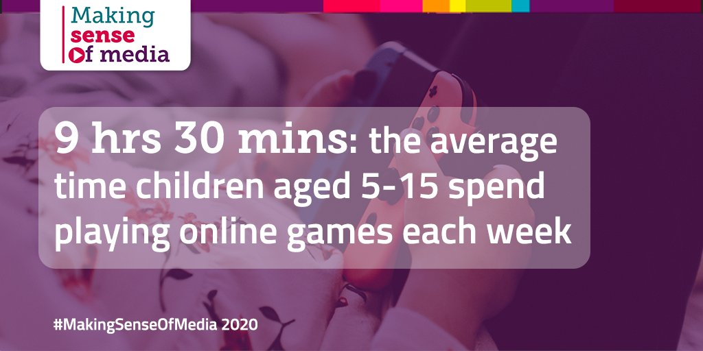
Are you familiar with the content they can come across whilst playing games and the age ratings?
Visit gaming.lgfl.net for advice and a guide to popular apps and games
Source: ofcom.in/msom2020 – Children’s
Media Use and Attitudes report 2019
Notes:
Almost half (48%) of girls aged 5-15 now play games online, increasing from 39% in 2018, while the proportion of boys who play online remained the same. Read more on these trends in today's report: https://ofcom.in/msom2020

Slide 8
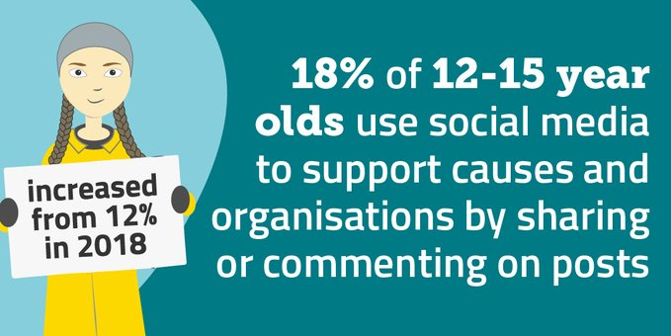
Remember the positives:
Almost a fifth of 12-15s use social media to express support for causes – environmental, political or charitable – by sharing or commenting on posts.
One in 10 signed petitions on social media.
Source: ofcom.in/msom2020 – Children’s
Media Use and Attitudes report 2019
Notes:
The 'Greta effect'. We have seen an increase in online social activism among children. Almost a fifth (18%, up from 12% in a year) of 12-15s use social media to express support for causes and organisations – potentially environmental, political or charitable – by sharing or commenting on posts. One in 10 signed petitions on social media.
Rise of the ‘vlogger next door’. While high-profile YouTube stars remain popular, children are now increasingly drawn to influencers like them. These people, known as ‘micro’ or ‘nano’ influencers, often have fewer followers. They might be local to a child’s area or share a niche interest. Children described these influencers as more relatable and directly engaged with their followers, while others described being able to imitate their content on their own social media channels.
Girl gamers on the increase. Almost half (48%) of girls aged 5-15 now play games online – a big rise from 39% in 2018. The proportion of boy gamers is unchanged at 71%, but boys spend twice as long playing online each week as girls (14 hours 36 minutes vs. 7 hours 30 minutes). Boys cited FIFA, Crew 2, Destiny 2 and Fortnite as examples of the games they play.

Slide 9
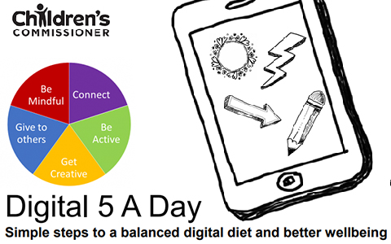
Is your child getting their digital 5 a day?
Go to socialnetworking.lgfl.net for the Digital 5 a Day for simple steps to balanced digital diet and better wellbeing
Proportion of parents of 5-15 year olds who agree with the statement:
“The benefits of the internet for my child outweigh any risks”
Source: ofcom.in/msom2020 – Children’s
Media Use and Attitudes report 2019

