Slide 1

‘Meet the teacher’
Year 4
2025-2026

Slide 2
Staff in Year 4
Class Teacher – Miss Dilsworth
Teaching Assistants – Miss Gardner & Mrs Grayson

Slide 3
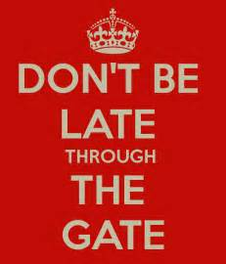

Attendance and punctuality
It is vital that your child is in school each day on time, in order for them not to miss out on vital parts of their learning. Children are brought into school at 8.45am and lessons begin promptly at 9.05am. Children who are late, arriving after 9.00am, must go to the main school entrance.

Slide 4
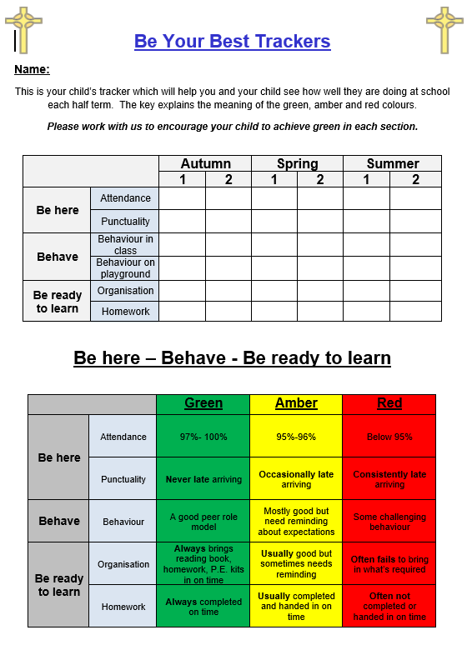
‘Be Your Best trackers’
From September 2020 we are now implementing a new tracking system known as ‘Be Your Best’. These trackers aim to keep parents fully informed of how their children are getting on in school at regular intervals through the school year.
These will monitor attendance, punctuality, behaviour, organisation and homework. They are colour coded and completed each half term.
Your child will be given a colour for each category to indicate where they are for that half term:
Green – On track
Amber – Working towards being on track
Red – Not on track
Please help support your child by ensuring they are in on time each day and that they return their homework each week.

Slide 5


Behaviour
At Holy Cross we have high standards of behaviour. All children are expected to behave well at all times, both inside and outside of the classroom.
Any misbehaviour will result in proportionate sanctions.
Parents will be spoken to if necessary about their child’s behaviour.
Class dojo’s, rewards, positive praise and stickers are all used to promote and encourage positive behaviour in school.

Slide 6

Class Dojo
Each child has a Dojo – these are used for rewards and converted in to house points.
This is used to encourage children to become more accountable for their own behaviour.
Please talk to your child about their progress on the Dojo chart.
At the end of each half term, children can enjoy a Dojo celebration providing they haven’t received 5 negative Dojos or more, that half term.

Slide 7

Homework
Homework will be uploaded to Seesaw every Thursday. Paper copies will be available to those children who need them. Homework should be completed for the following Wednesday.
Homework consists of…
Maths
Writing
reading
spellings
Children are expected to read their school reading book daily to an adult and record this is their reading diary. Additional reading of choice may also be recorded in the reading diary. Reading diaries should be brought into school daily.
Please be aware that Y4 children are also working towards their statutory multiplication tables check this year. Schools will have a one week window in June to administer the test. Please support your child with times tables homework.

Slide 8
NATIONAL CURRICULUM
■ English – develop reading, writing and spelling
■ Maths – building more secure knowledge of basics. Developing fluency and reasoning skills.
■ Topic – Develop a range of skills through cross-curricular approach
knowledge based
■ Assessment – Internal testing and assessment. Focus on teacher
judgement accompanied by NFER tests.

Slide 9

RSE
As part of our learning we will be focusing on the following themes, which link to our ‘Come and See’ topics throughout the year:
To make connections to show that we are all different.
To celebrate these differences as we appreciate that God loves and accepts us as we are now and as we change.

Slide 10
RE
Our topics are:
People
Called
Gift
Community
Giving and receiving
Self Discipline
New Life
Building Bridges
Gods People
This is taught through the ‘Come and See’

Slide 11
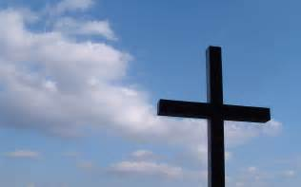
Gospel values
The Social, Spiritual, Moral and Cultural Development of pupils is important to us and one way in which we foster this is by promoting our ‘Gospel Values’ alongside our British Values. Our policies, procedures and daily teaching are underpinned by these values.
Our weekly Gospel assembly, whole school, key stage and class collective worship are based around the Gospel Values, which forms an important focus in the daily life of our school.
Courage, creativity, thankfulness, responsibility, compassion, peace, service, justice, trust, hope, love, forgiveness, friendship, humility, generosity and reverence and respect are our key Gospel values.

Slide 12

British values
Democracy
The rule of law
Individual liberty
Mutual respect
Openness of those of different faiths and beliefs.
These are our British values and we promote these in school in a variety of ways. To name a few examples: Children participate in nominating and electing class school council representatives, we actively celebrate the Holy days of other faiths and our children are taught how to negotiate and respect the views of peers.

