Slide 1


Ash Croft Primary Academy
This year, we are taking part in an exciting project in which five of our pupils have become i-Vengers.

Slide 2
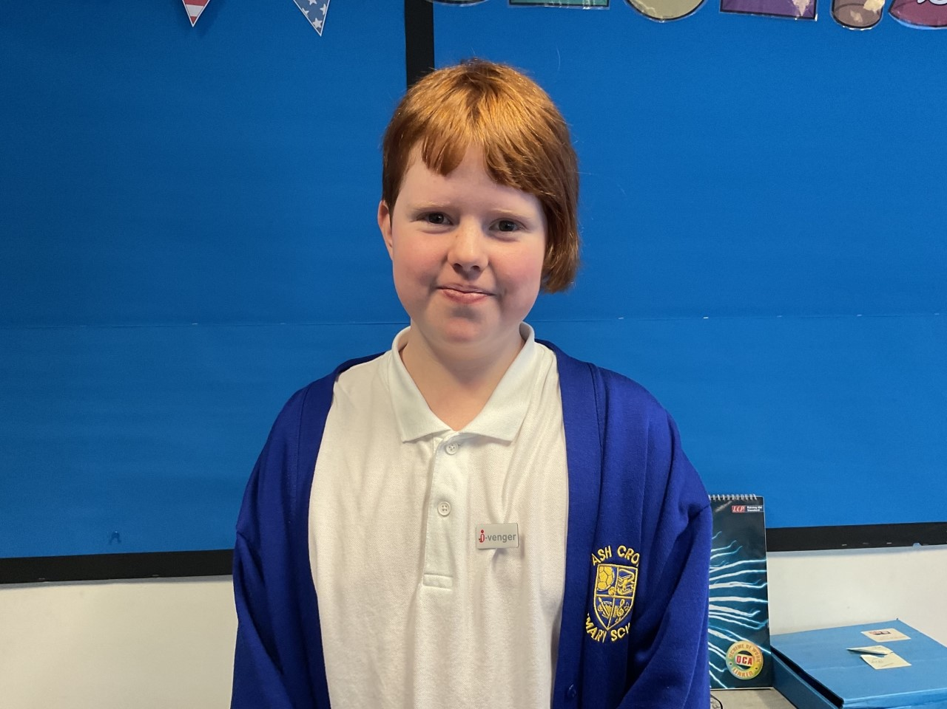
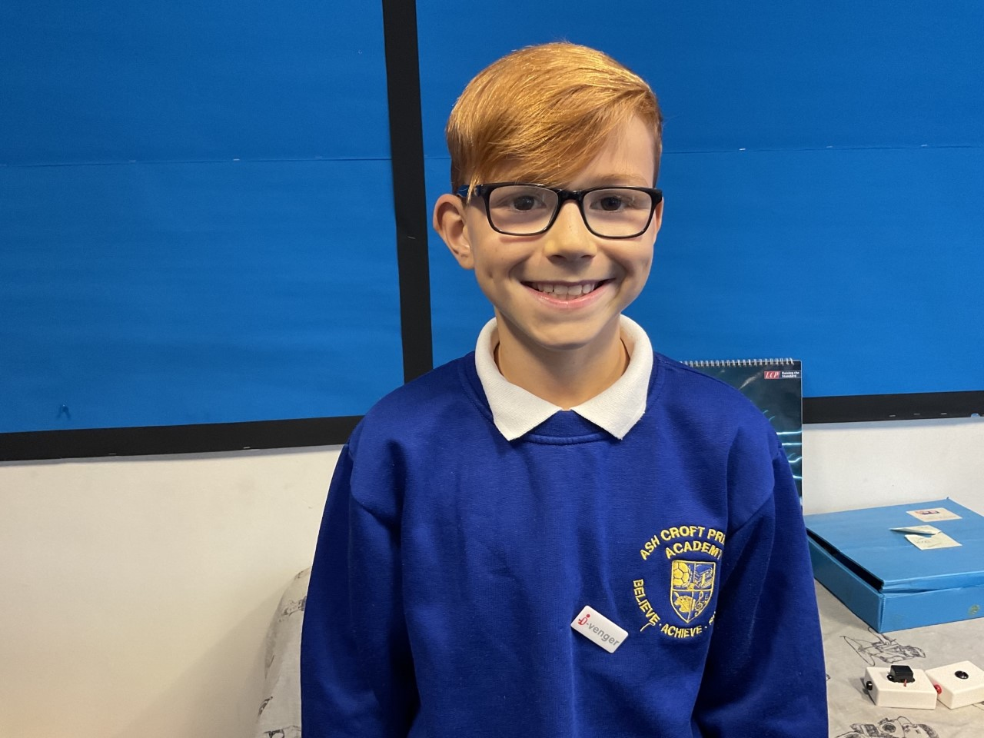
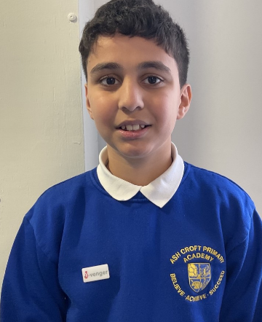
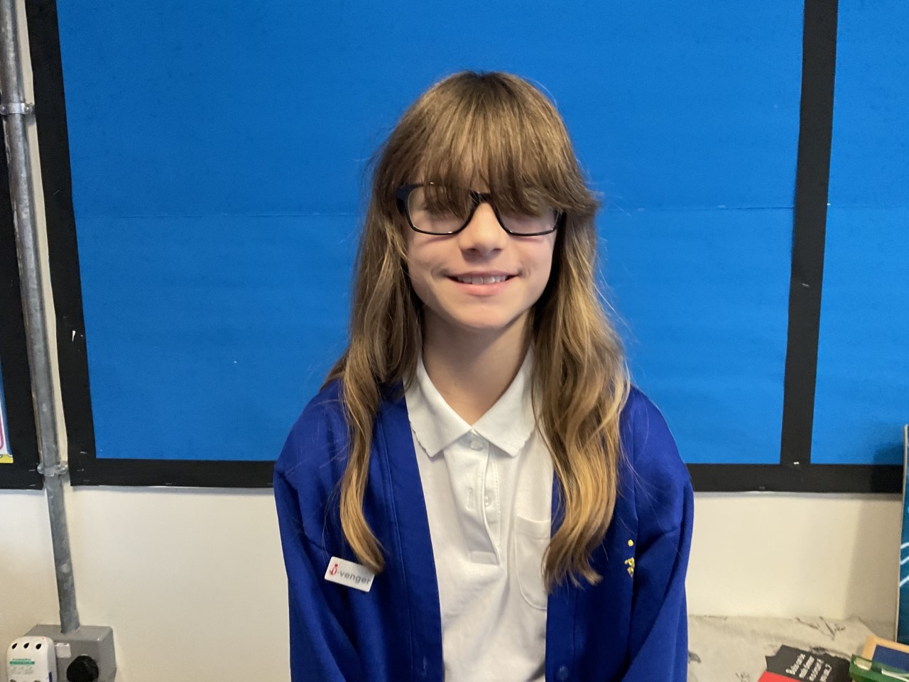
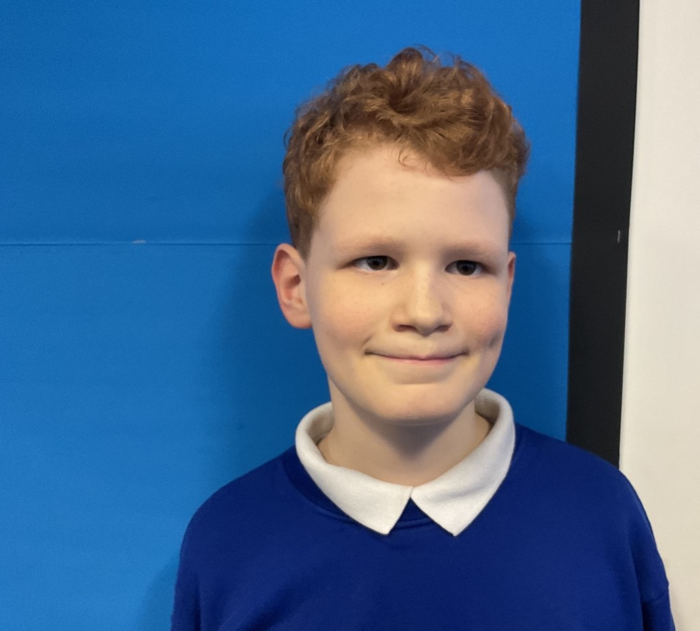
Meet the I-Vengers
Hannah – Year 6
Riley – Year 6
Arunveer – Year 6
Elise – Year 6
Leo – Year 6

Slide 3

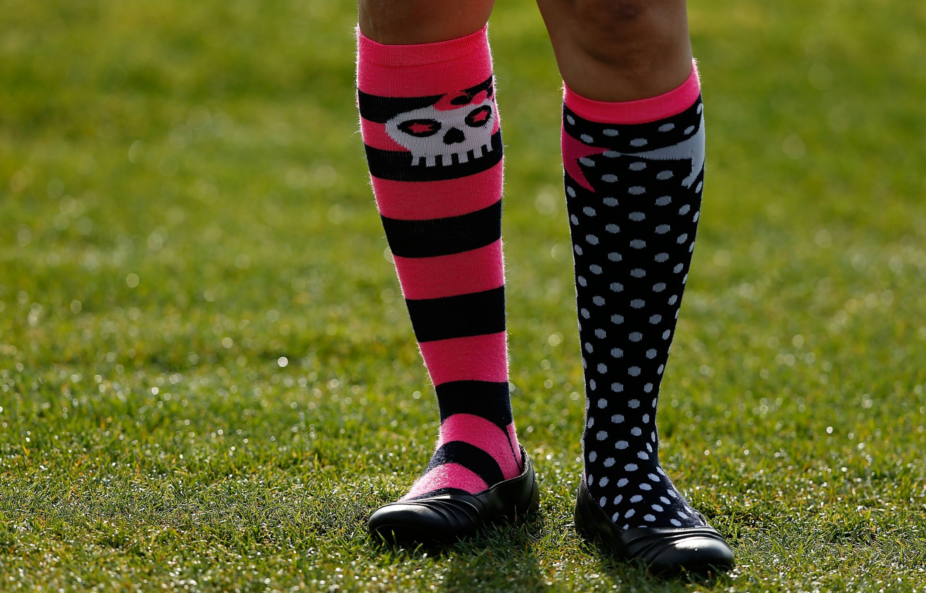
Anti-Bullying week

Slide 4
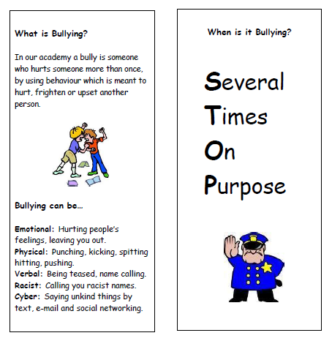
What is bullying?
TASK!
Tell your partner one kind thing.
How does it make you feel?

Slide 5


Postbox outside Mrs Twigg's office

Slide 6
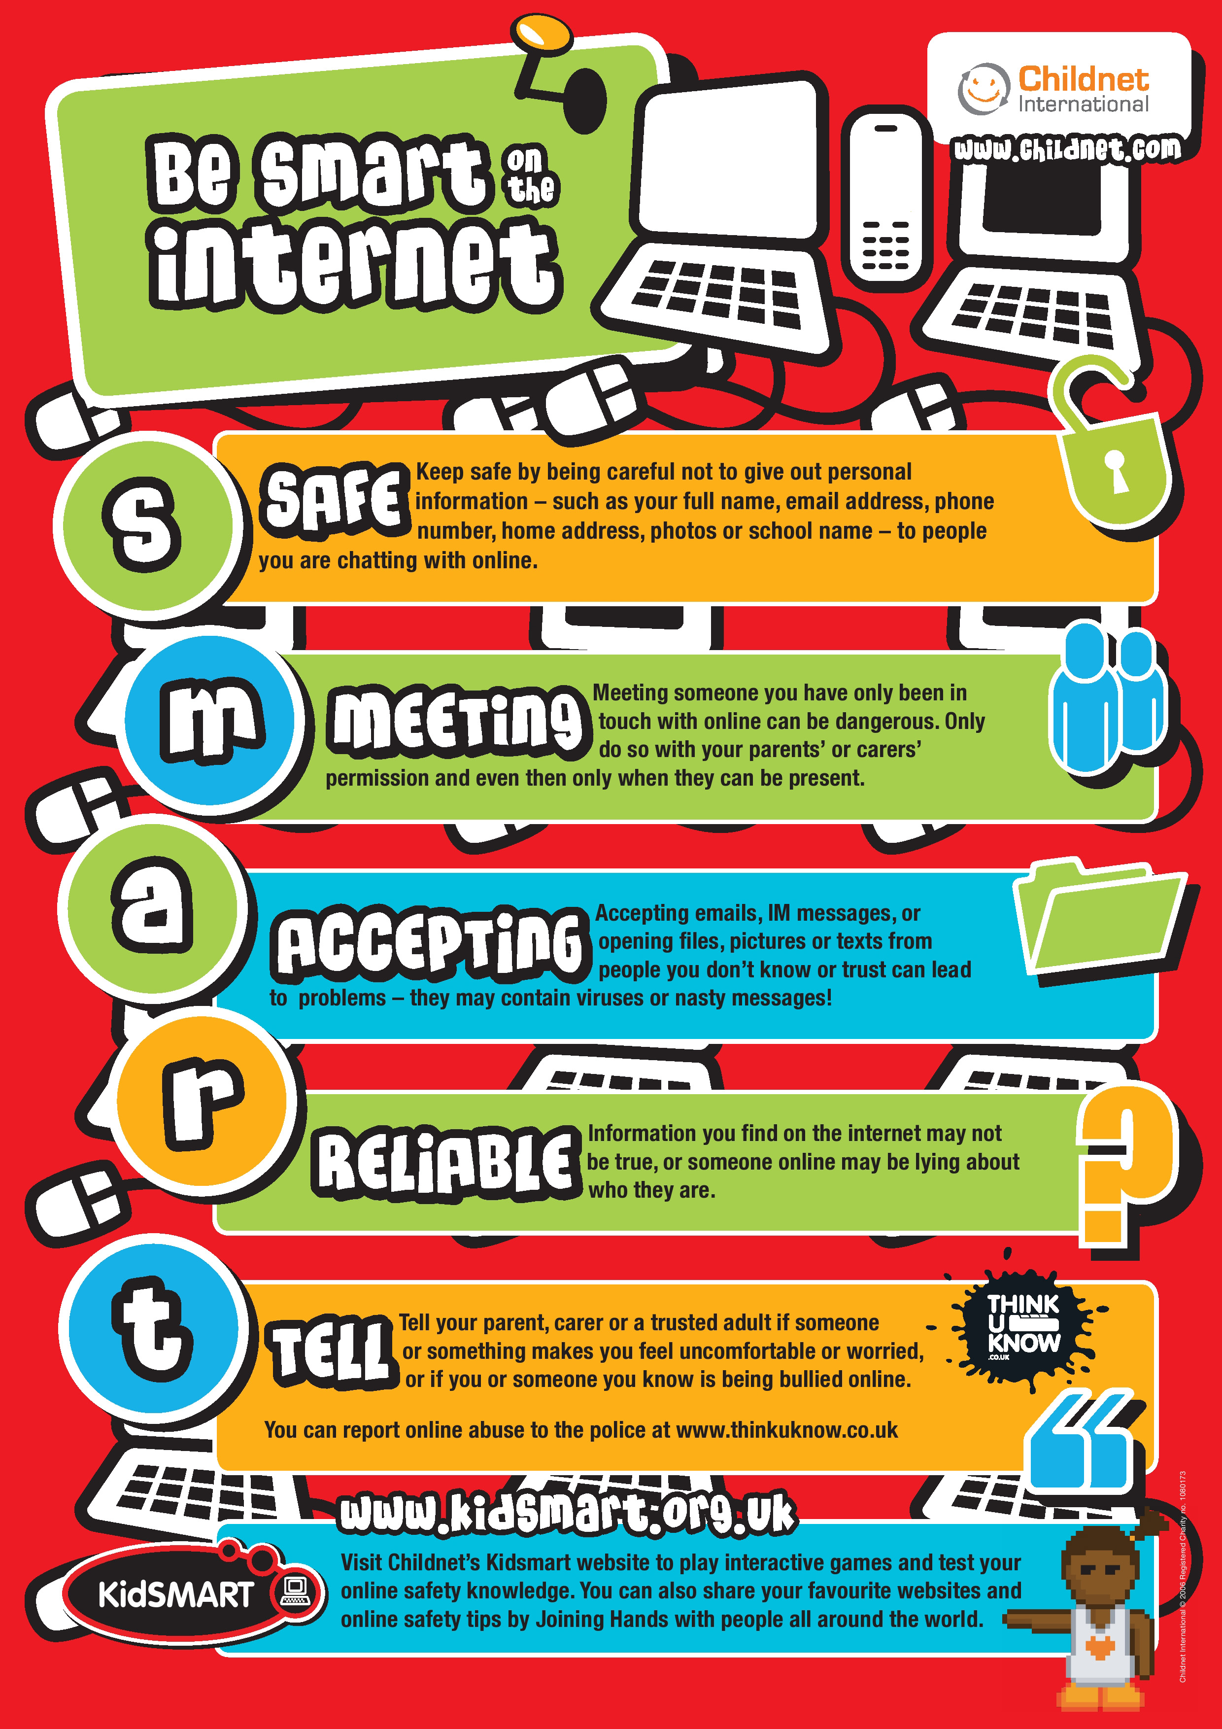

Our MISSION
Reminding you of our Online Safety rules
We are leaders in Online Safety.
Teach you all to be safe and kind online.

Slide 7
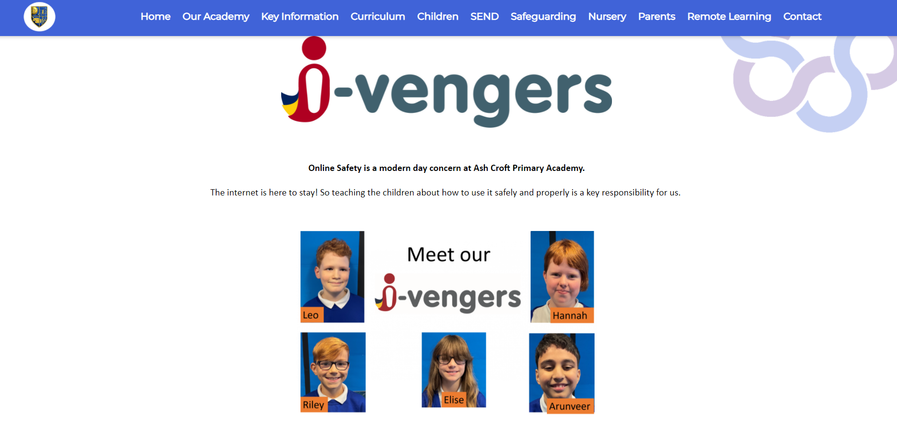

We, the i-Vengers, are now on school website! We will post all our tips on here and on Class Dojo!

Slide 8
What is our next task?
Before Christmas, the i-vengers will be asking you all to share 2 top tips with them so we can create a poster on how we can be kinder and safer online.
Start thinking and they will come and ask you soon.

Slide 9

Anti-Bullying week

