Slide 1




SCIENCE
Diet & Lifestyle
Lesson 5

Slide 2
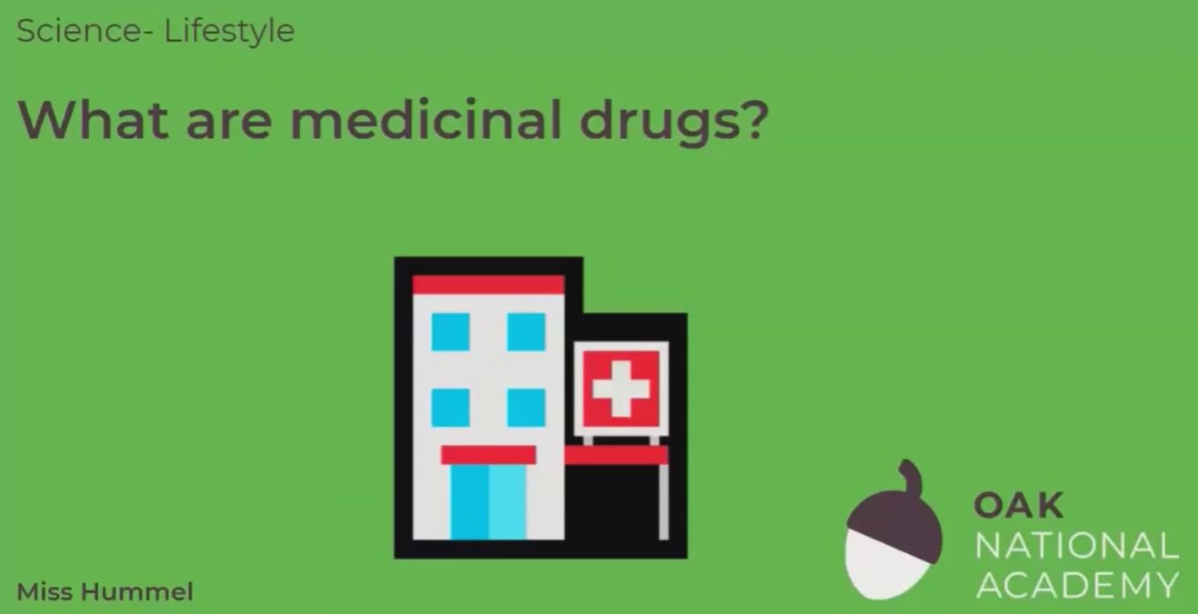
What are medicinal drugs?
In this lesson, we will learn what drugs are and therefore what medicinal drugs are. We will learn about different examples of medicinal drugs, including painkillers, antibiotics and anaesthetics. Finally, we will apply our knowledge of medicinal drugs to different scenarios.
Click on the following link to watch and take part in the following video lesson. Start with the quiz and the recap of last lesson’s learning.
https://classroom.thenational.academy/lessons/what-are-medicinal-drugs-68vk0e?activity=video&step=2&view=1
Play the audio first before clicking on the link to the lesson.

Slide 3
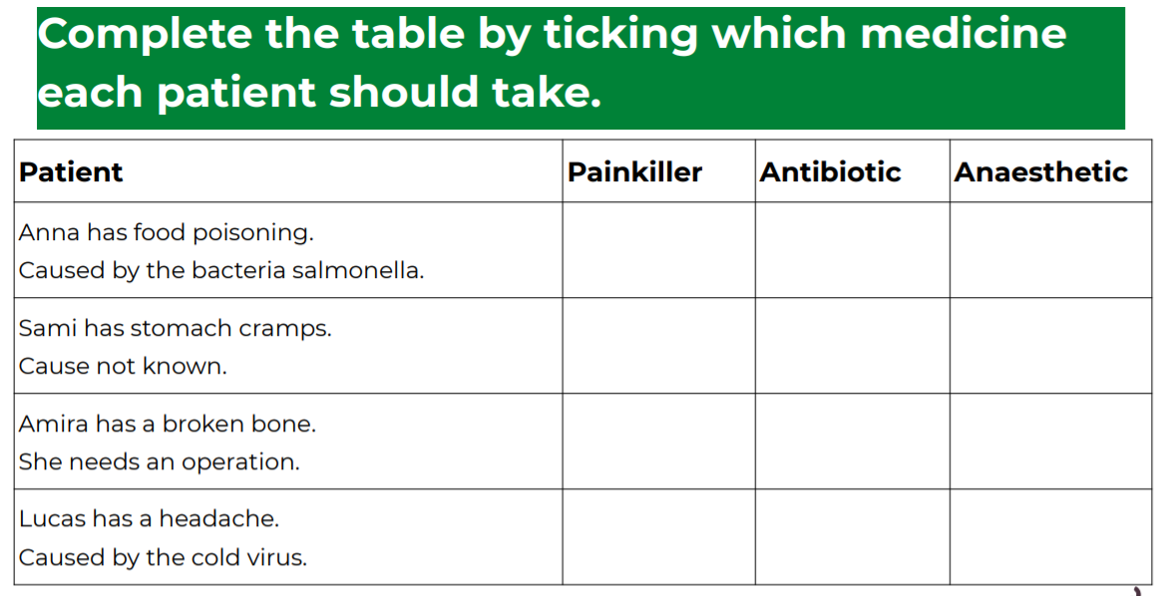
What are medicinal drugs?
Click on the following link to complete the activities for today’s lesson:
https://classroom.thenational.academy/lessons/what-are-medicinal-drugs-68vk0e?step=3&activity=worksheet

Slide 4
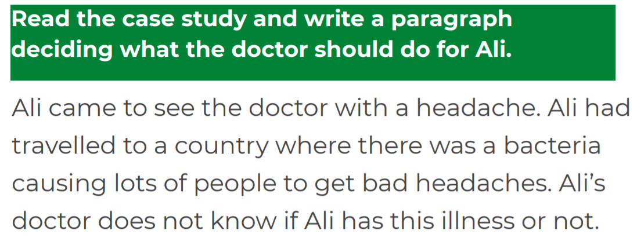
WRITING TASK
Have a go at this final task and finish the lesson with the quiz at the end!

