Slide 1

Starlings English Home Learning
Friday 26th February

Slide 2
Today we are going to find out about other animals in the text and write questions which use question marks
To do this you will need to:
Read page 4 of the text
Make a list of endangered animals from this page (using pictures to help)
Choose 5 endangered animals you would like to find more information about
Think of 3 different questions for each of your chosen animals. These should be where, why, what, how questions
Write your questions down and use ? at the end of your question
Research to find the answers to your questions and write some notes

Slide 3
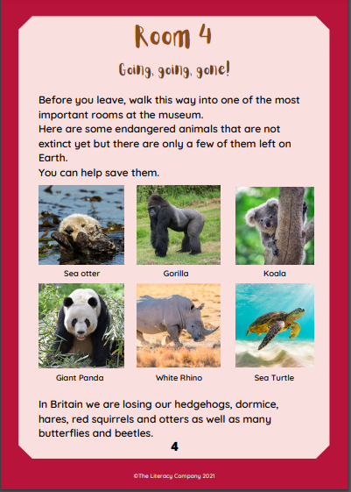

Slide 4
Endangered Animals

Slide 5
Animal | Question 1 Where Why What How | Question 2 Where Why What How | Question 3 Where Why What How
1.
2.
3.
4.
5.

Slide 6
Animal | Question 1 Where Why What How | Question 2 Where Why What How | Question 3 Where Why What How
1. Giant panda | Where do they live? | What do they eat? | Why are they endangered?
2.
3.
4.
5.

Slide 7
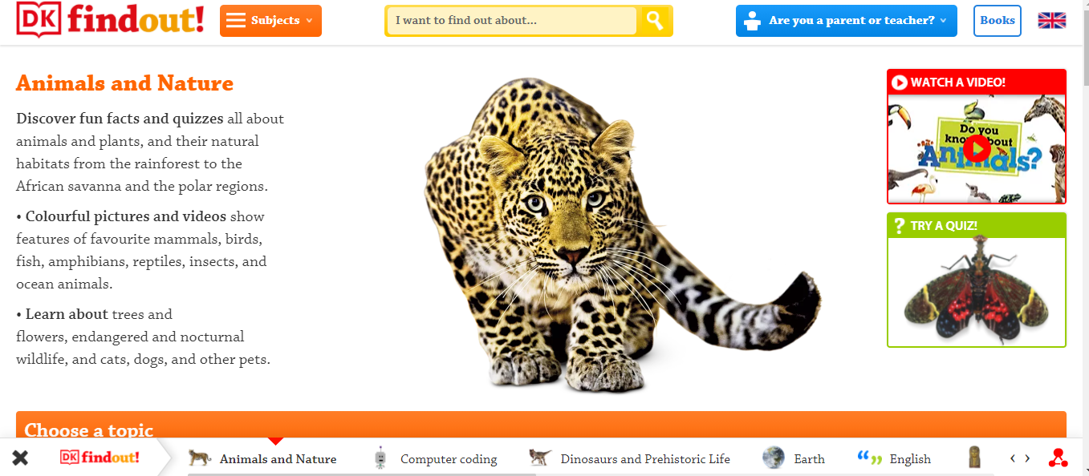
https://www.dkfindout.com/uk/animals-and-nature/

Slide 8
Animal | Facts I found out
1.
2.
3.
4.
5.

