Slide 1


Starlings Science Home Learning
Friday 26th February2021

Slide 2
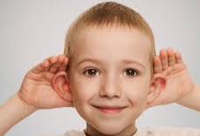
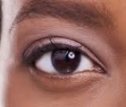
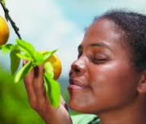
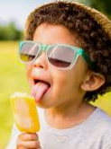
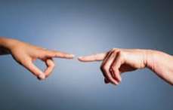
Lets get our brains working and see what we can remember?
Can you tell me what the five senses are?
hearing
ears
sight
Eyes
smell
taste
touch
nose
tongue
skin
Notes:
So Starlings we have been learning about our five senses. We have had a restful week at home so shall we see if we can remember what our five sense are?

Slide 3
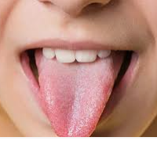
Today we are going to be learning about our sense of taste
Have you ever wondered why your favourite food or drink tastes so nice?
Notes:
Have you ever wondered why your favourite food or drinks tastes so nice? Well, you can thank your taste buds as they allow you to experience different tastes.
Go and find a mirror and stick your tongue out like on the picture. Can you see all those little red bumps? They are called papillae (puh-pill-ee) and most of them contain taste buds but they are so very tiny you can’t see them with just your eyes. They contain microscopic hairs which send messages to your brain about how something tastes –Have a think about what the four different tastes might be as we are going to be looking at that shortly. On the next slide there is a short video for you to watch.

Slide 4
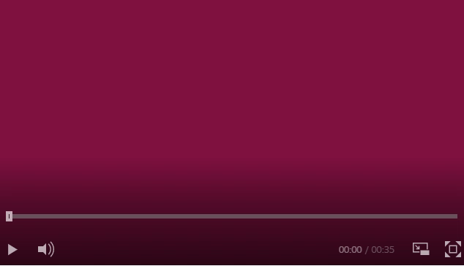

Slide 5
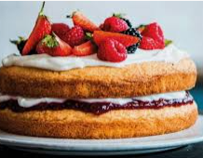
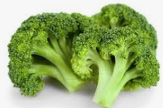
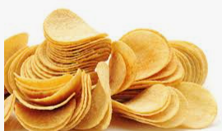
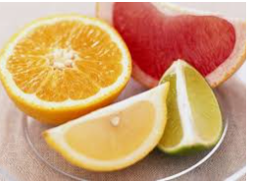
So we know that there are four main tastes that our taste buds detect.
sweet
bitter
salty
sour
Notes:
So we know that our taste buds are found in our mouth and on our tongue and detect four main tastes. Can you think about what these might be? Think about different foods – lemons, cake, crisps, That’s right – we have salty, sweet, sour and bitter. Can you now think of any food or drink that go with each taste?
For salty I thought about salty crisps For sweet I thought about cake Sour made me think about lemons and grapefruits and bitter mdde me think about broccoli. What foods did you think of?

Slide 6
Salty | Sour
Crisps chips | Lemons Sour snakes sweets
Bitter | Sweet
Broccoli coffee | cakes biscuits
Notes:
Have a look at the table. Can you copy my table on a piece of paper? Put the names of food and drink that you think go in each box. It would be lovely if you could upload it as we would love to see what items you put in each box.

Slide 7
  Message for parents
The next activity is an extra activity that you may enjoy doing with your child but there is no pressure to do this at all
You will need a number of items from each category of sweet, sour, bitter and salty. Some ideas might be:
slice of lemon
coffee
toothpaste
crisps
Tomato ketchup
jam
You would need to blindfold your child and then offer them a sample of each item. Can they identify the sample and say whether they think it is salty, sweet, sour or bitter?

Slide 8
Well Done
Starling Superstars
Notes:
Well done super starlings

