Slide 1
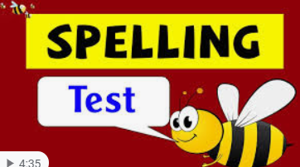



Click the microphone to hear your spelling quiz!
Good Luck xxx

Slide 2
Here are the answers.
Time to ticky tick and dotty dot!
circle
certain
caught
complete
build
busy
breath
breathe

