Slide 1


English
Date: 26.02.21
Week 7 – Lesson 5
Great Gods of Norse Mythology

Slide 2

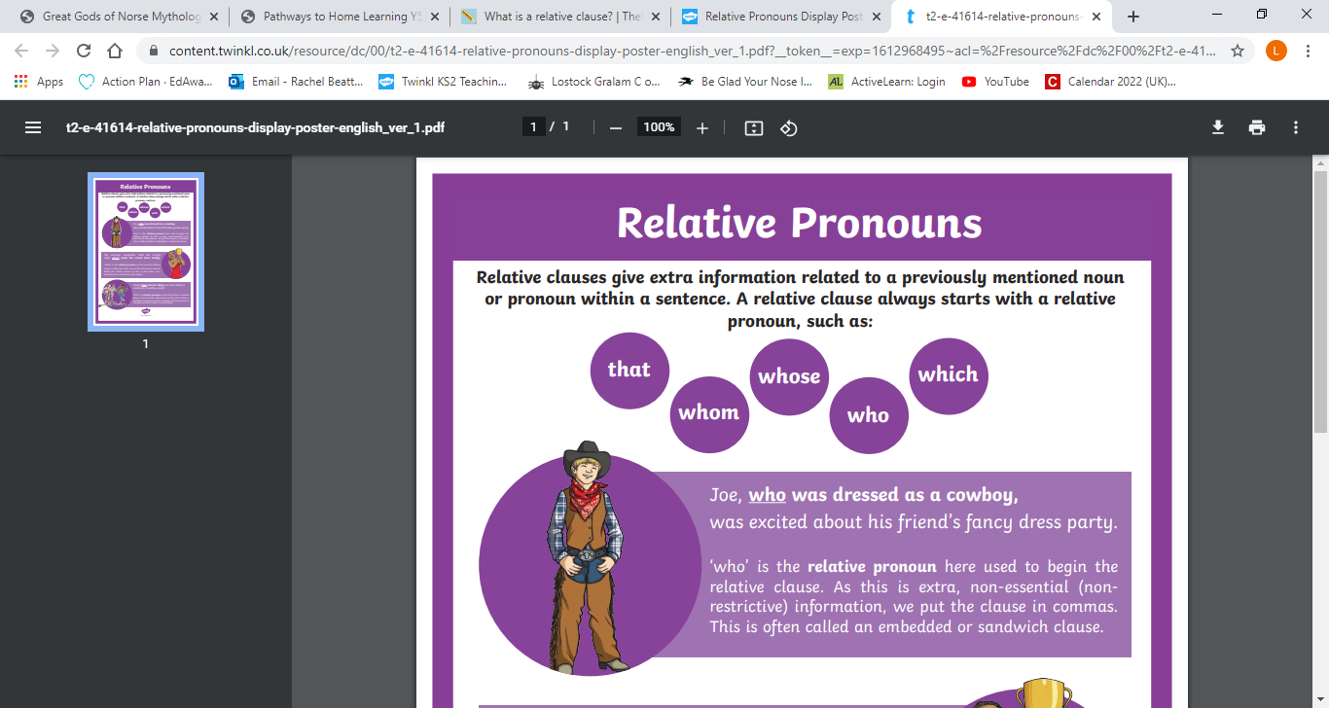
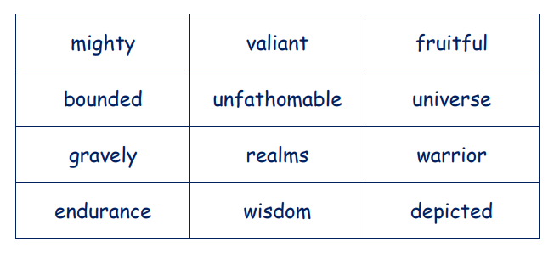
Let’s Recap:
Click on the sound button to hear this slide read to you.
This week we have learnt about relative clauses and also focussed on developing our vocabulary.
Today, we are going to use our knowledge of relative clauses and our new vocabulary in our writing.
Relative clauses add extra information to sentences using a relative pronoun.
Examples:
E.g. The mighty beast showed great strength and endurance.
I liked the new chair, which was very comfortable.
My Gran, who is 82, still goes swimming every day.

Slide 3
Activity 1:
Click on the sound button to hear activity 1 read to you.
Write a description about Odin using relative clauses and the new vocabulary. Don’t forget to use your work from the past couple of lessons to help you.
Your writing does not need to be very long – approximately one paragraph
(5-6 sentences).
WAGOLL on the next slide…

Slide 4

Click on the sound button to hear this slide read to you.
Odin, who is the most popular Norse God, features in most Norse stories. He is known as the ‘All-Father’ because he has great wisdom and an unfathomable amount of knowledge about the universe. Asgard, which can be reached by a bridge, is home of the gods. However Odin, who takes his ravens everywhere, enjoys travelling around the world.
Can you spot the relative clauses and new vocabulary in the WAGOLL?

Slide 5
Click on the sound button to hear this slide read to you.
Odin, who is the most popular Norse God, features in most Norse stories. He is known as the ‘All-Father’ because he has great wisdom and an unfathomable amount of knowledge about the universe. Asgard, which can be reached by a bridge, is home of the gods. However Odin, who takes his ravens everywhere, enjoys travelling around the world.
Relative Clauses
New Vocabulary

Slide 6
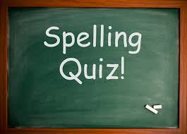
ei
Click on the sound button to hear the spellings for this week’s quiz.

Slide 7
Answers:
receive
deceive
protein
caffeine
neither
Click on the sound button to hear the spelling quiz answers.

Slide 8
