Slide 1


Starlings Maths Home Learning
Thursday 25th February

Slide 2
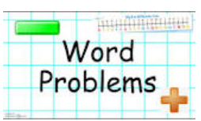
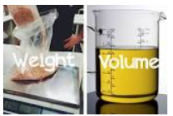
WEIGHT & VOLUME LESSON 7
Good Morning Starlings
This is our last maths lesson on weight and volume and you have learnt so much before and after half term. As usual at the end of a topic, we do some words problems so we will be doing some today on weight and capacity.

Slide 3
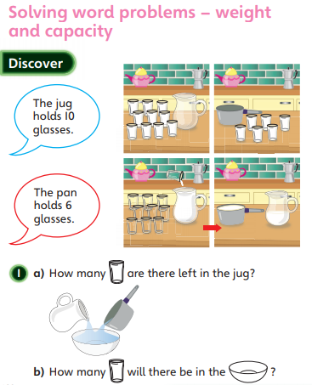
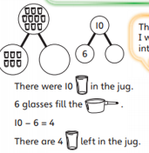


Slide 4
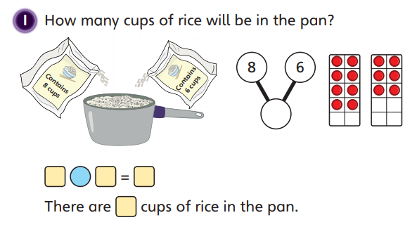
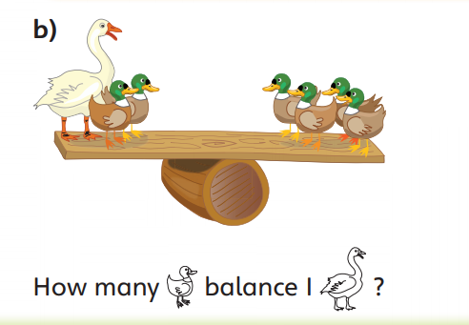
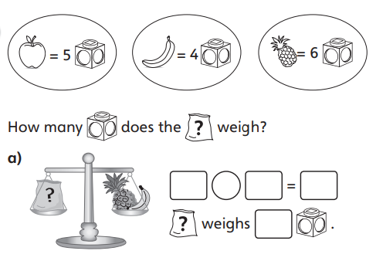
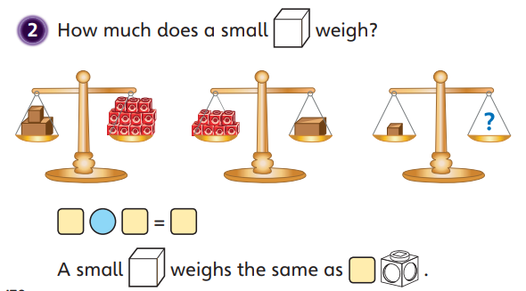

Slide 5

