Slide 1

Starlings English Home Learning
Thursday 25th February

Slide 2
Today we are going to write sentences to share facts about the extinct animals
To do this you will need to:
Talk about the 3 extinct animals from the text
Remember and find important information about the extinct animals
Write sentences and join them together using the conjunction ‘and’
Check your sentences for capital letters, full stops and the word ‘and’

Slide 3
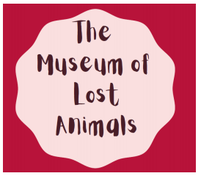
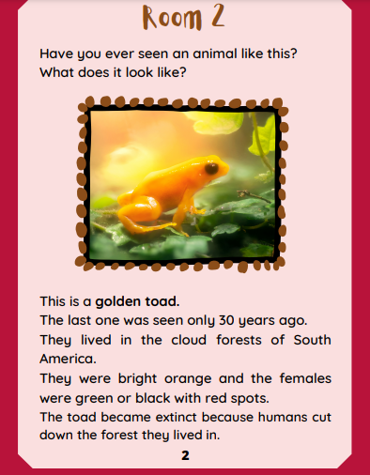
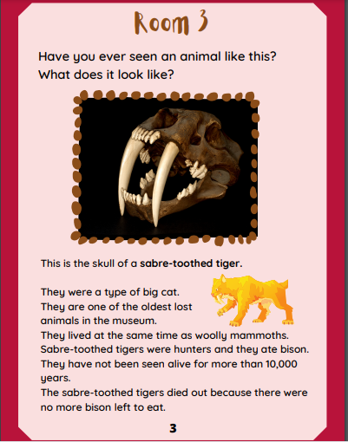
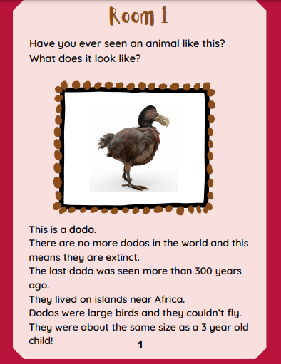

Slide 4
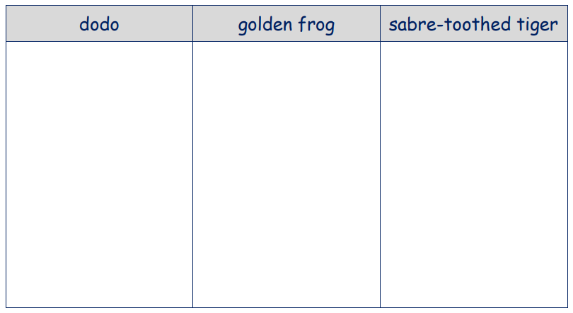

Slide 6
The dodo was the same size as a 3 year old child.
They lived on islands near Africa.

Slide 8
The dodo was the same size as a 3 year old child.
They lived on islands near Africa.
They are extinct.
Humans cut down the forest they lived in.

Slide 10
The dodo was the same size as a 3 year old child.
They lived on islands near Africa.
They are extinct.
Humans cut down the forest they lived in.
They were a type of big cat.
They lived at the same time as wooly mammoths.

Slide 11


Slide 12
The dodo lived on islands near Africa and they were the same size as a 3 year old child.
Dodo

Slide 13





Words of the day!
the they there
Can you write the word the 5 times with your eyes closed
Can you write the word they 5 times while spinning around
Can you write the word there 5 times sticking your tongue out?

