Slide 1


Mathematics
Date: 25.02.21
Week 7 – Lesson 4
Multiplying 2-digit number
Long multiplication

Slide 2
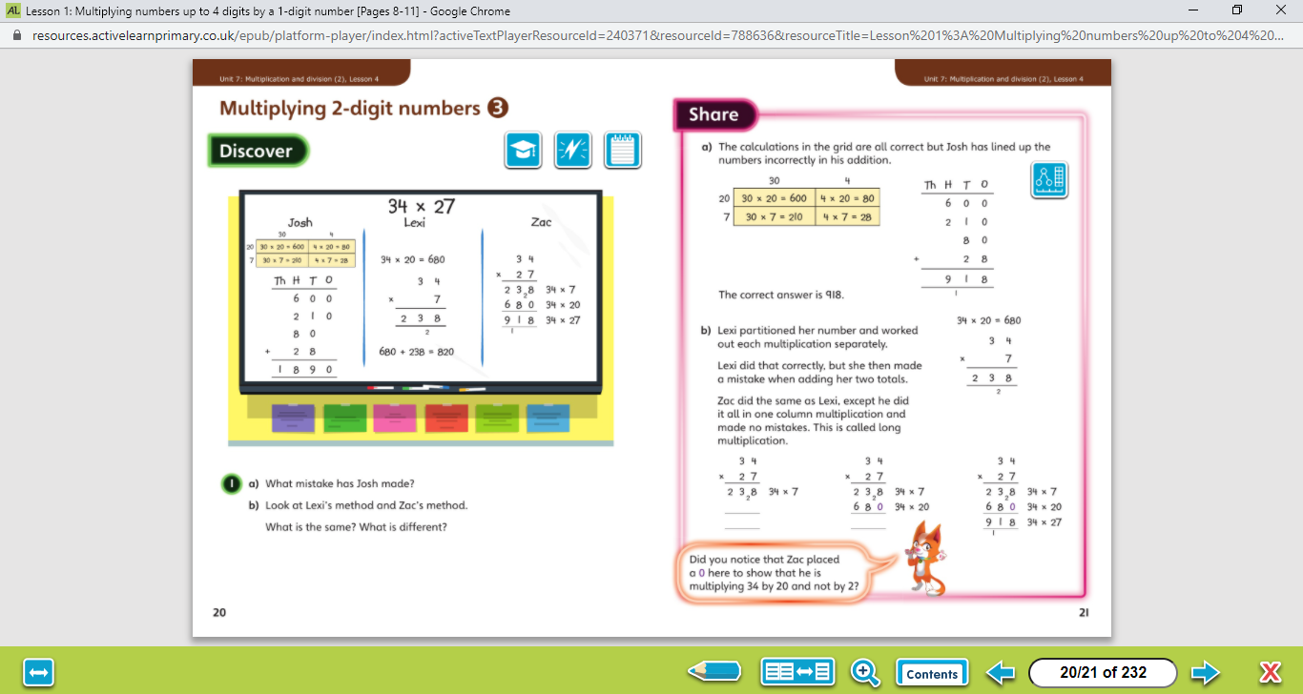

Let’s work together!
Look at the picture clue. What can you see?
Have a look at the questions.
Click on the sound button to hear the questions read to you. We will also talk through the questions together like we do in school.
We will go through the possible methods and answers on the next slide.

Slide 3
Let’s work together!
Click on the sound button to hear the answers and possible methods for question A.
Click on the sound button to hear the answers and possible methods for question B.

Slide 4
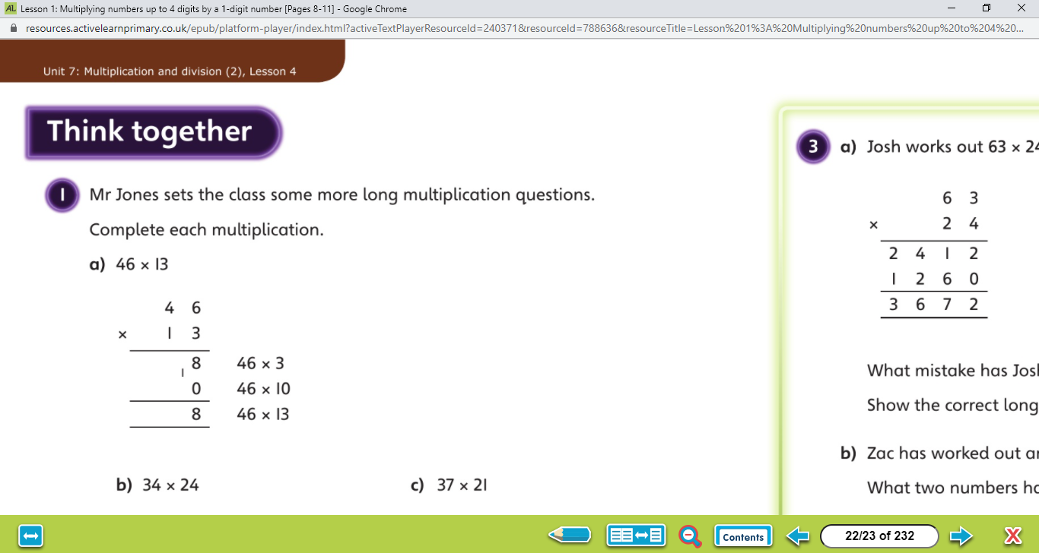
Lets look at an example of long multiplication:
Let’s work together!
1. Multiply by the ones column
1
3
8
1

Slide 5
Lets look at an example of long multiplication:
Let’s work together!
2. Add zero as a place holder
1
3
8
1
0

Slide 6
Lets look at an example of long multiplication:
Let’s work together!
3. Multiply by the tens column
1
3
8
1
4
6
0

Slide 7
Lets look at an example of long multiplication:
Let’s work together!
4. Add your two answers together
1
3
8
1
4
6
0
5
9
8

Slide 8
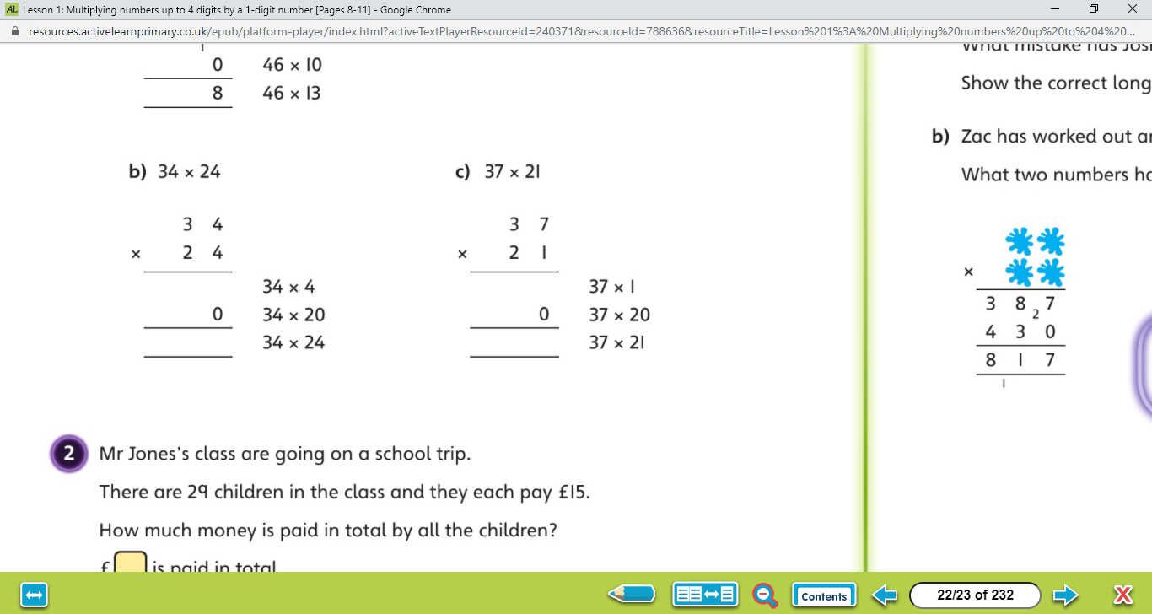
Click on the sound button below to hear the question read to you. We will work together to reach the answer.
Let’s work together!
1. Multiply by the ones column
2. Add zero as a place holder
3. Multiply by the tens column
4. Add your two answers together
Click on the next slide to hear the answers.

Slide 9
Click on the sound button to hear the answers.
Let’s work together!
1. Multiply by the ones column
2. Add zero as a place holder
3. Multiply by the tens column
4. Add your two answers together
1
3
6
3
7
6
1
8
7
4
1
8
1
6
7
7
7
1

Slide 10
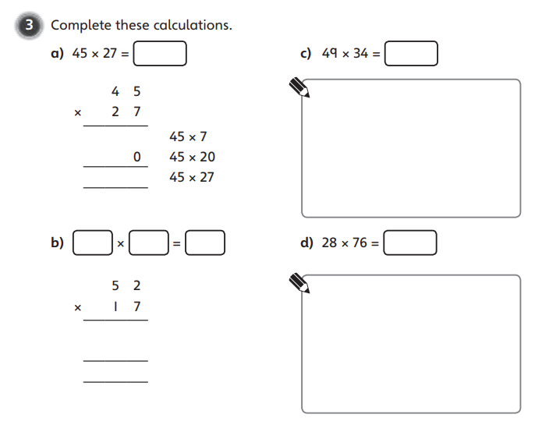
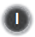
Your Turn…
1. Multiply by the ones column
2. Add zero as a place holder
3. Multiply by the tens column
4. Add your two answers together
Have a go at these questions independently. Click on the button if you would like the questions read to you.
We will go through the answers for questions 1 and 2 after completing all of the questions.

Slide 11
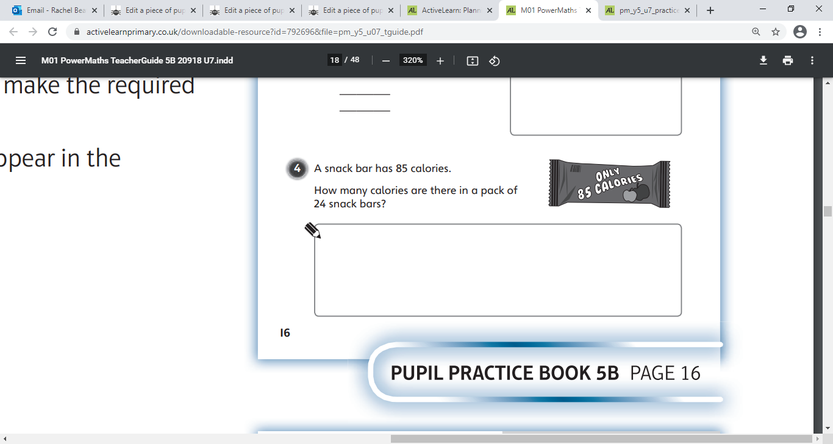
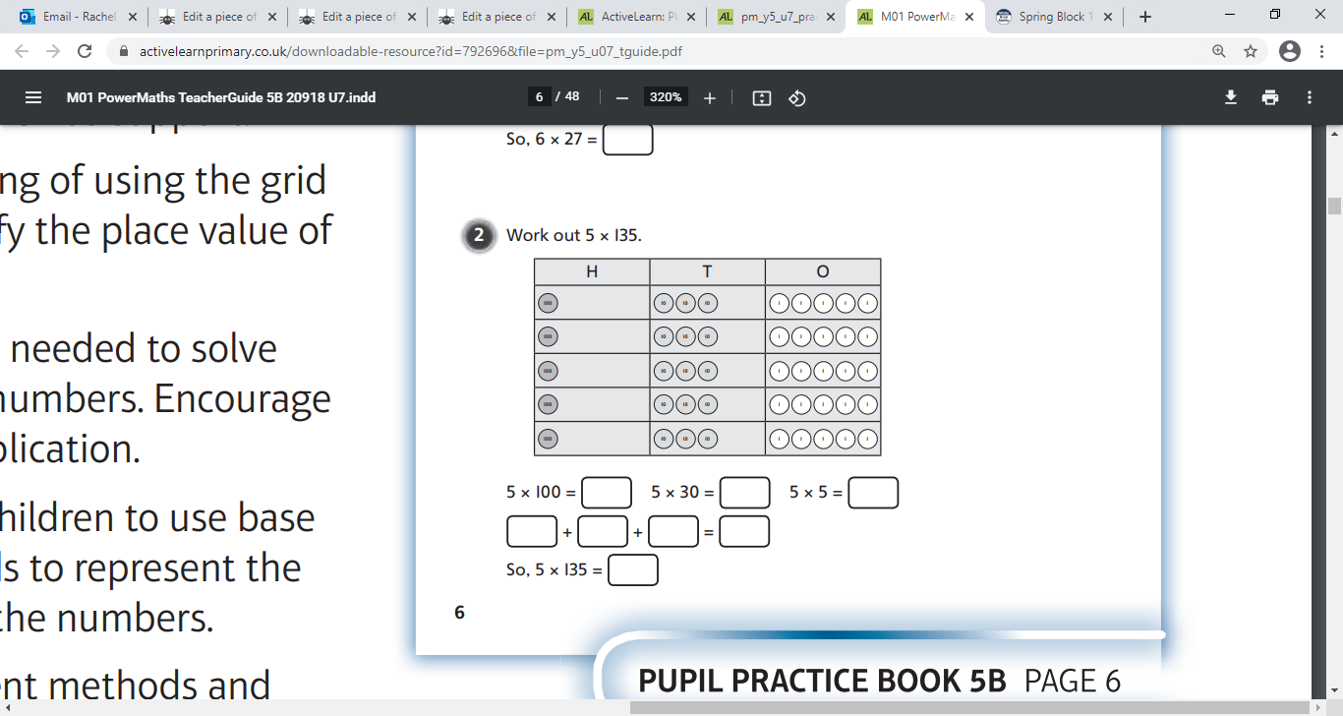
Your Turn…
Have a go at these questions independently. Click on the button if you would like the questions read to you.
1. Multiply by the ones column
2. Add zero as a place holder
3. Multiply by the tens column
4. Add your two answers together
We will go through the answers for questions 1 and 2 after completing all of the questions.

Slide 12
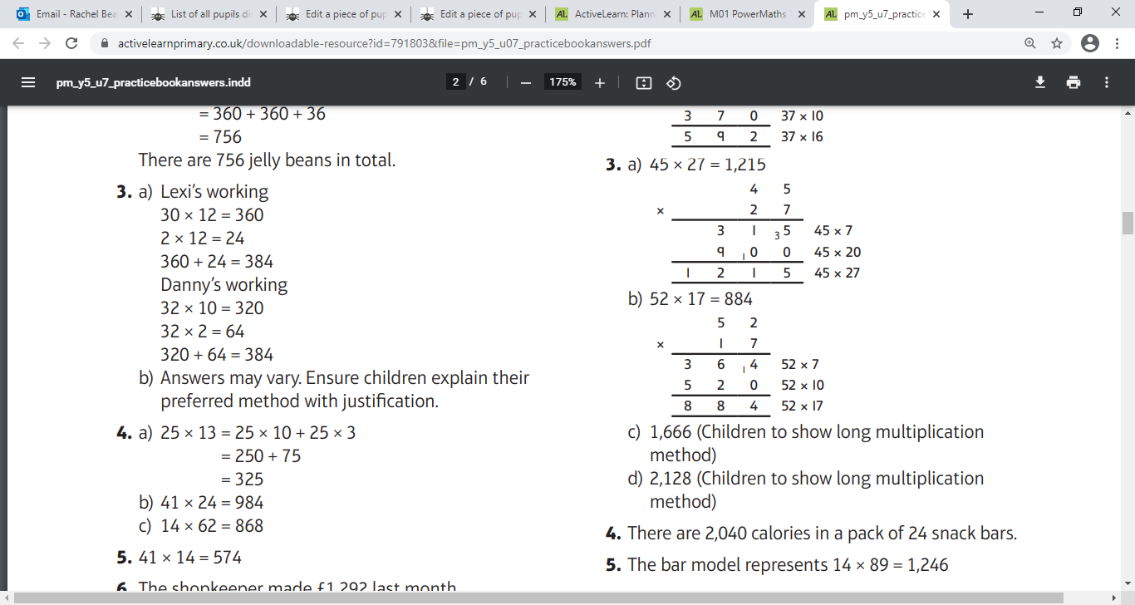
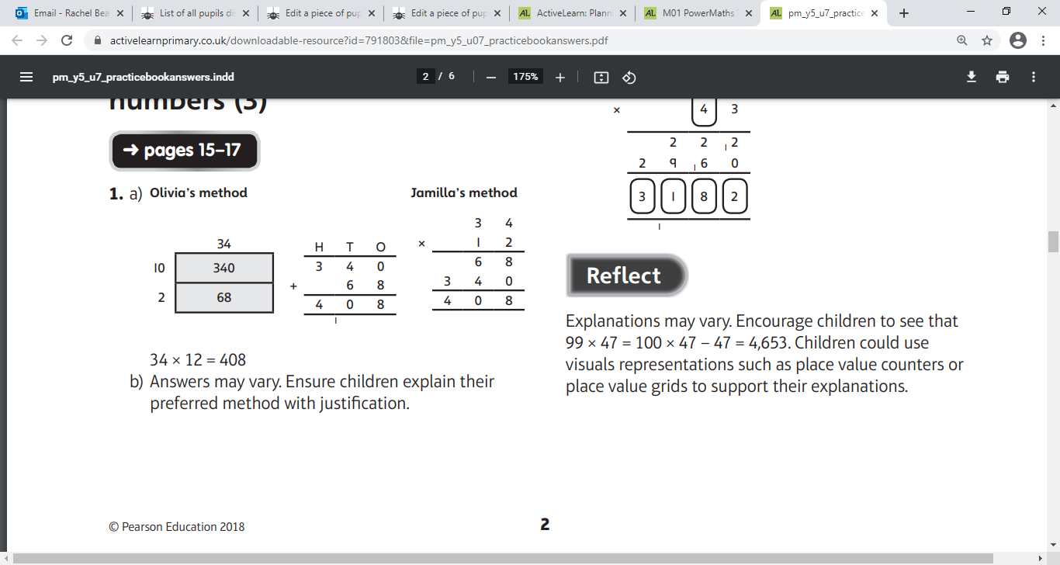
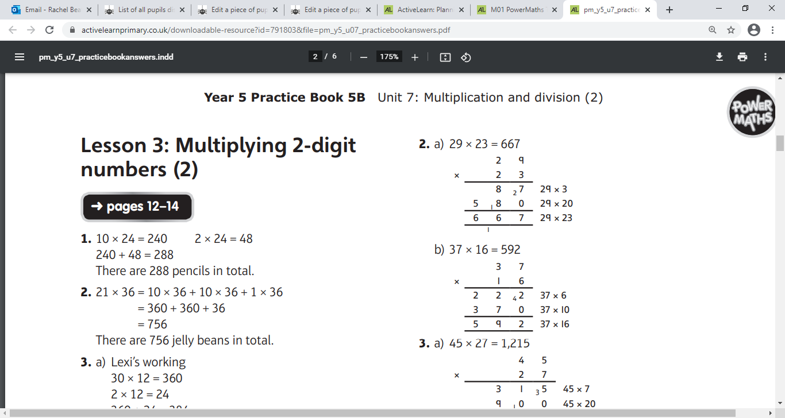
Questions 1 - 2 Answers:
Click on the sound button to hear the answers being read to you.

Slide 13
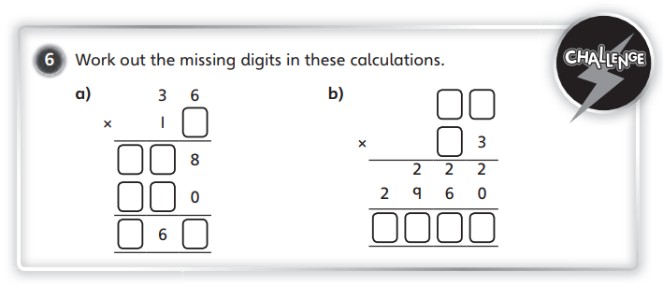
Challenge Time!
Only try this question if you are feeling confident ☺
Your Turn…
Click on the button if you would like the question read to you.
Click on the next slide to hear the answer.

Slide 14
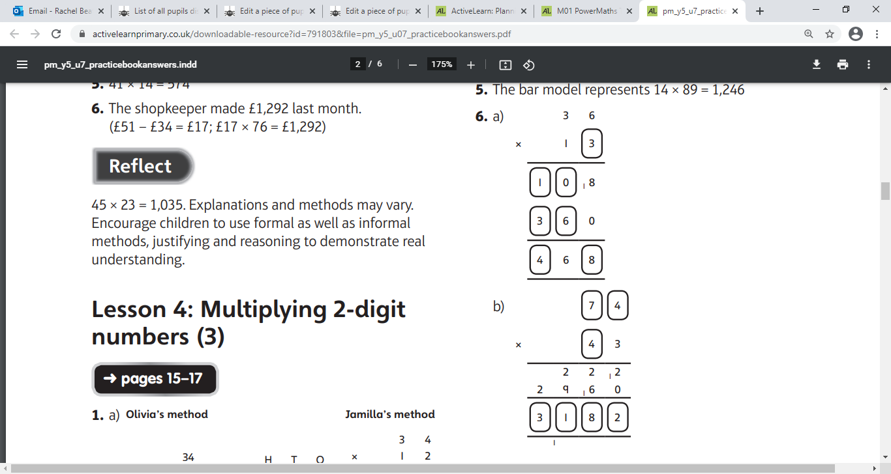
Challenge Time Answer:
Your Turn…
Click on the button if you would like the answer read to you.

