Slide 1


English
Date: 25.02.21
Week 7 – Lesson 4
Vocabulary
Great Gods of Norse Mythology

Slide 2

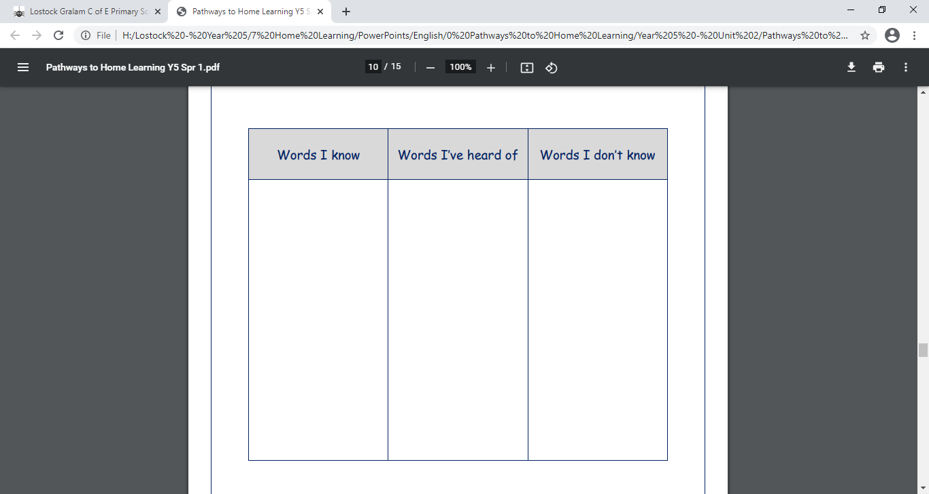
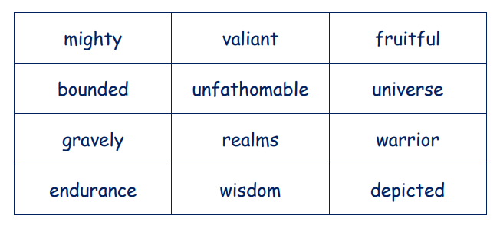
Activity 1:
Click on the sound button to hear activity 1 read to you.
Look at, think about and discuss all of the vocabulary below.
Draw your own grid like the one shown and sort the words into one of the three columns in the table.
(Words that you know and can explain)
(Words that you have heard of and might know a little bit about)
(Words that you have never heard of and don’t know at all)

Slide 3

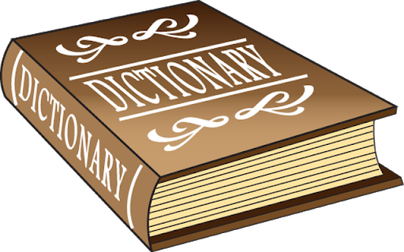
Click on the sound button to hear activity 2 read to you.
Activity 2:
Put the words in your ‘words I know’ column into sentences.
  E.g. The mighty beast showed great strength and endurance.
Use the internet or a dictionary to look up the words in your ‘words I’ve heard of’ and ‘words I don’t know’ columns.
Once the meaning of these words are clear, make up sentences using these words (perhaps about Odin and Norse mythology)

Slide 4
