Slide 1


Starlings Maths Home Learning
Wednesday 24th February

Slide 2
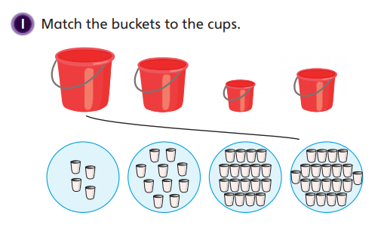
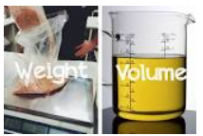
WEIGHT & VOLUME LESSON 6
Good Morning Starlings.
I hope you’re enjoying learning all about volume and capacity, today we are going to compare and order objects according to their capacity.
Can you choose a large and a small container and predict how many cups it will take to fill each of them? Look at my picture above and see how many cups I took to fill my different sized buckets.

Slide 3
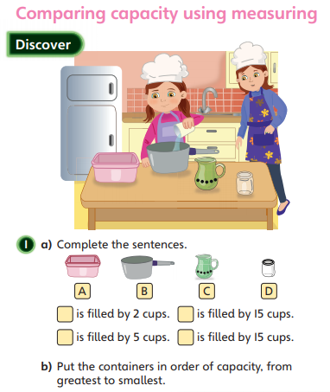
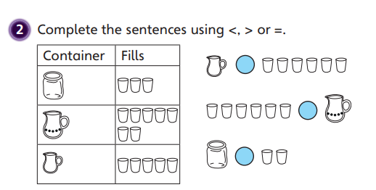

Slide 4
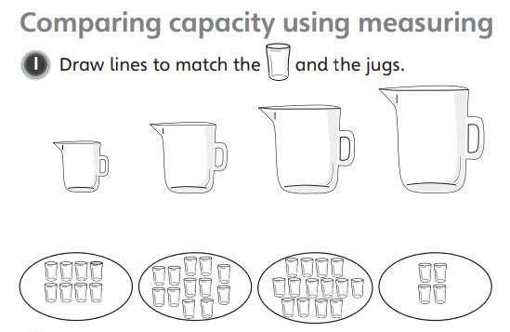
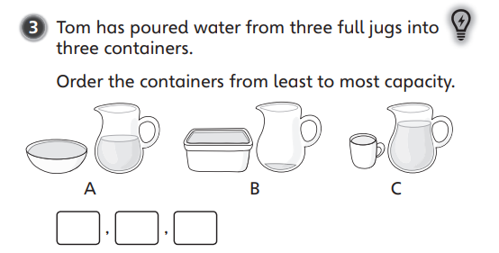
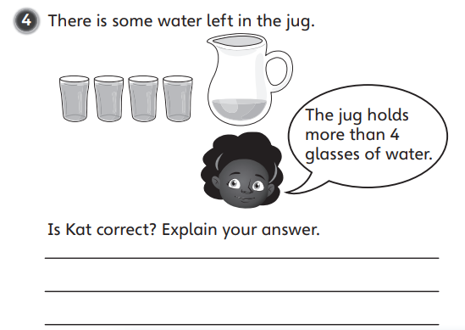
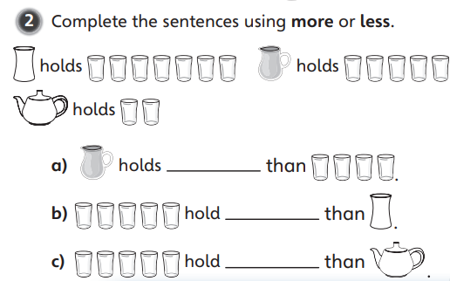

Slide 5

