Slide 1

Starlings English Home Learning
Wednesday 24th February

Slide 2
Today we are going to learn and use new vocabulary from the text
To do this you will need to:
Read the text with a little help from your grown ups
Highlight or point to new or tricky words – we call this new vocabulary
Talk about what this new word will mean and have a go at using it in different spoken sentences
When you have finished reading you will have a task to complete where you need to match up pictures and words and try to use this new word in a sentence

Slide 3
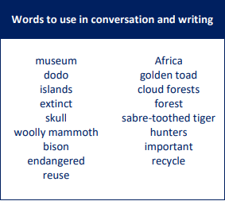
Remember, these are some of the key words from this unit of work.
Can you find any of these to highlight in the text today?

Slide 4


Slide 5
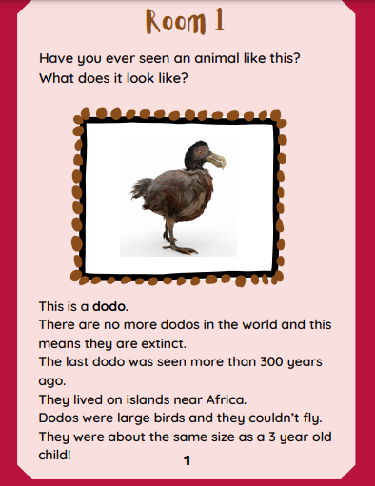

Slide 6
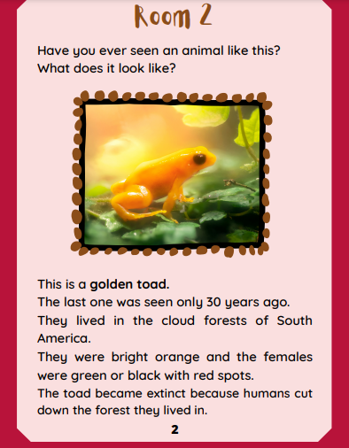

Slide 7
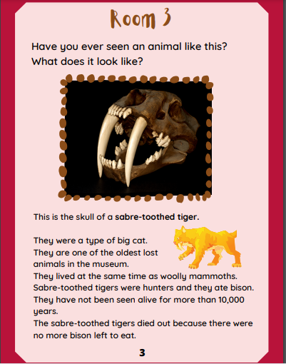

Slide 8
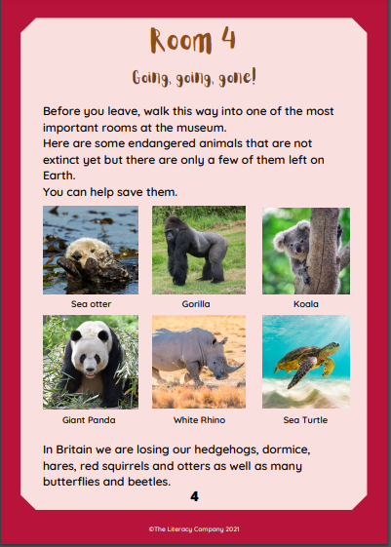

Slide 9


Slide 10
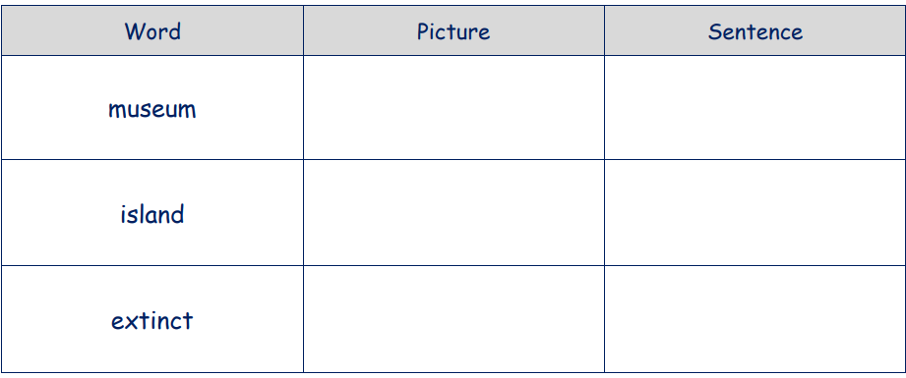
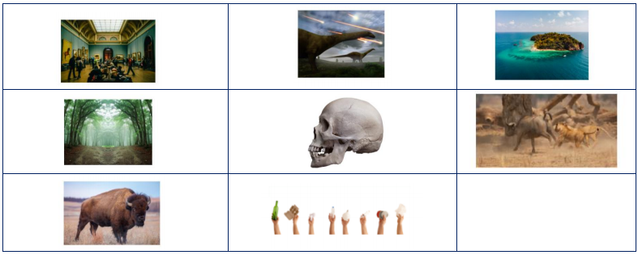
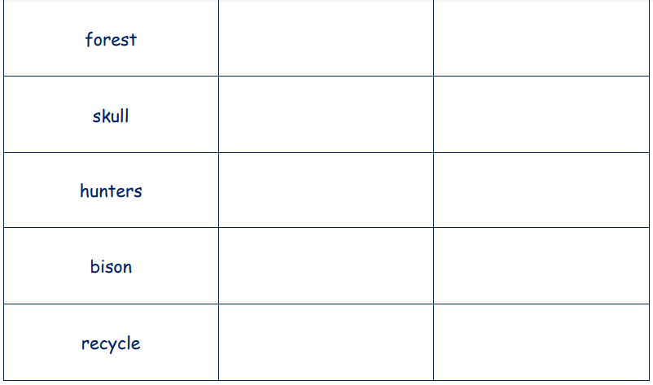

Slide 12

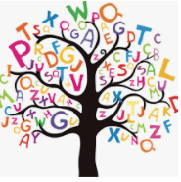



Words of the day!
do we of
Can you write the word do 5 times in your prettiest handwriting?
Can you write the word we 5 times using your other hand?
Can you write the word of 5 times sticking your tongue out?

