Slide 1


English
Date: 24.02.21
Week 7 – Lesson 3
Relative Clauses
Great Gods of Norse Mythology

Slide 2
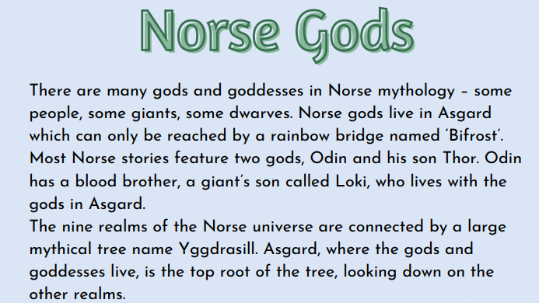

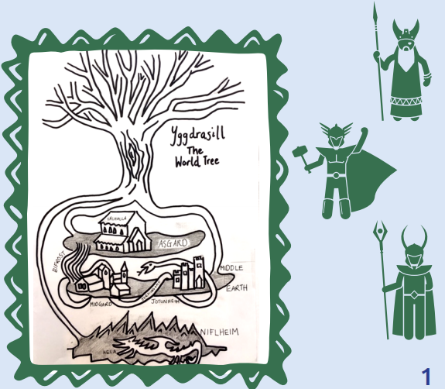
The text is also attached to our blog if you want to open or print it this way.
Re-read pages 1 and 2 of ‘Great Gods of Norse Mythology’ or click on the sound button to hear it being read to you.

Slide 3
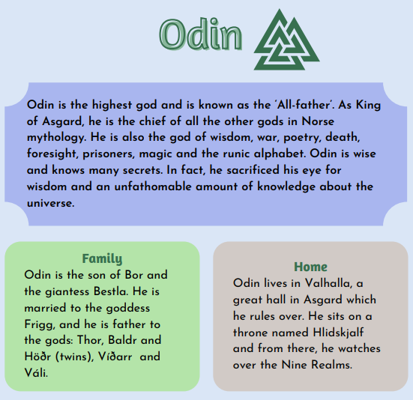
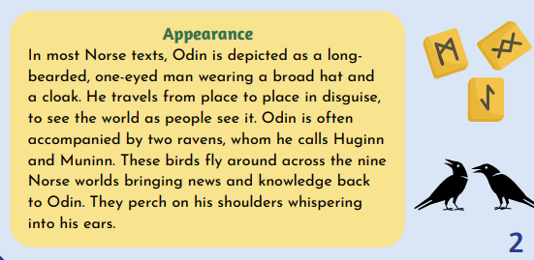
Re-read pages 1 and 2 of ‘Great Gods of Norse Mythology’ or click on the sound button to hear it being read to you.
The text is also attached to our blog if you want to open or print it this way.

Slide 4
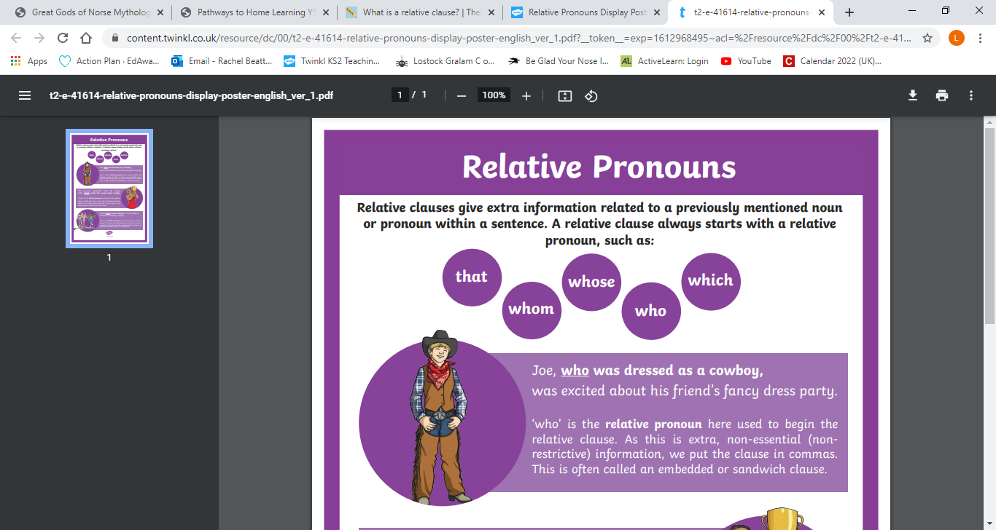
Click on the sound button to hear this slide read to you.
Let’s recap Relative Clauses:
Relative clauses add extra information to sentences using a relative pronoun.
Here are 5 relative pronouns:
Examples:
I liked the new chair, which was very comfortable.
My Gran, who is 82, still goes swimming every day.

Slide 5
Click on the sound button to hear activity 1 read to you.
Activity 1:
Today we are going to write some relative clause sentences about Odin and Norse Gods.
Add relative clauses to the sentences below, starting with a relative pronoun:
Odin, _________________, enjoys travelling around the world.
Odin has a son called Thor, __________________.
Asgard, ________________, is home of the Gods.

Slide 6
Click on the sound button to hear activity 2 read to you.
Activity 2:
Can you have a go at writing three of your own relative clause sentences about Odin and the Norse Gods?
Remember commas go either side of the relative clause if it is in the middle of your sentence.
Don’t forget to use our relative pronouns:

Slide 7
