Slide 1

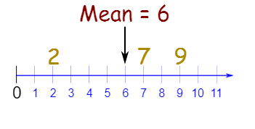


Mathematics
Date: 23.02.21
Finding the mean
The mean is the total of the numbers divided by how many numbers there are.
To find the mean, add all the numbers together then divide by the number of numbers.

Slide 2
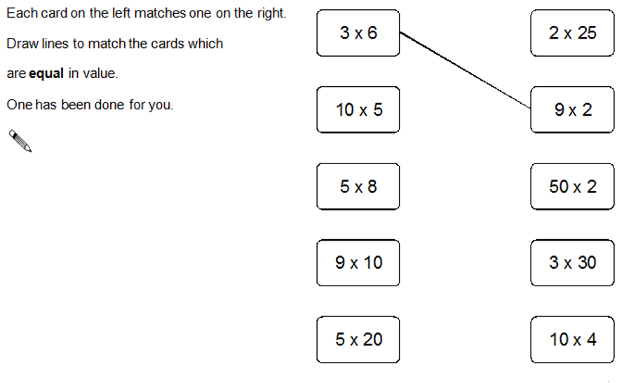
Starter Activity

Slide 3

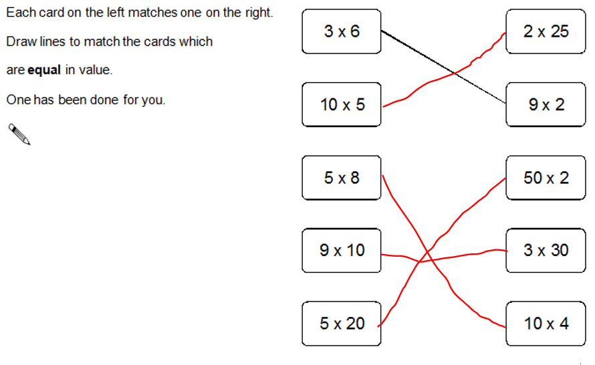
Starter Activity

Slide 4

Calculating the Mean

Slide 5
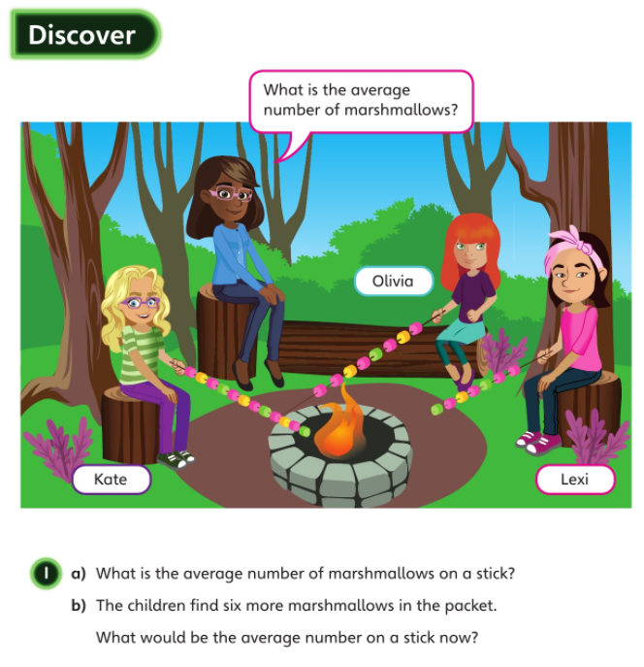

Average = mean

Slide 6
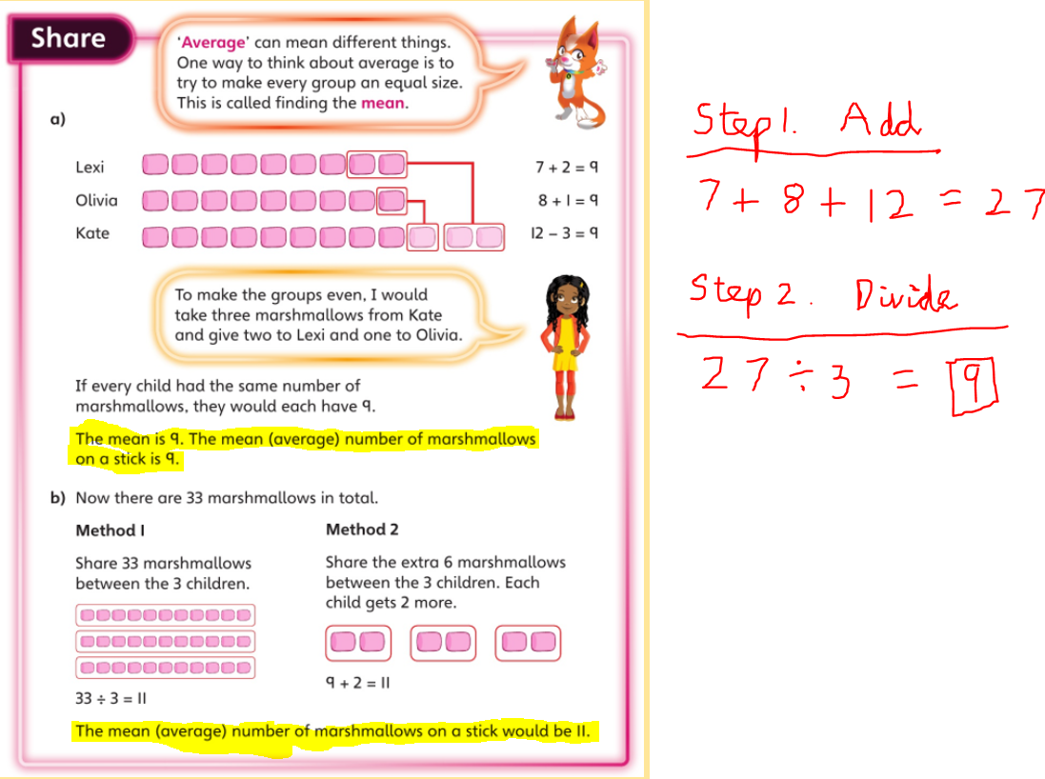

Slide 7
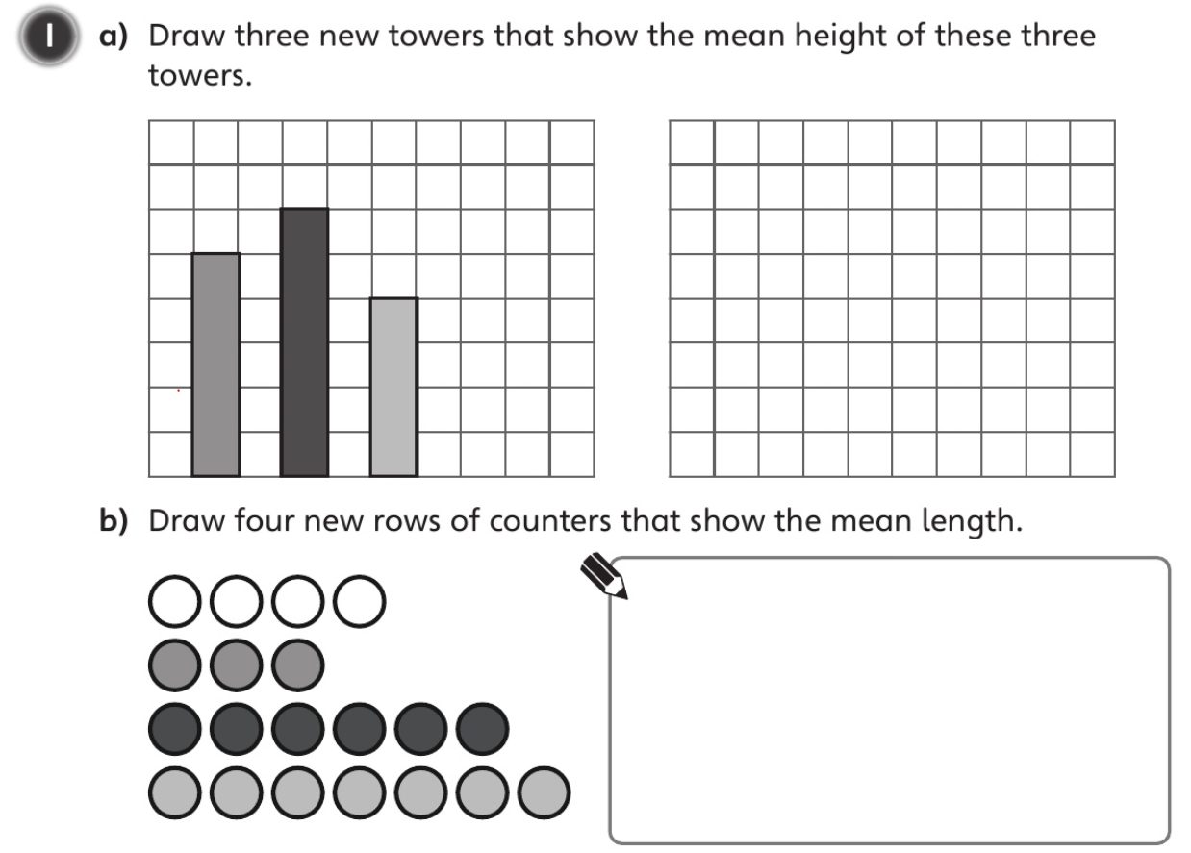


Slide 8
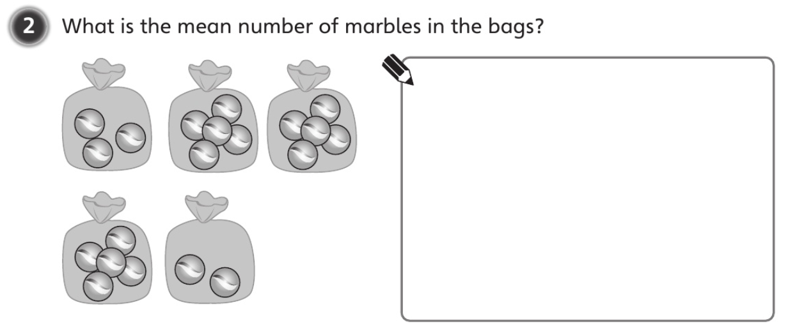

Slide 9
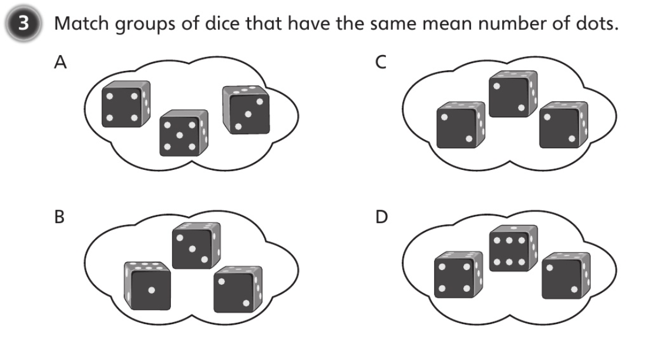

Slide 10
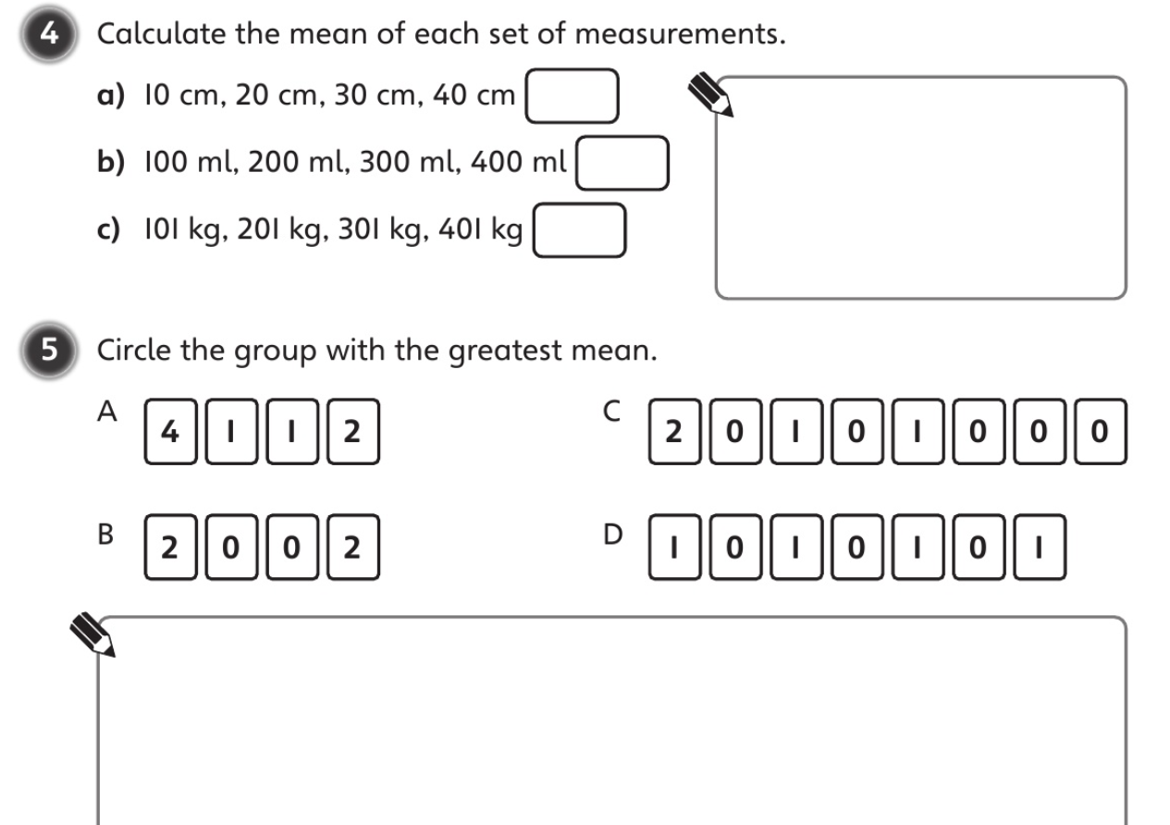

Slide 11
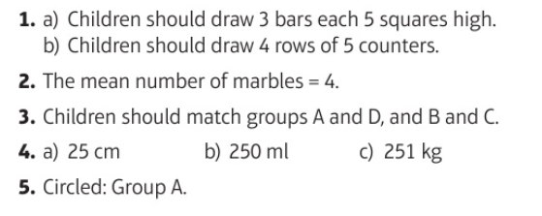

Slide 12
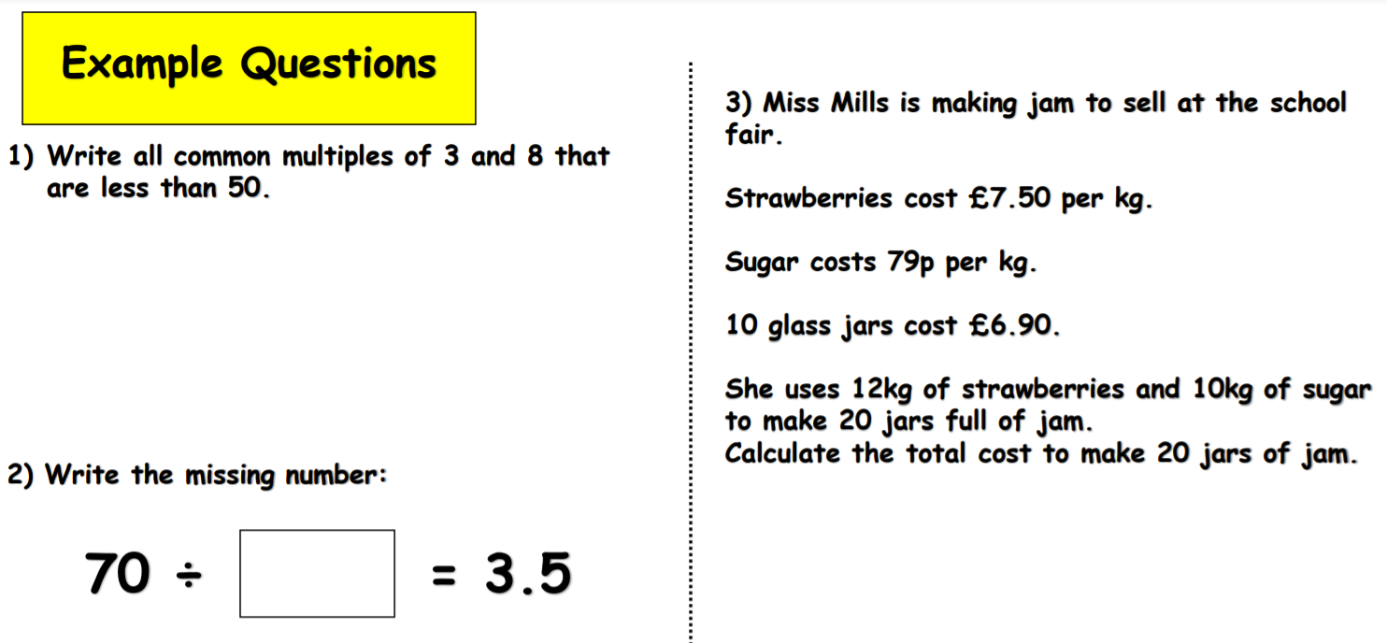
Challenge

Slide 13
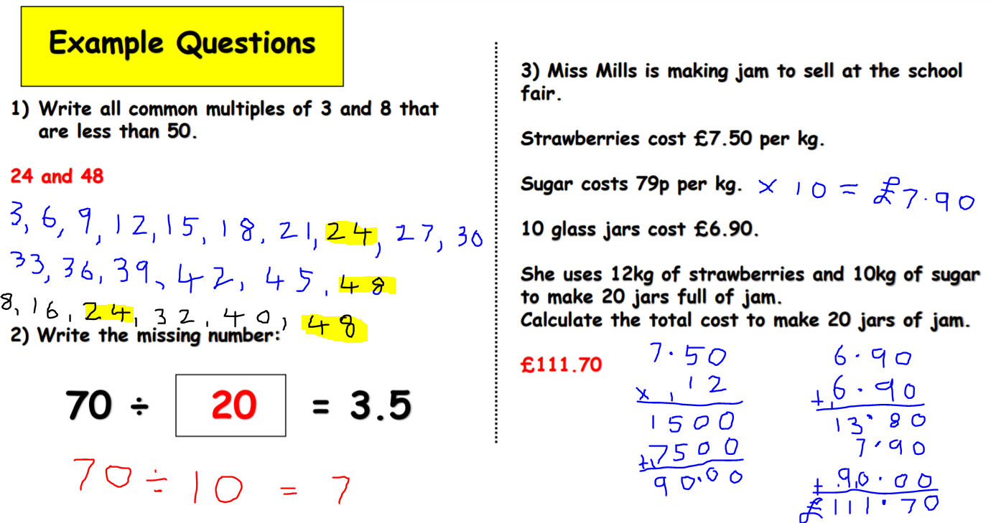
Challenge

