Slide 1

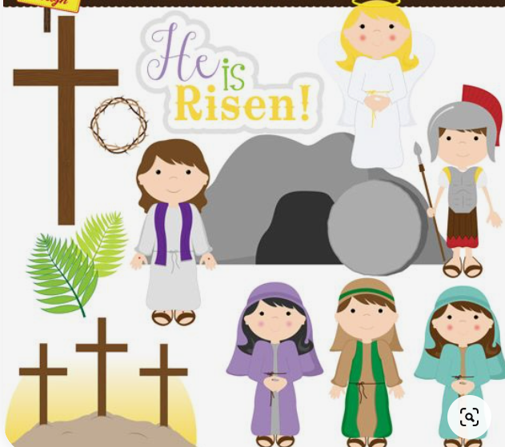
Easter lesson 1 - Salvation
Key vocabulary
Salvation
Repentance
Sacrifice

Slide 2
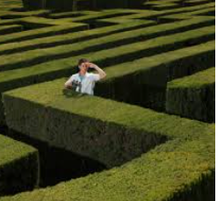
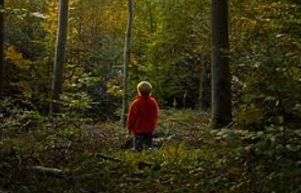
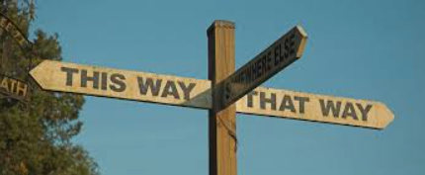
Being Lost
Have you ever been lost? What happened? Who found you?

Slide 3
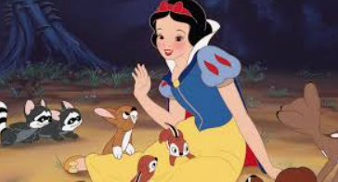

Being Lost
What films have you seen where a rescue took place?
eg 101 Dalmatians, Snow White.
Were those who were lost able to rescue themselves?
What does it means to be rescued from something that you can’t rescue yourself from?
We are going to look at a Bible story where someone was rescued.

Slide 4
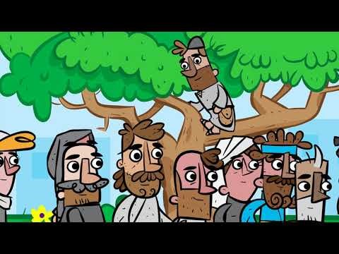
The story of Zacchaeus: Luke 19:1-10
https://www.youtube.com/watch?v=5BjtbJFz2ug

Slide 5
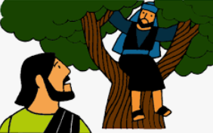
Hot Seating - Zacchaeus
Activity 1
Why were you a tax collector? Why were you taking more money from people than you should have done? What do you think people felt about you? Are you important to other people? Are people scared of you? Do you want to be rescued from this kind of life? Do you sleep at night? Why do you want to see Jesus?

Slide 6

Retell the story
Activity 2

Slide 7
Jesus meets Zacchaeus (Luke 19:1-10)
Jesus was passing through Jericho. There was a chief tax collector there named Zacchaeus, who was rich. Zacchaeus was a little man, and wanted to see Jesus, so he climbed a sycamore tree. Jesus looked up and said, “Hurry down, Zacchaeus, because I must stay in your house today.” The people started grumbling because Jesus was going to the home of a sinner. However, Zacchaeus promised to give half his belongings to the poor and pay back four times as much to anyone he had cheated. Jesus concluded by saying “The Son of Man came to seek and to save the lost.”

Slide 8
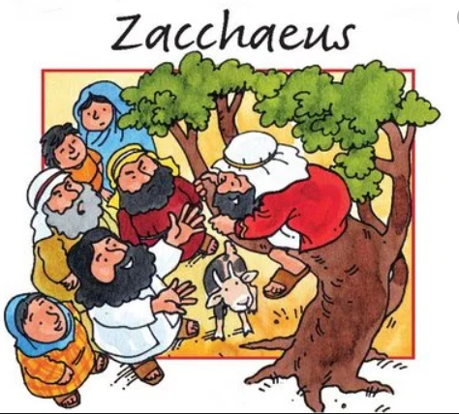
Next Lesson –
Continue to explore the concept Salvation and look in more detail at the story of Zacchaeus

