Slide 1

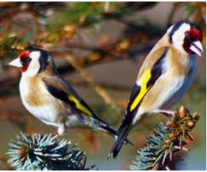
Goldfinches Arithmetic Lesson
01.03.21

Slide 2
Spring Arithmetic 4
6 Times Tables – count in 6s, write down multiples,
Let’s sing along with a cover of Taylor Swift’s song ‘Shake it off’ to learn our 6 times tables
Revise some key facts together
https://www.youtube.com/watch?app=desktop&v=e7rYbk9PNuM

Slide 3
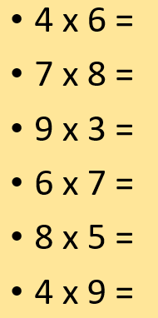
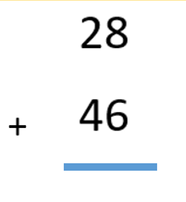
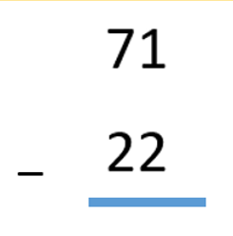
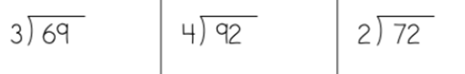
Revision of key Arithmetic questions

Slide 4
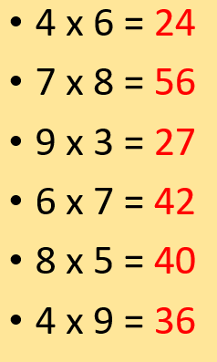

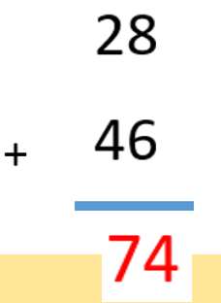
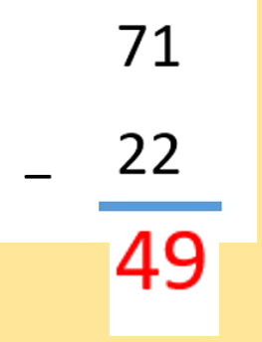
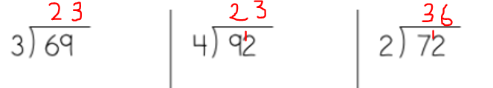
Answers to key Arithmetic questions

Slide 5

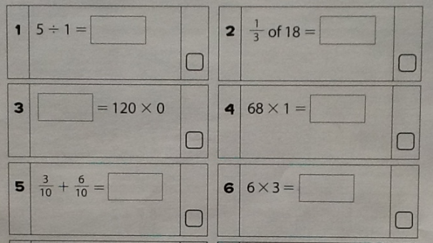
18 divided by 3 =

Slide 6
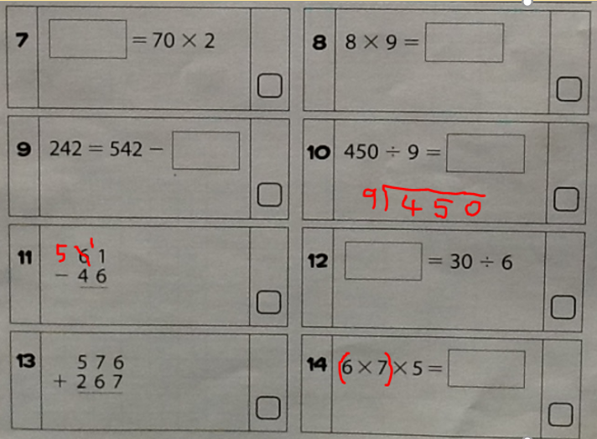

Slide 7
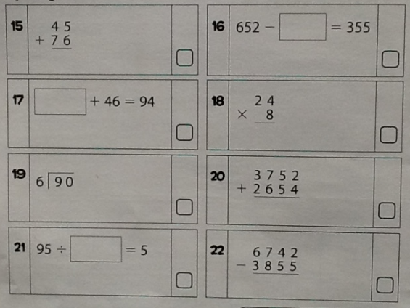
652 – 355 =
94 – 46 =
95 divided by 5 =

Slide 8
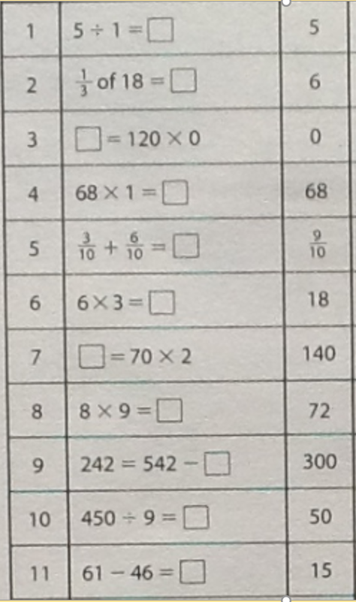

Slide 9
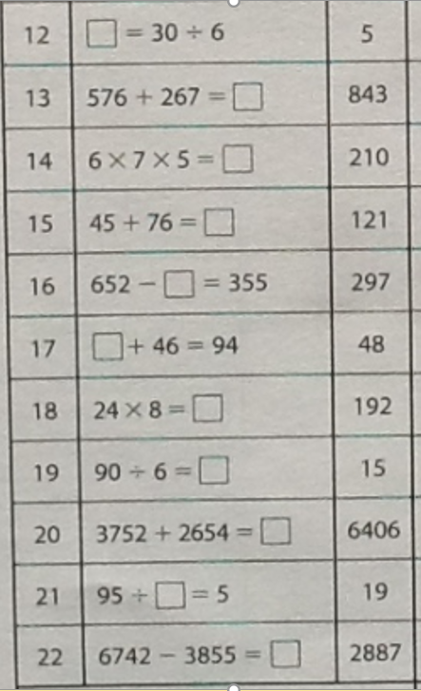

Slide 10
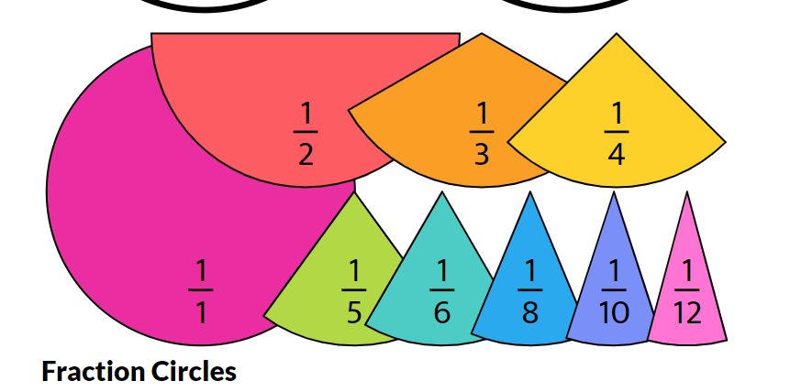
Next Week
See you all back in school
Adding and subtracting fractions with the same denominator
https://www.topmarks.co.uk/Search.aspx?q=fractions

