Slide 1

Starlings English Home Learning
Tuesday 23rd February

Slide 2
In today’s lesson you will be:
Making predictions about animals in the text
Checking if your predictions were right by reading parts of the text
Using labels to add information you find out in the text to your pictures

Slide 3
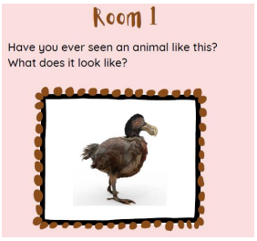

Slide 4
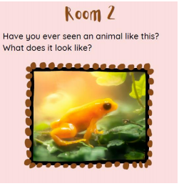

Slide 5
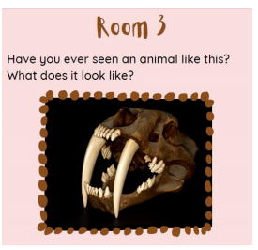

Slide 6
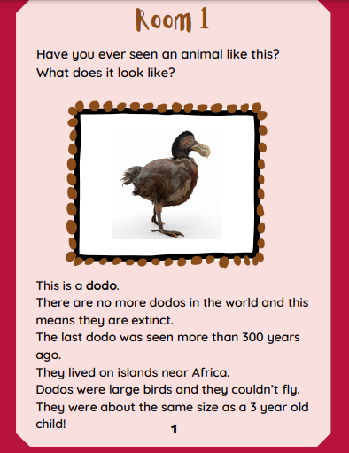

Slide 7
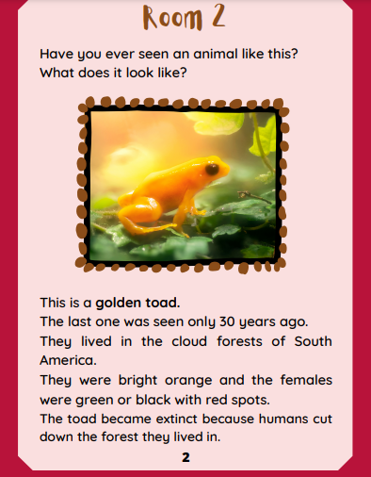

Slide 8
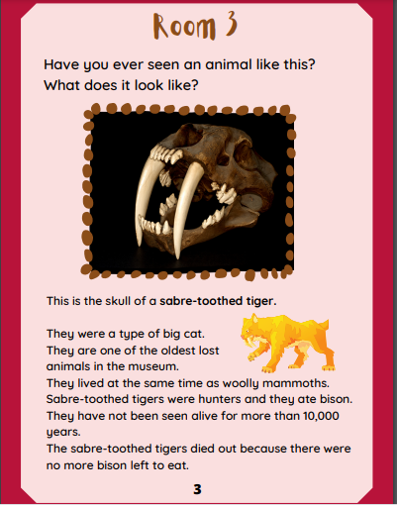

Slide 9
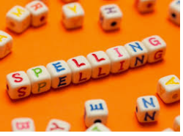
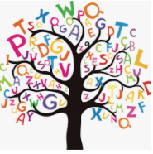



Words of the day!
was one were
Can you write the word was 5 times in your biggest handwriting?
Can you write the word one 5 times using a different colour for each letter?
Can you write the word were 5 times with your eyes closed?

