Slide 1


Starlings Maths Home Learning
Tuesday 23rd February

Slide 2

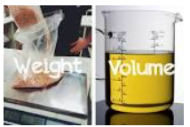
WEIGHT & VOLUME LESSON 5
Good Morning Starlings
I hope you had fun measuring capacity yesterday. Today, you’re going to estimate and measure the capacity of a range of containers, using a variety of non-standard units (things that you can you find around the house).

Slide 3
Watch this video to see if you can guess what will happen: https://www.youtube.com/watch?v=wR558tARkHY

Slide 4
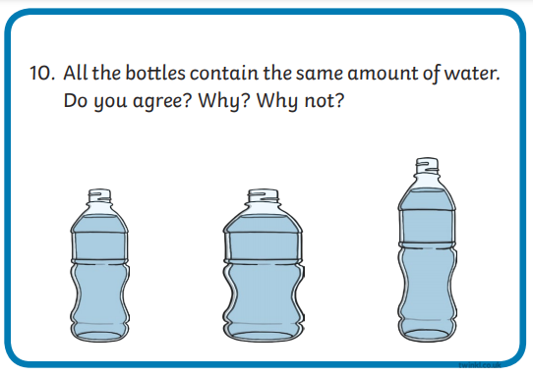
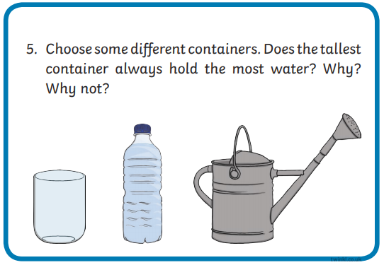
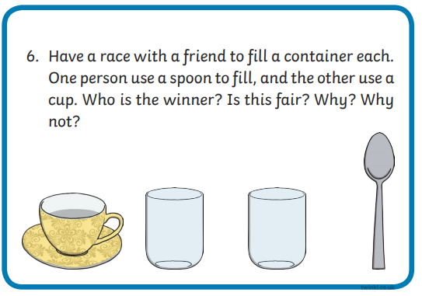
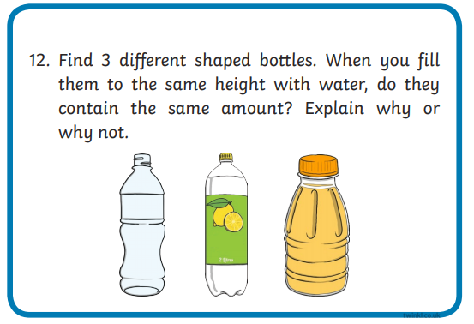
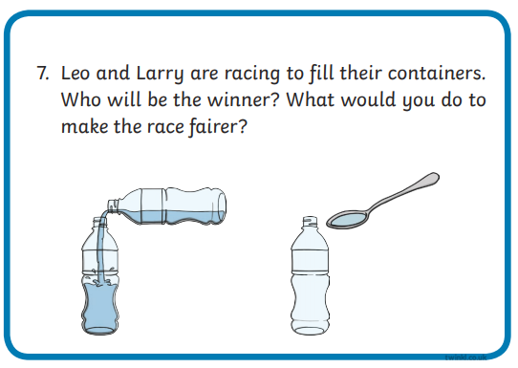
That’s right – different shaped containers can have the same capacity. Go and collect some different sized containers and have some fun trying these challenges for yourself:

Slide 5
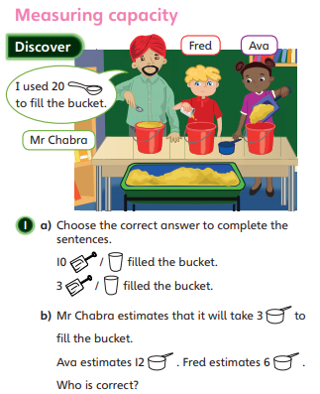
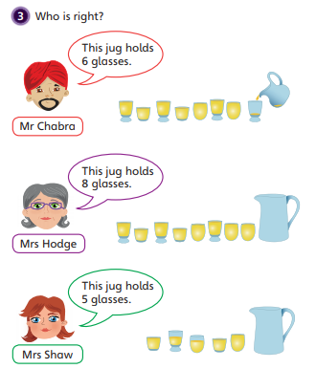
Remember that the number of units needed to fill a container depends on the size of the measuring unit used: the larger the unit, the fewer of them are needed, and vice versa.
10 cups
3 spades
Fred
Mrs Hodge

Slide 6
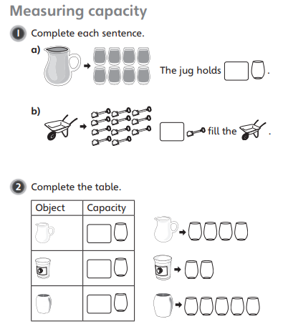
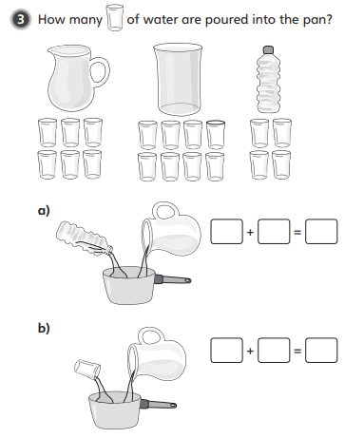

Slide 7

