Slide 1


English
Date: 23.02.21
Week 7 – Lesson 2
Relative Clauses

Slide 2

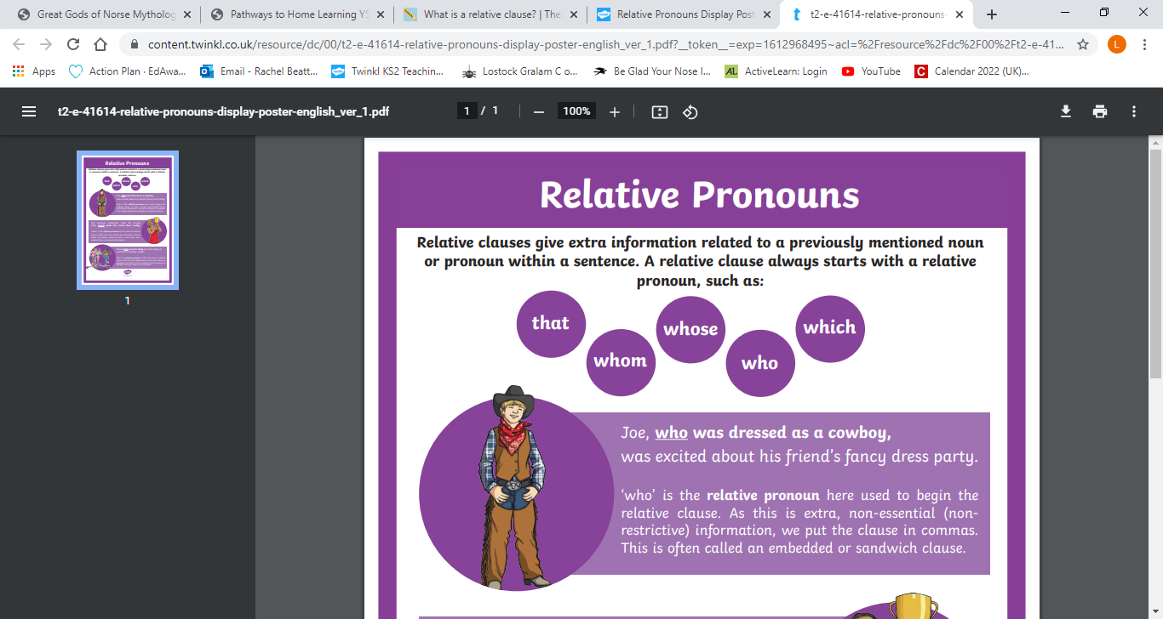
Relative clauses:
Click on the sound button to hear this slide read to you.
Relative clauses add extra information to sentences using a relative pronoun.
Here are 5 relative pronouns:
Can you think of any sentences that use these word to add extra detail?
You might want to watch this short video clip on relative clauses:
https://www.bbc.co.uk/bitesize/topics/zwwp8mn/articles/zsrt4qt
Examples on next slide…

Slide 3
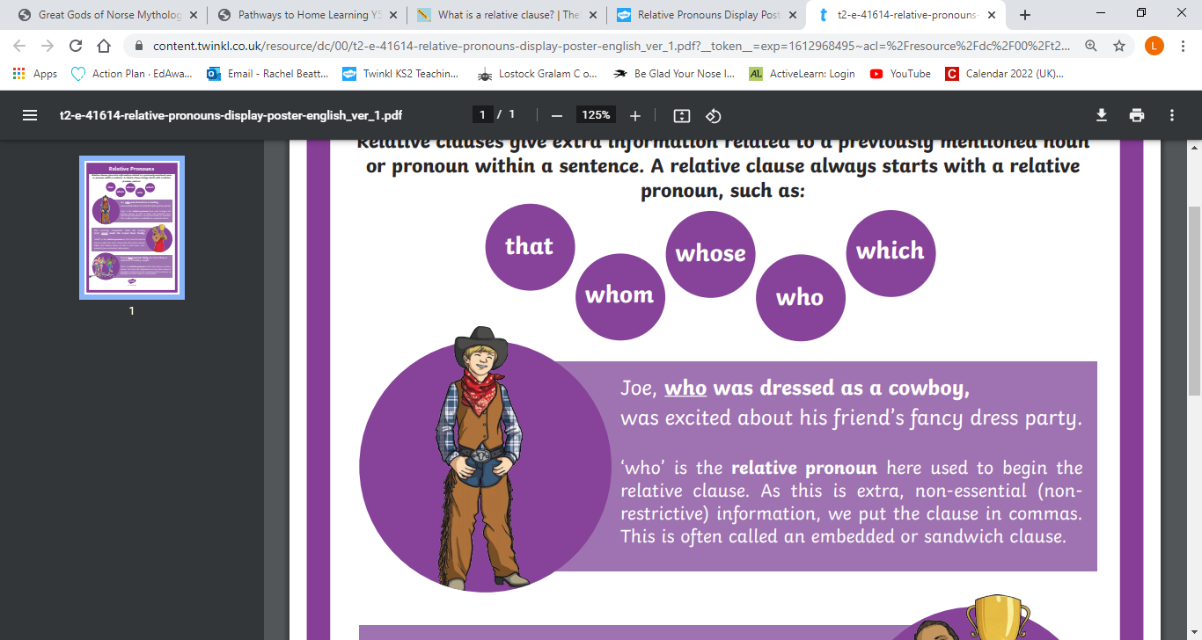
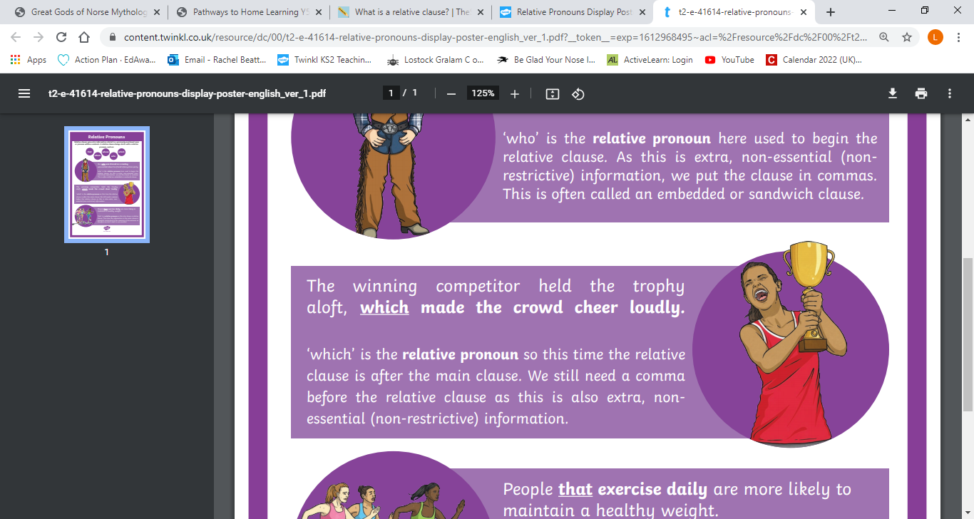
Relative clauses can come in the middle or at the end of a sentence. Like this:
Click on the sound button to hear this slide read to you.

Slide 4
Activity 1:
Click on the sound button to hear activity 1 read to you.
Write out the sentences on the next slide, then circle the relative pronoun and underline the relative clause.
Remember you should be able to take out the relative clause (extra information) and the sentence should still make sense on its own.
Let’s look at some more together first:
I liked the new chair, which was very comfortable.
My Gran, who is 82, still goes swimming every day.

Slide 5
Click on the sound button to hear activity 1 read to you.
Activity 1 (continued):
Write out the sentences below, then circle the relative pronoun and underline the relative clause.
The girl, who was feeling excited, walked to the park.
The dragon, whose breath smelt awful, roared with all its might.
I don’t like the clown that has a bright nose.
I liked my new toy, which was bought for my birthday.

Slide 6
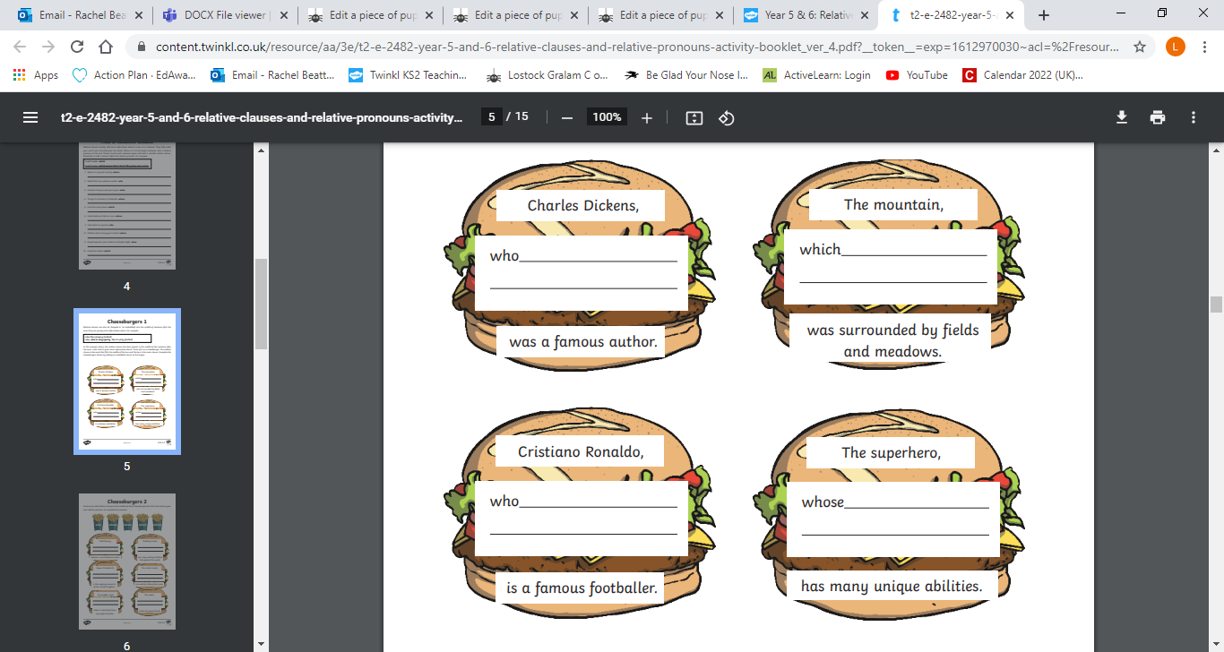
Activity 2:
Use the burger sentences to write your own relative clauses using the relative pronouns ‘which’ and ‘whose’.
Click on the sound button to hear activity 2 read to you.

Slide 7
