Slide 1






English
Tuesday 23rd February 2021

Slide 2
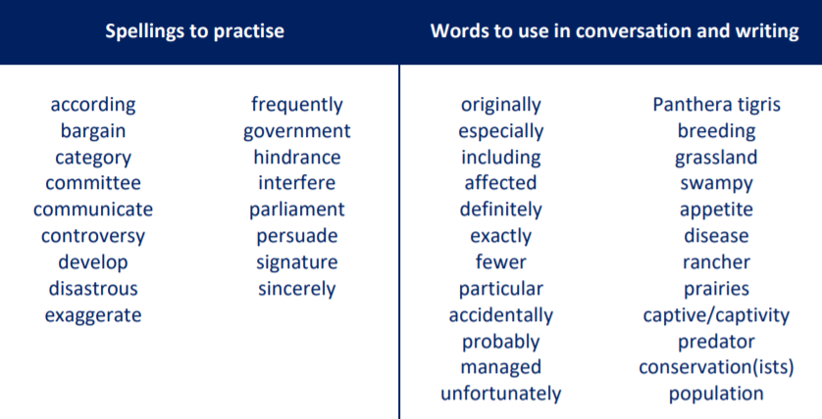
Main outcome of the session:
To write informative paragraphs about an endangered animal of your choice.
To apply all of the grammar skills practised throughout this unit.
These are the spelling words that go along with this unit of work exactly like when we’re in school.

Slide 3
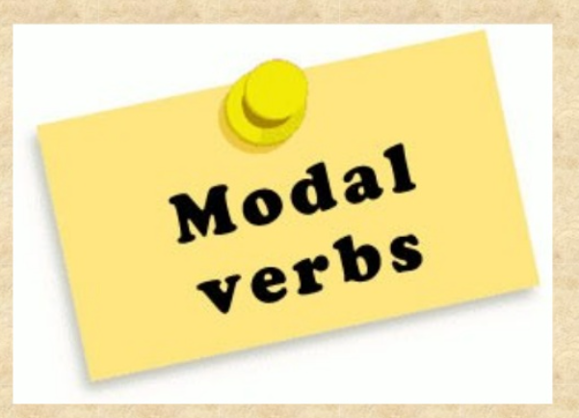
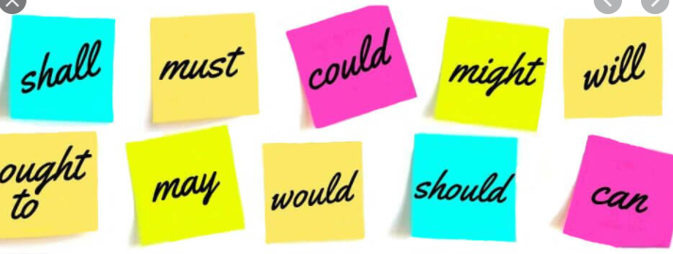
Remember…
Brackets are used to add extra information in a sentence – an informal comment, extra detail or a list of items
e.g. I loved France (especially the food!) and I’ll definitely visit again.
Dashes are used in a similar way but are useful for adding additional comments at the end of the sentence e.g. I visited the beach in Wales – it was stunning!
Activity 1
Practise writing sentences about your chosen endangered animal using modal verbs, brackets and dashes.
See the next slide for my model sentences.

Slide 4
Practise writing sentences which use modal verbs and brackets or dashes about your chosen animal.
I have selected the Sumatran Elephant to focus my research on.
Model Sentences
Sumatran elephants feed on a variety of plants and deposit seeds wherever they go. This will contribute to a healthy forest ecosystem.
They also share their lush forest habitat with several other endangered species (the Sumatran rhino, tiger, and orang-utan and countless other species) that all benefit from an elephant population that thrives in a healthy habitat.
In 2012, the Sumatran elephant was changed from “Endangered” to “Critically Endangered” because half of its population has been lost in one generation—a decline that is largely due to habitat loss and as a result human-elephant conflict.

Slide 5
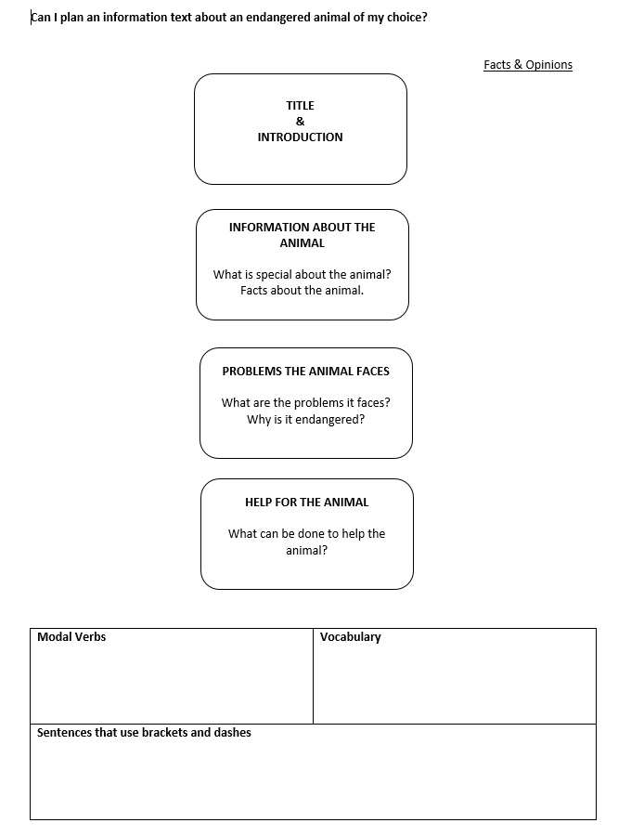
Activity 2
Plan your information writing using this planning template.
Use your notes from yesterday to help but you need to focus on the grammar features today too:
Modal verbs
Brackets and dashes
Facts and opinions
Vocabulary
Please continue on to the next slide to see my model plan for you. If you can have a go at planning your writing without my model, that would be fantastic!

Slide 6
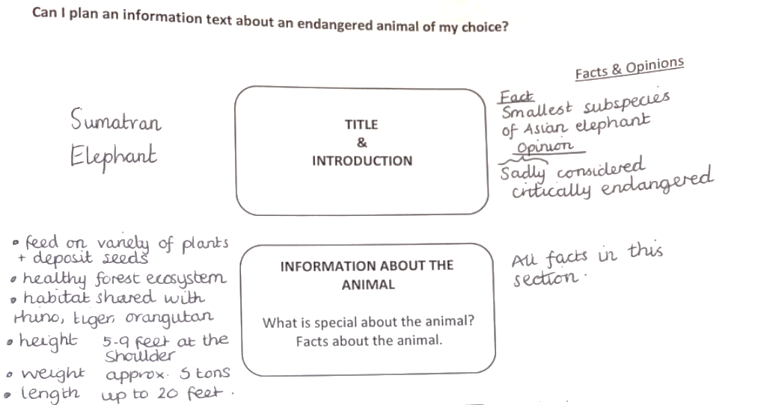
Model Plan

Slide 7
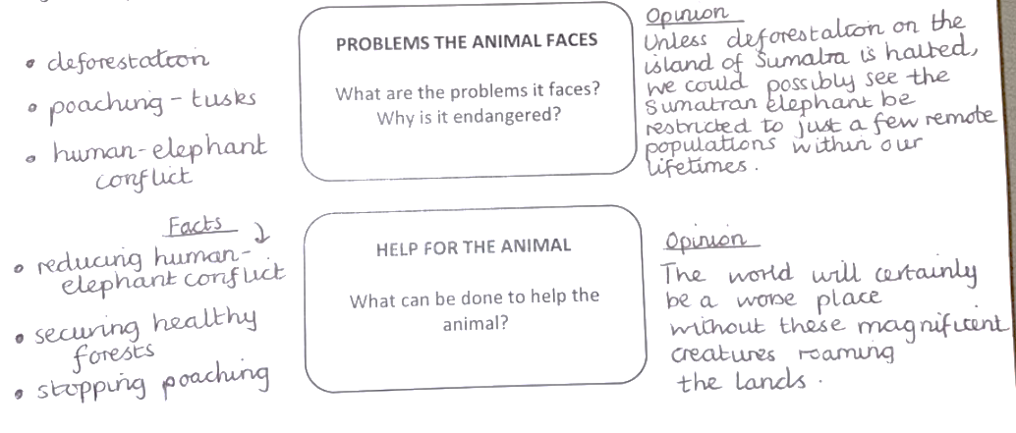
Model Plan continued…

Slide 8
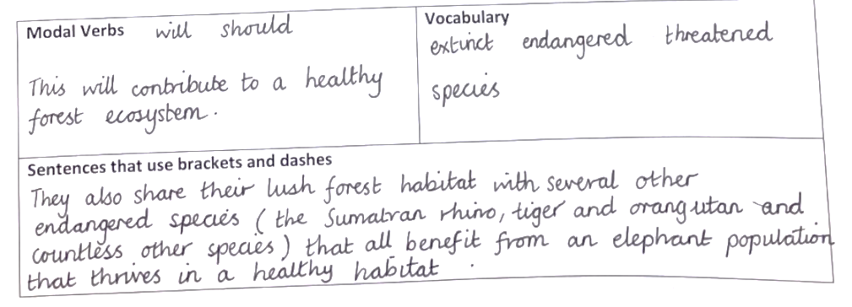
Model Plan continued…

Slide 9

‘The Explorer’ by Katherine Rundell, read by Mrs Whittingham
Please follow this link to see Mrs Whittingham read our new class novel.
https://youtu.be/jowzBCsMbZk

