Slide 1

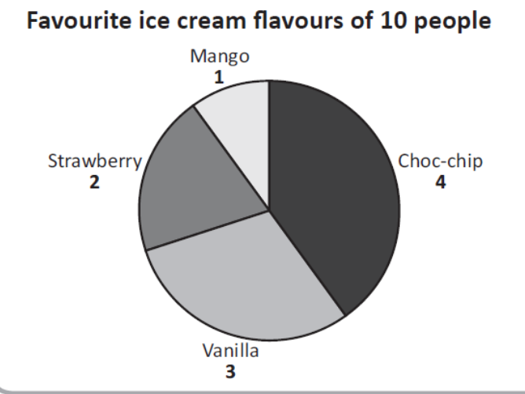


Mathematics
Pie charts are used in data handling and are circular charts divided up into segments which each represent a value. Pie charts are divided into sections (or 'slices') to represent values of different sizes.
Date: 23.02.21
Pie Charts

Slide 2
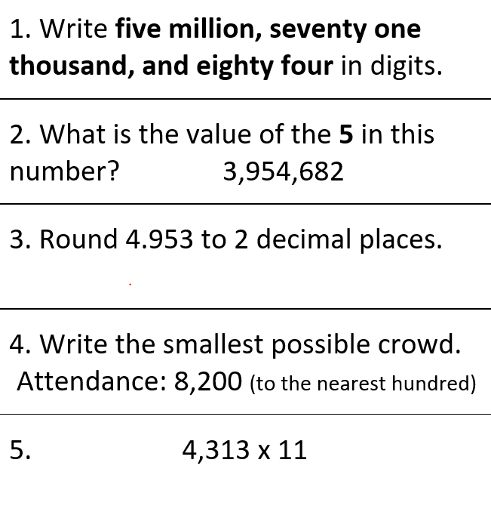
Starter Activity

Slide 3
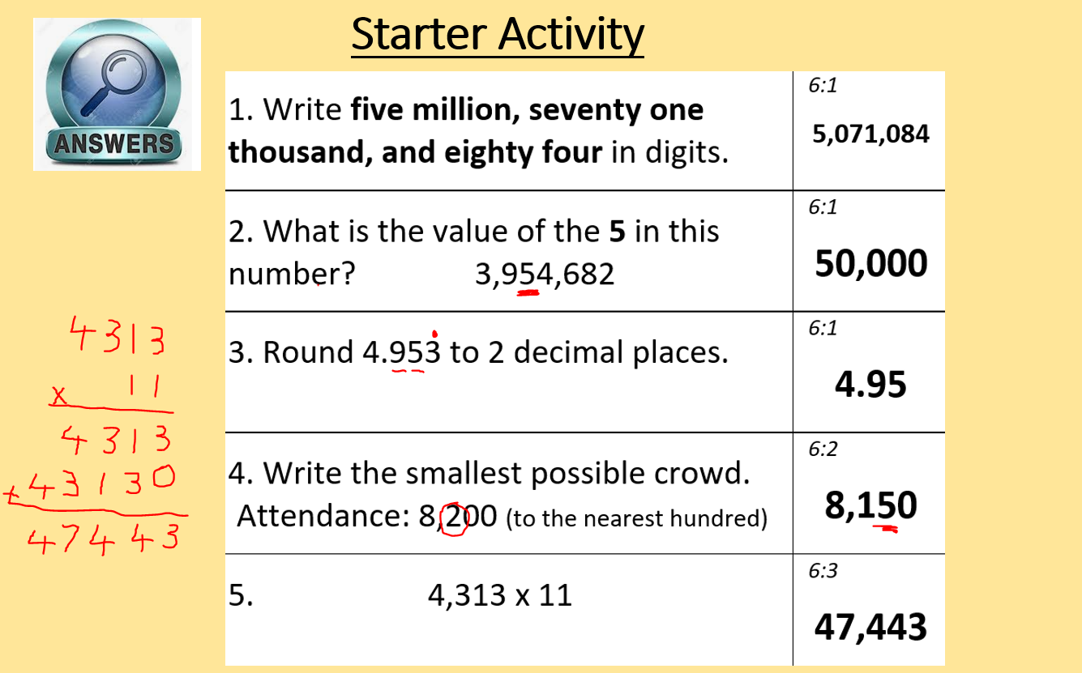

Slide 4
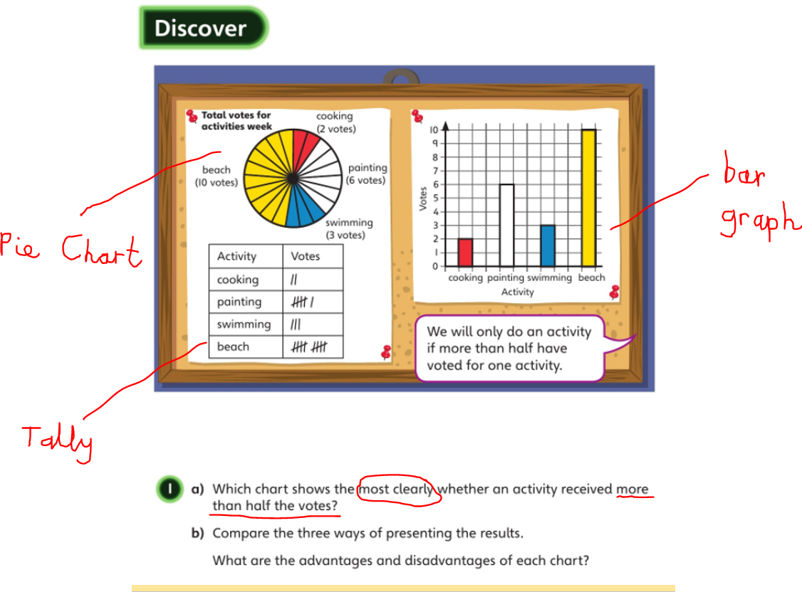

Slide 5
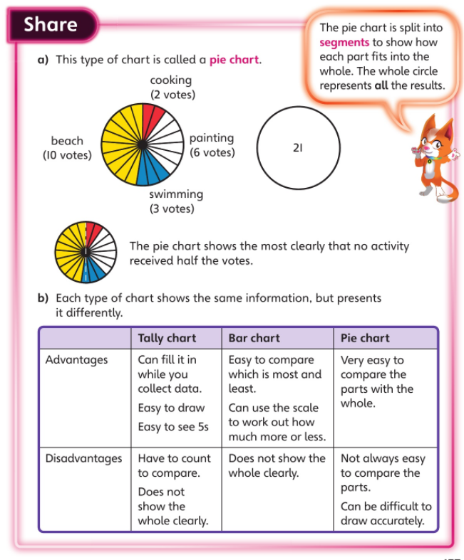

Slide 6
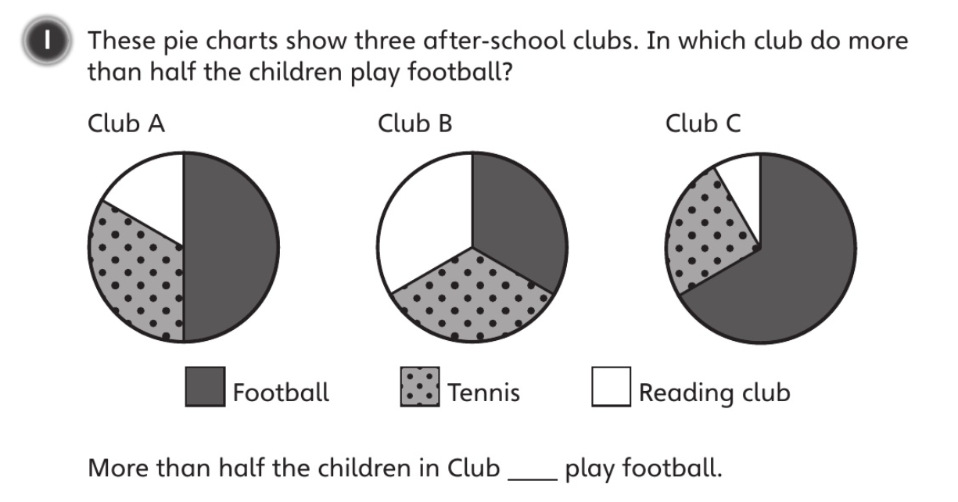


Can you find the diameter?

Slide 7
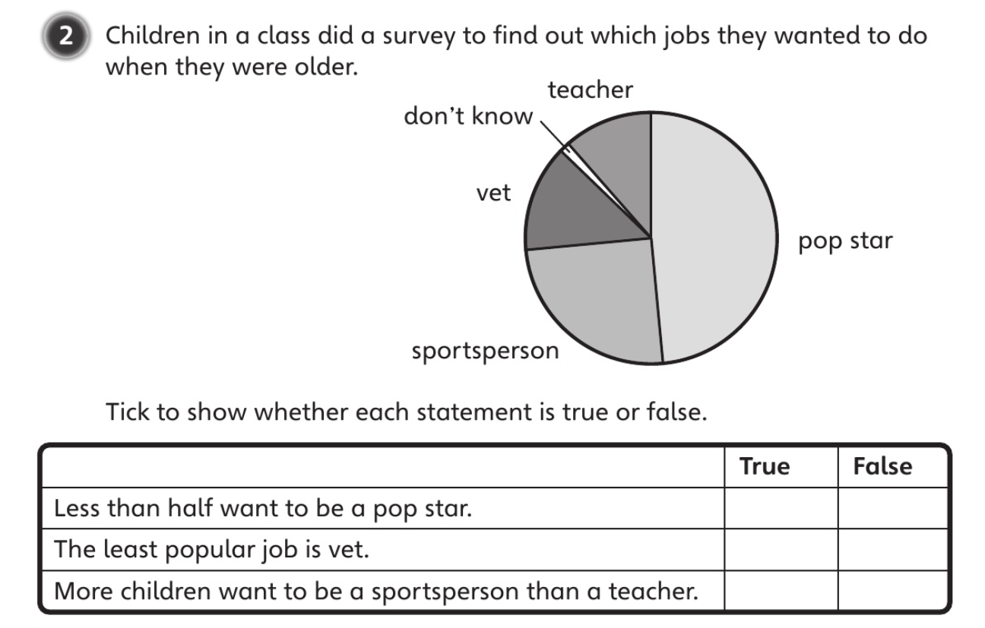

Slide 8
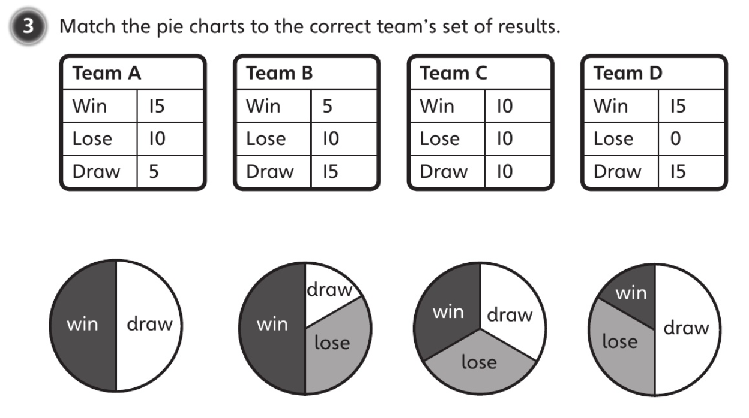

Slide 9
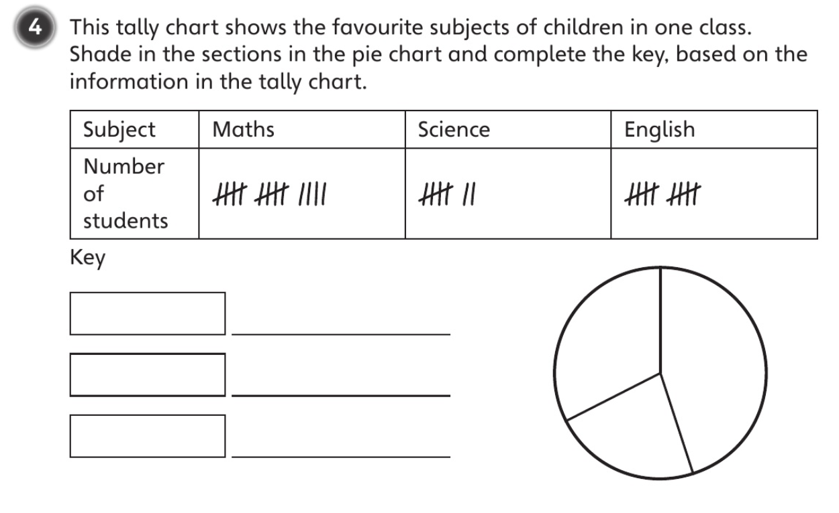

Slide 10

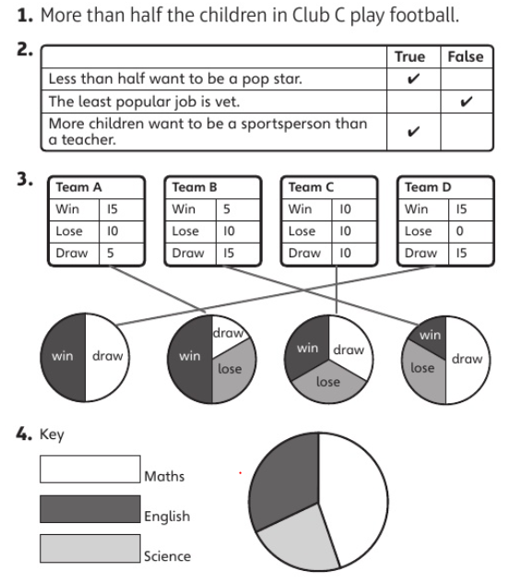

Slide 11
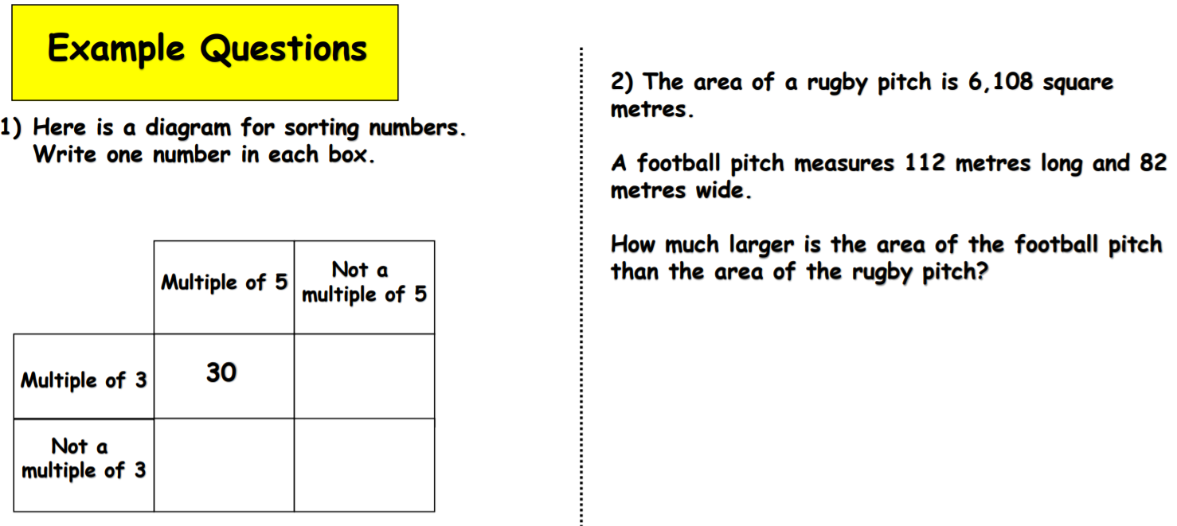
Challenge
List multiples of 3 and 5
Area = length x width

Slide 12
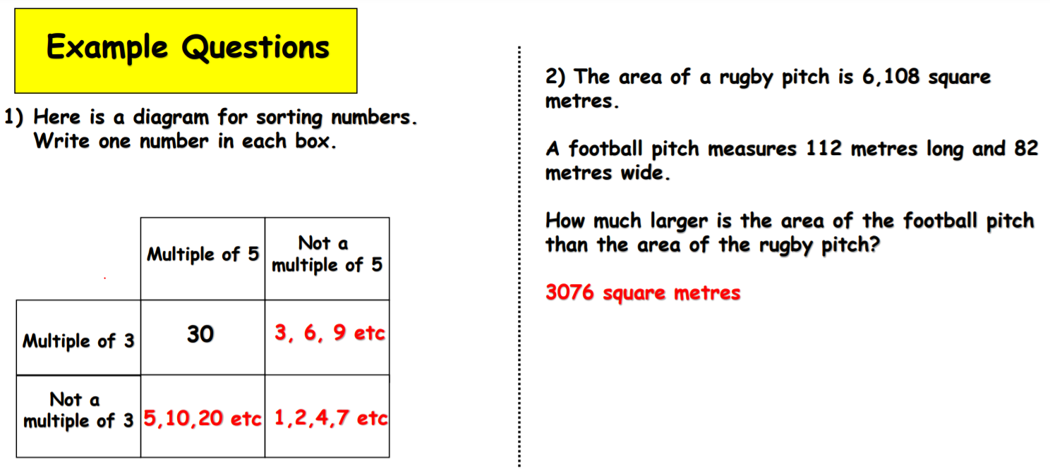
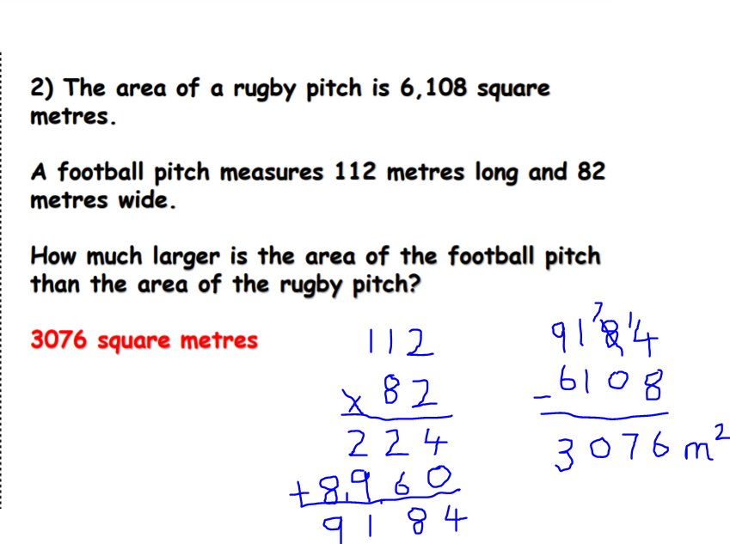
Challenge

