Slide 1

Starlings English Home Learning
Monday 22nd February

Slide 2
Today I am going to share some pictures from our new book, you are going to be making predictions about what type of book you think it is.
Parents, you can either share each image individually on the screen and note your child’s response to each image, or you can print the pictures and hide them around the house to make a treasure hunt and record your child’s response to each picture as they find it.
There is a printable page on the blog for you to download and record responses onto if you wish. Alternatively, you can record your child’s response to each image using paper or post-it notes.
The audio will guide the children’s responses and predictions.

Slide 3
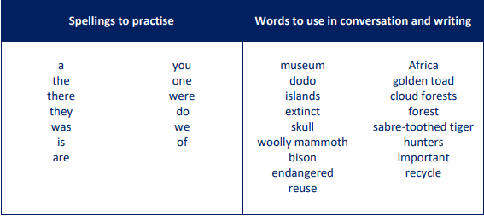
Here are some key words for this unit of writing.
The spellings will form part of our daily spelling work but you may want to print this page off and have visible at home to support recognition and spelling.

Slide 4


Slide 5
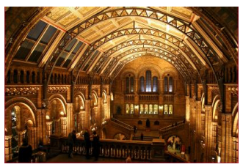

Slide 6
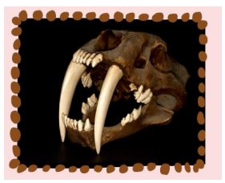

Slide 7


Slide 8
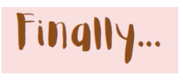

Slide 9


Slide 10
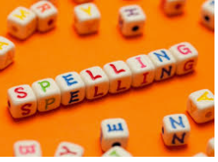
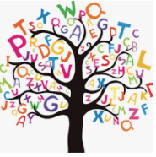



Words of the day!
you are they
Can you write the word you 5 times in your prettiest handwriting?
Can you write the word are 5 times using your other hand?
Can you write the word they 5 times sticking your tongue out?

