Slide 1

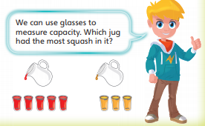

Starlings Maths Home Learning
Monday 22nd February

Slide 2
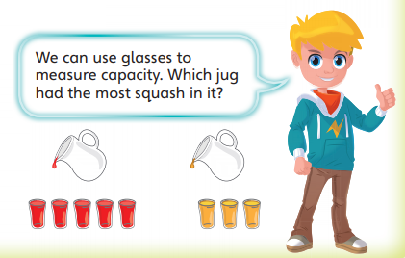
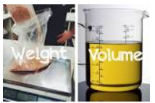
WEIGHT & VOLUME LESSON 4
Good Morning Starlings
I hope you had a lovely, restful half term and you’re ready to get back to our home learning. We know it’s not the same as being in school but have fun learning all about volume and capacity this week.
So today we are going to compare a range of objects using their capacity (how much an object can hold) and remember that the volume is the amount of space an object takes up.

Slide 3
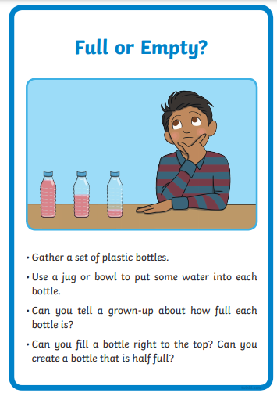
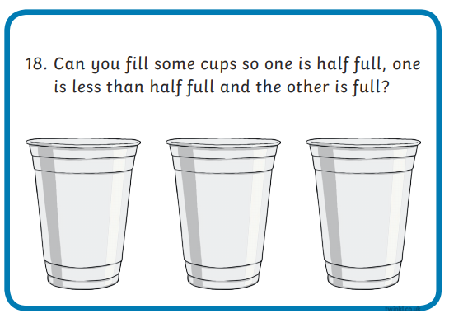
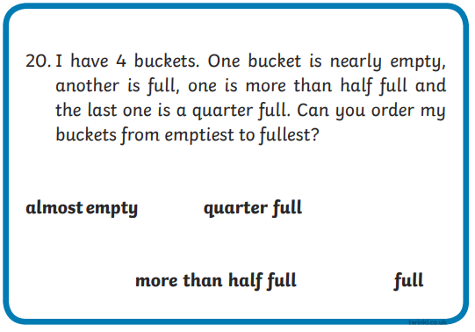
Go and find some containers which are the same size in your house and fill them up with different amounts of water.
Can you order them from smallest to largest?
Have fun and try some of these challenges:

Slide 4
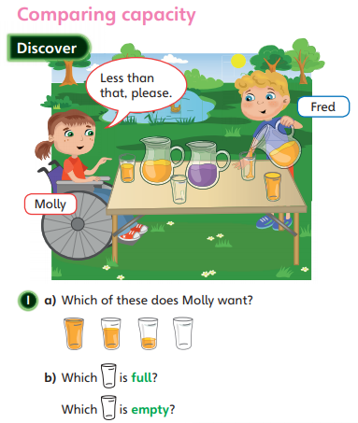
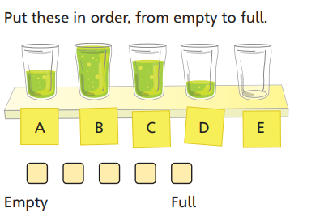

Slide 5
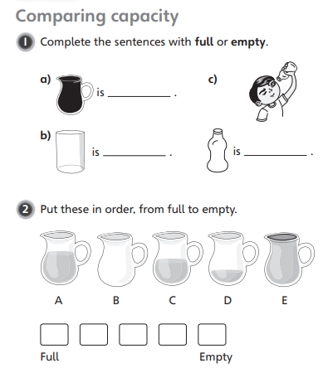
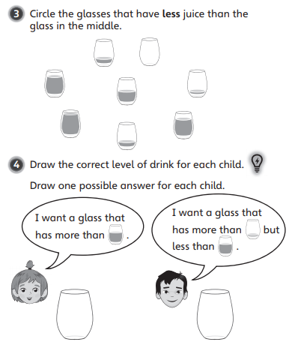

Slide 6

