Slide 1


Mathematics
Date: 22.02.21
Week 7 – Lesson 1
Multiplying by a 1-digit number

Slide 2
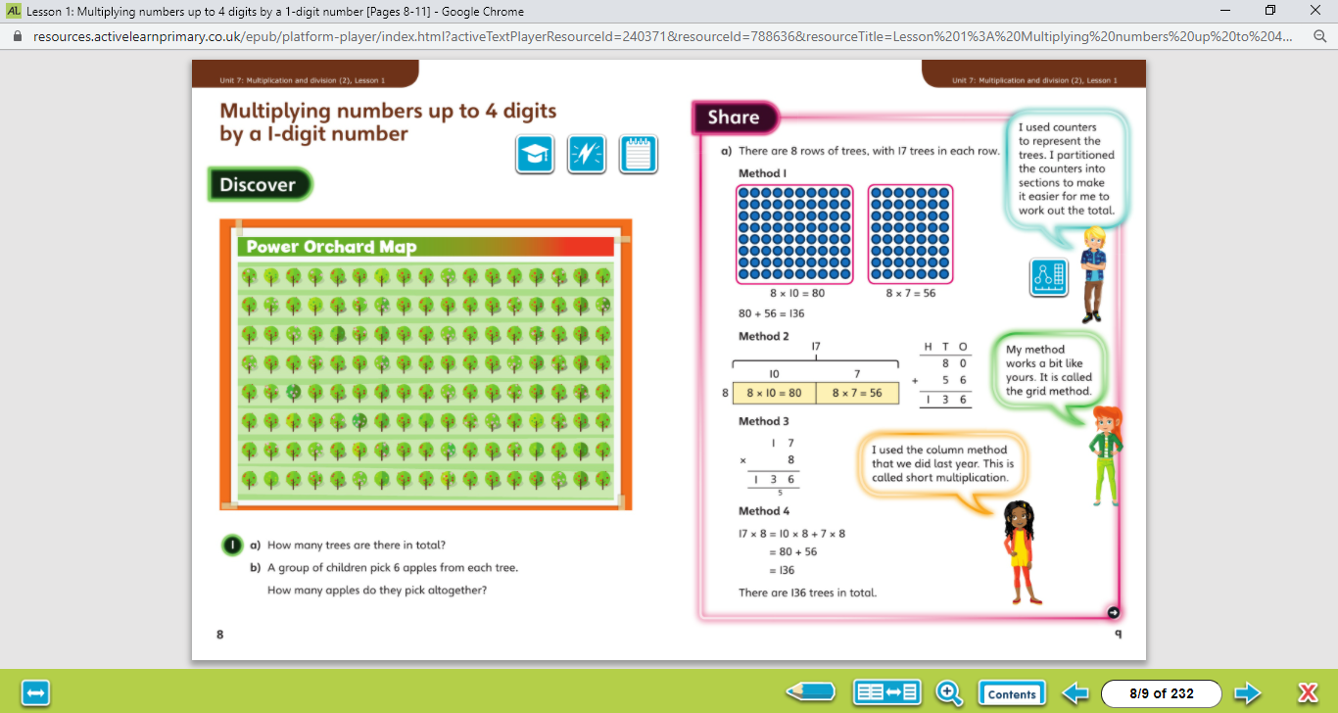

Let’s work together!
Look at the picture clue. What can you see?
Have a look at the questions.
Click on the sound button to hear the questions read to you. We will also talk through the questions together like we do in school.
We will go through the possible methods and answers on the next slide.

Slide 3
Let’s work together!
Click on the sound button to hear the answers and possible methods for question A.

Slide 4
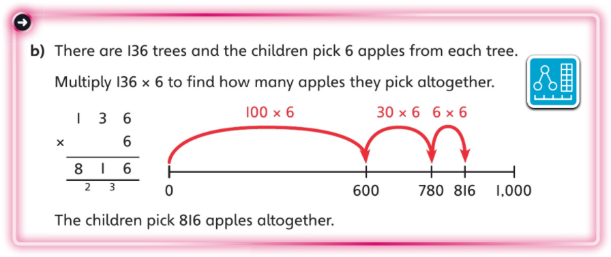
Let’s work together!
Click on the sound button to hear the answers and possible methods for question B.

Slide 5
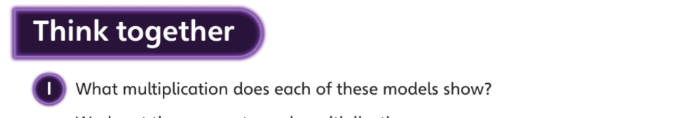
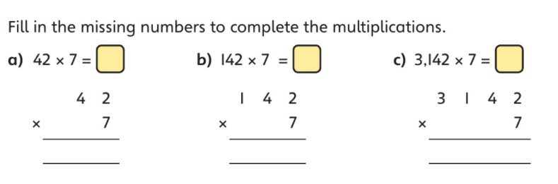
Let’s work together!
Click on the sound button below to hear the question read to you. We will work together to reach the answer.
2 9 4
1
We will go through the answers on the next slide.

Slide 6
Let’s work together!
Click on the sound button to hear the answers.
2 9 4
9 9 4
2 1 9 9 4
1
2 1
2 1

Slide 7
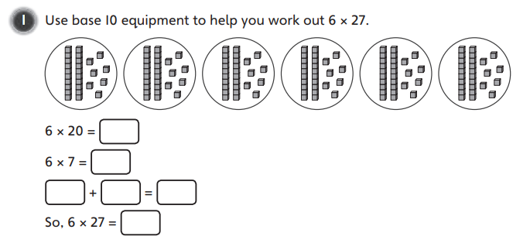
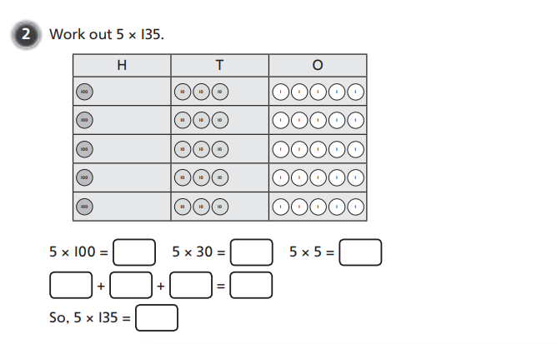
Your Turn…
Have a go at these questions independently. Click on the button if you would like the questions read to you.
We will go through the answers for questions 1, 2, 3 and 4 after completing all of the questions.

Slide 8
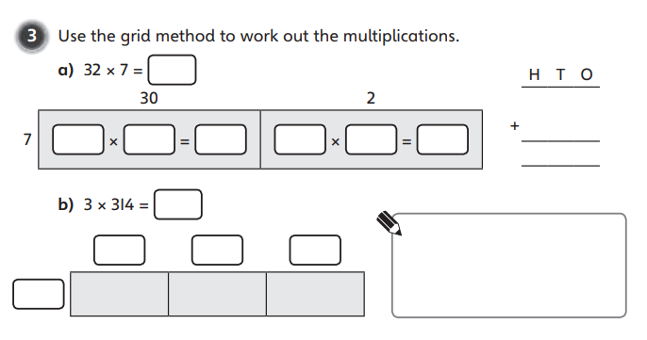
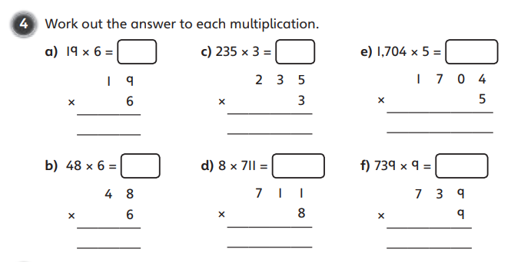
Your Turn…
Have a go at these questions independently. Click on the button if you would like the questions read to you.
We will go through the answers for questions 1, 2, 3 and 4 after completing all of the questions.

Slide 9
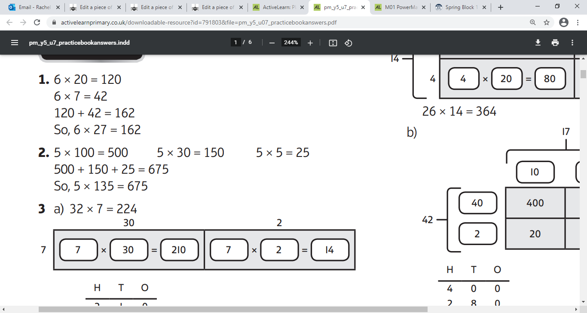
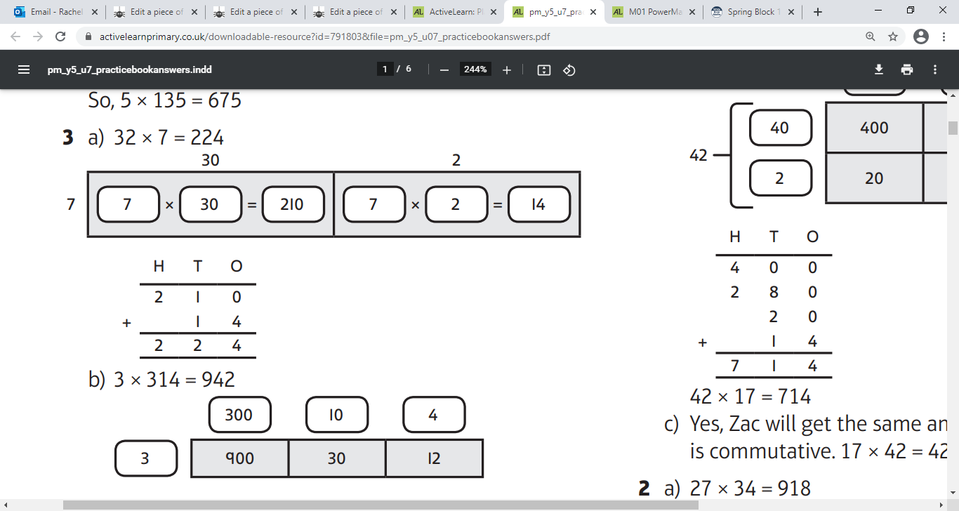
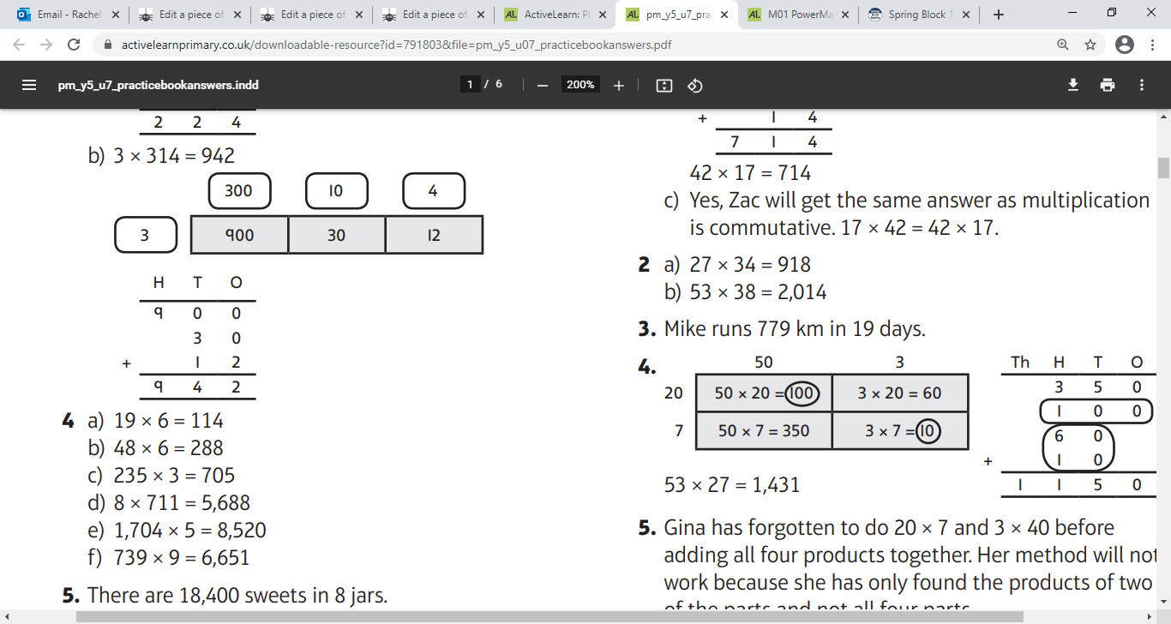
Questions 1 - 4 Answers:
Click on the sound button to hear the answers being read to you.

Slide 10
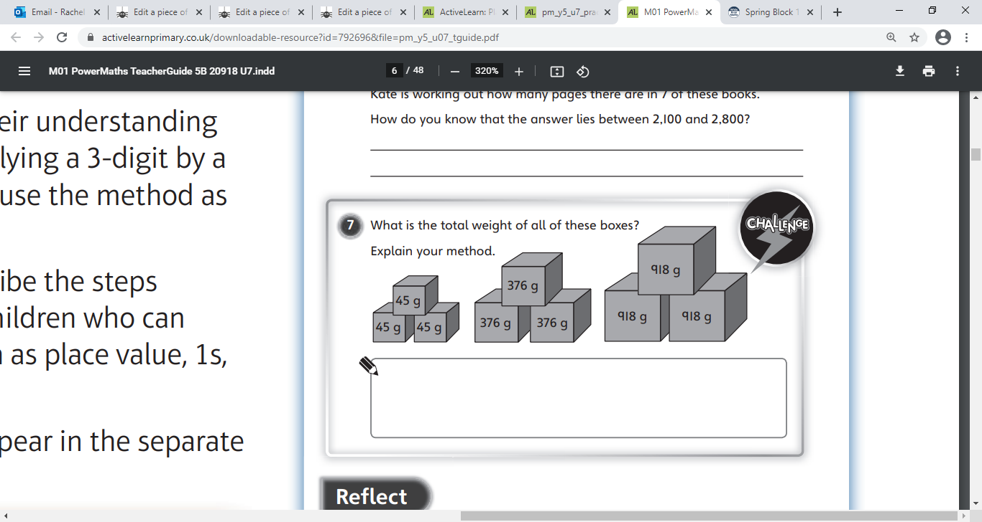
Challenge Time!
Only try this question if you are feeling confident ☺
Your Turn…
Click on the button if you would like the question read to you.
Click on the sound button to hear the answer.

