Slide 1


English
Date: 22.02.21
Week 7 – Lesson 1
Great Gods of Norse Mythology

Slide 2

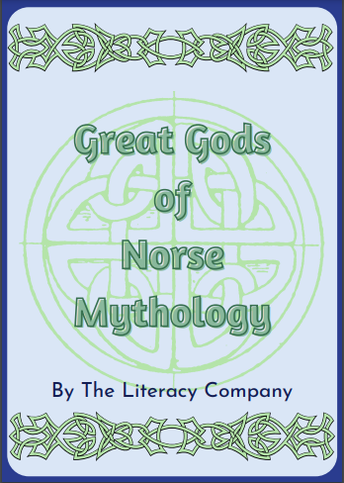
Click on the sound button to hear this slide read to you.
Great God of Norse Mythology
Today, we are going to start a new unit of work looking at the text ‘Great God of Norse Mythology’.
The text is an information text. The details in this text are facts about characters in Norse mythology.
Norse mythology are the stories that the Vikings told.
Myths are stories that have been told and passed on over time.

Slide 3
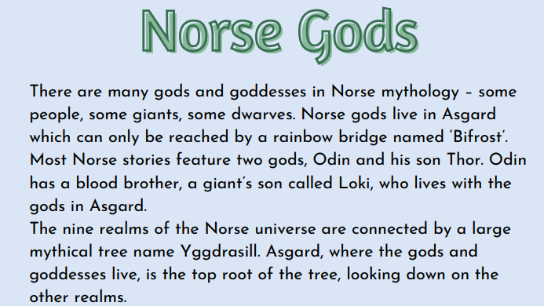
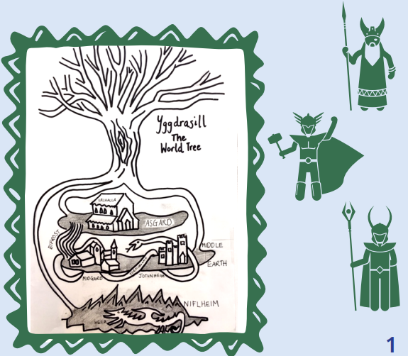
The text is also attached to our blog if you want to open or print it this way.
Read pages 1 and 2 of ‘Great Gods of Norse Mythology’ or click on the sound button to hear it being read to you.
As you are reading/listening to the text, jot down or highlight any words that you don’t understand. Use a dictionary or the internet to look them up.

Slide 4
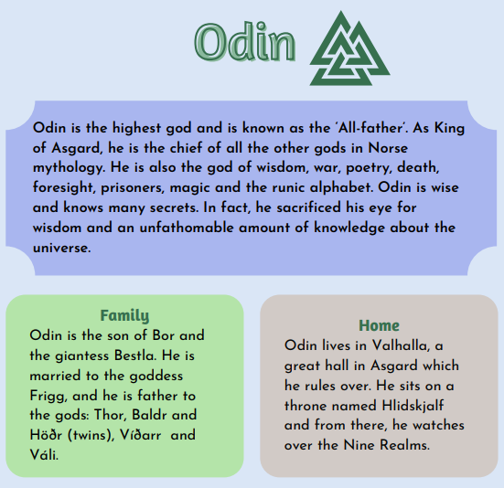
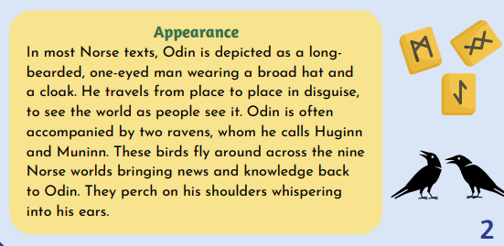
Read pages 1 and 2 of ‘Great Gods of Norse Mythology’ or click on the sound button to hear it being read to you.
As you are reading/listening to the text, jot down or highlight any words that you don’t understand. Use a dictionary or the internet to look them up.
The text is also attached to our blog if you want to open or print it this way.

Slide 5
Activity 1:
Click on the sound button to hear activity 1 read to you.
E.g. Odin has a son called Thor.
Can you write 5 interesting facts about Odin?
E.g. Odin is the highest God and is known as the ‘All-Father’

Slide 6
Activity 2:
Click on the sound button to hear activity 2 read to you.
Complete the following comprehension questions:
Where do the Gods live?
Name one of Thor’s relations (page 1)
Find a phrase that tells you Odin is powerful.
List 4 matters that Odin is the God of.
What does the word ‘unfathomable’ tell you about how much knowledge Odin gained.
What is the name of Odin’s mother?
What impression do you get of Odin?

Slide 7
Reading Comprehension Answers:
The gods live in Asgard.
Odin is Thor’s father.
The phrase that shows Odin is powerful is ‘Odin is the highest god and is known as the All-father’.
Odin is the god of: wisdom, war, poetry, death, foresight, prisoners, magic and the runic alphabet.
Unfathomable tells me that he has vast knowledge/he knows a lot of things.
Odin’s mother is called Bestla.
I get the impression that he is a powerful god with a lot of knowledge and he is also a fighter and a warrior.
Click on the sound button to hear this slide read to you.

Slide 8
