Slide 1






English
Monday 22nd February 2021

Slide 2
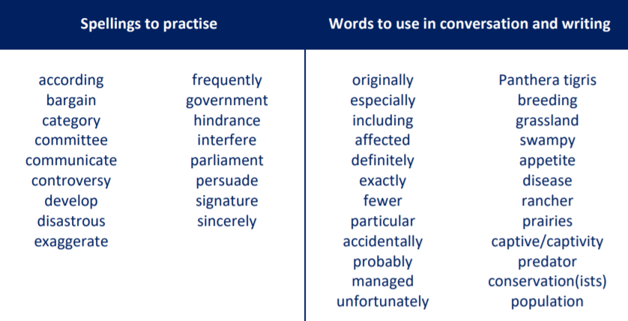
Main outcome of the session:
To write informative paragraphs about an endangered animal of your choice.
To apply all of the grammar skills practised throughout this unit.
These are the spelling words that go along with this unit of work exactly like when we’re in school.

Slide 3

Activity 1
Complete some online research about endangered animals.
What animals are currently on the endangered species list?
Here’s some really useful websites that you can use to do your research:
https://www.worldwildlife.org/species/directory?page=2
https://www.britannica.com/list/10-of-the-most-famous-endangered-species
https://onekindplanet.org/top-10/top-10-worlds-most-endangered-animals/
Choose one animal that is currently endangered to focus on.

Slide 4
Activity 2
Make notes on your chosen endangered animal. Section your notes into the following headings:
What is special about the animal/facts about it?
What are the problems you animal faces and why is it endangered?
What can be done to help the animal?
The WWF website is a really good website to use. See if you can follow any of the links
to find out the answers to the questions/sections above and make your detailed notes.
Remember when making notes, keep them brief and you can use bullet points.

Slide 5
Model Notes
I have chosen to focus on the Sumatran Elephant
Have a look at my model notes here. I have used the WWF website to help me.
What is special about the animal/facts about it?
Feed on a variety of plants and deposit seeds wherever they go, contributing to a healthy forest ecosystem
Share their lush forest habitat with several other endangered species which all benefit from an elephant population that thrives in a healthy habitat
STATUS Critically Endangered
POPULATION 2,400 – 2,800
SCIENTIFIC NAME Elephas maximus sumatranus
HEIGHT 5-9 feet at the shoulder
WEIGHT approximately 5 tons
LENGTH up to 20 feet
HABITATS Broadleaf moist tropical forests
What are the problems you animal faces and why is it endangered?
Deforestation and habitat loss - in Sumatra’s Riau province, pulp and paper industries and oil palm plantations have caused some of the world’s most rapid rates of deforestation.
Poaching - sell their tusks on the illegal ivory market.
Human-elephant conflict - as a result of the rapid development and deforestation in Sumatra, elephants often come into contact with human settlements. They raid crops, trample homes and sometimes even hurt or kill people. Those affected sometimes retaliate and poison or shoot elephants.

Slide 6
Model Notes Continued
What can be done to help the animal?
Reducing human-elephant conflict
  In 2004, WWF started an Elephant Flying Squad, which is made up of rangers, noise and light-making devices, a truck, and four trained elephants that would drive wild elephants back into the forests if they threatened to enter villages.
Securing healthy forests
  A major breakthrough was achieved in Sumatra with the 2004 declaration of Tesso Nilo National Park, a protected area, which represents a significant step towards the protection of the elephant's habitat.
Halting poaching and stopping trade
  In response to high incidents of elephant and tiger poaching in central Sumatra, WWF and its local partners have coordinated wildlife patrol units that conduct antipoaching patrols, confiscate snares and other means of trapping animals, educate local people on the laws in place concerning poaching, and help authorities apprehend criminals.

Slide 7

‘The Explorer’ by Katherine Rundell, read by Mrs Whittingham
Please follow this link to see Mrs Whittingham read our new class novel.
https://youtu.be/TMqh-tRaGO8

