Slide 1


Owls class home learning
Monday 22nd February
RE – All about Lent

Slide 2


Slide 3

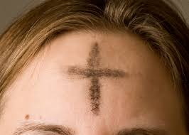

Slide 4

Lent

Slide 5


Slide 6

kindness
thanks
fasting
prayer
sorry
forgiveness

Slide 7


