Slide 1


Owls class home learning
Monday 22nd February
Handwriting

Slide 2
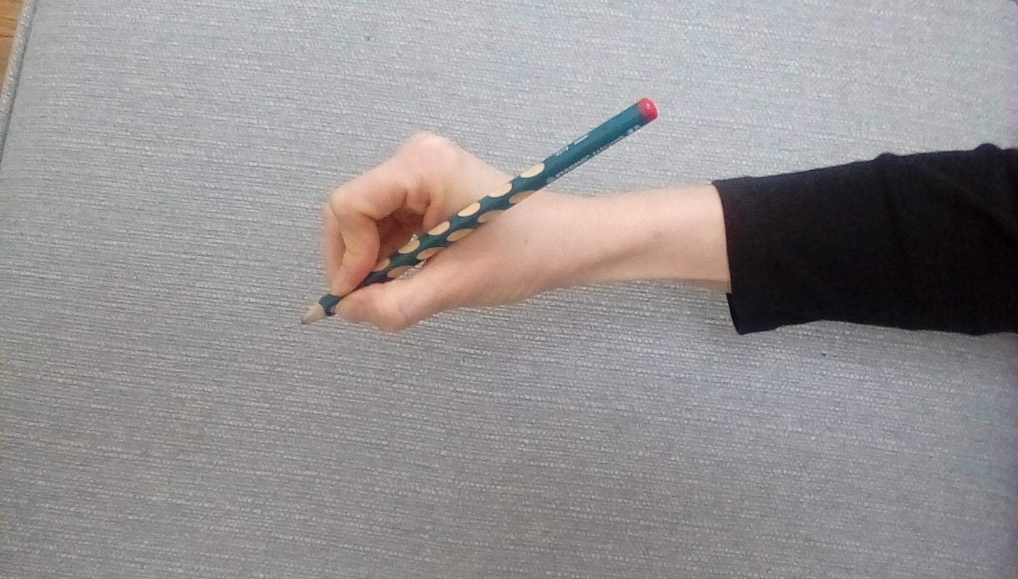
How to hold your pencil

Slide 3
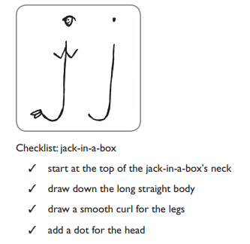

Slide 4
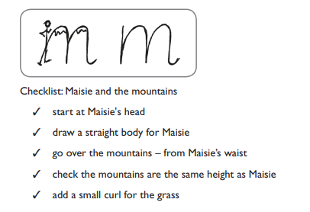
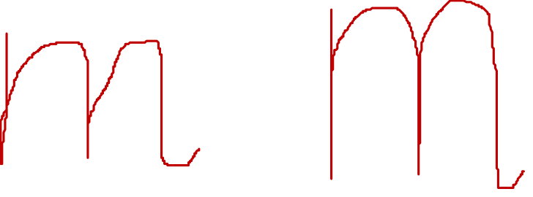

Slide 5
