Slide 1

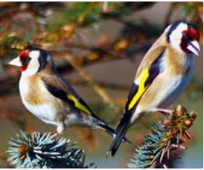
Goldfinches Arithmetic Lesson
22.2.21

Slide 2

Times Tables
Can we begin by counting in 6s.
Can you write down these multiples and then you can check them on the next slide.

Slide 3
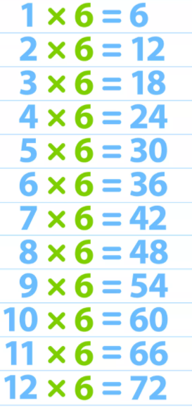
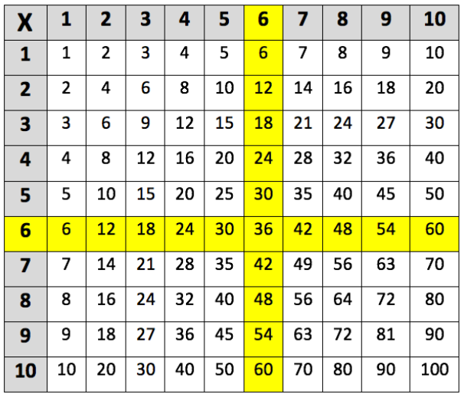
Times Tables
Multiples of 6 – 6, 12, 18, 24, 30, 36, 42, 48, 54, 60, 66, 72

Slide 4
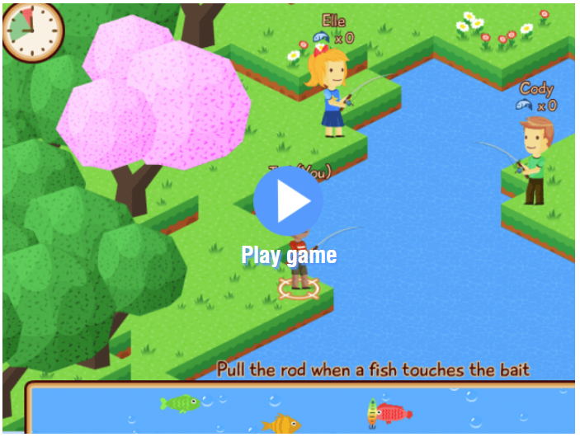
Times Tables
Now here’s a game to revise our Times Tables – Maths Fishing
https://mathsframe.co.uk/en/resources/resource/306/Maths-Fishing-Multiplication
Start by choosing just the 6 times tables and then you can work on others

Slide 5
Four Rules of Number - Multiplication
Lets start with some x 6 quick fire multiplication facts
4 x 6 =
7 x 6 =
9 x 6 =
6 x 6 =
8 x 6 =
12 x 6 =

Slide 6
6 Times Tables
How did you get on?
4 x 6 = 24
7 x 6 = 42
9 x 6 = 54
6 x 6 = 36
8 x 6 = 48
12 x 6 = 72
Let’s sing along with a cover of Taylor Swift’s song ‘Shake it off’ to learn our 6 times tables
https://www.youtube.com/watch?app=desktop&v=e7rYbk9PNuM

Slide 7
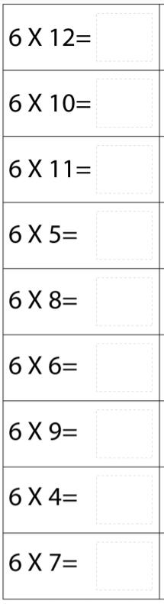
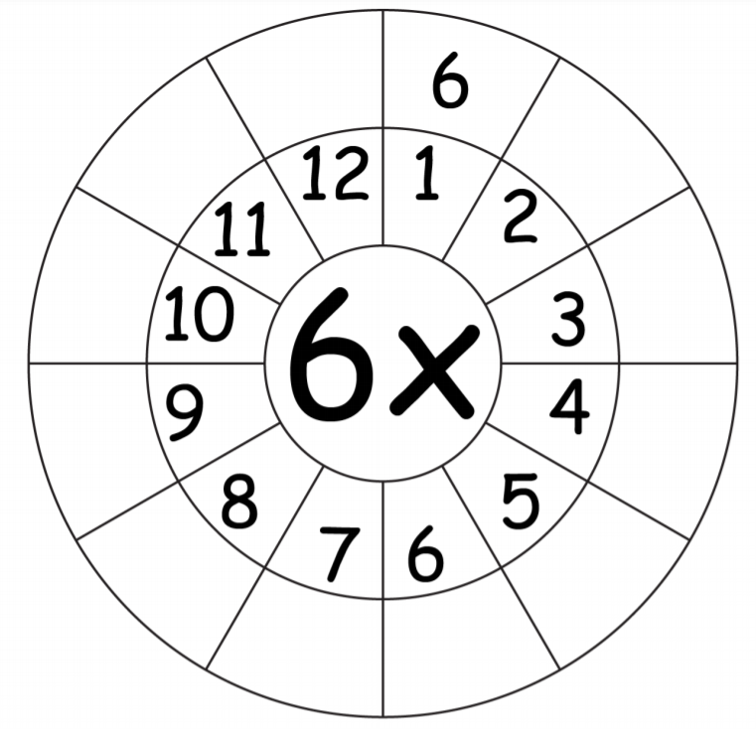
6 Times Tables

Slide 8

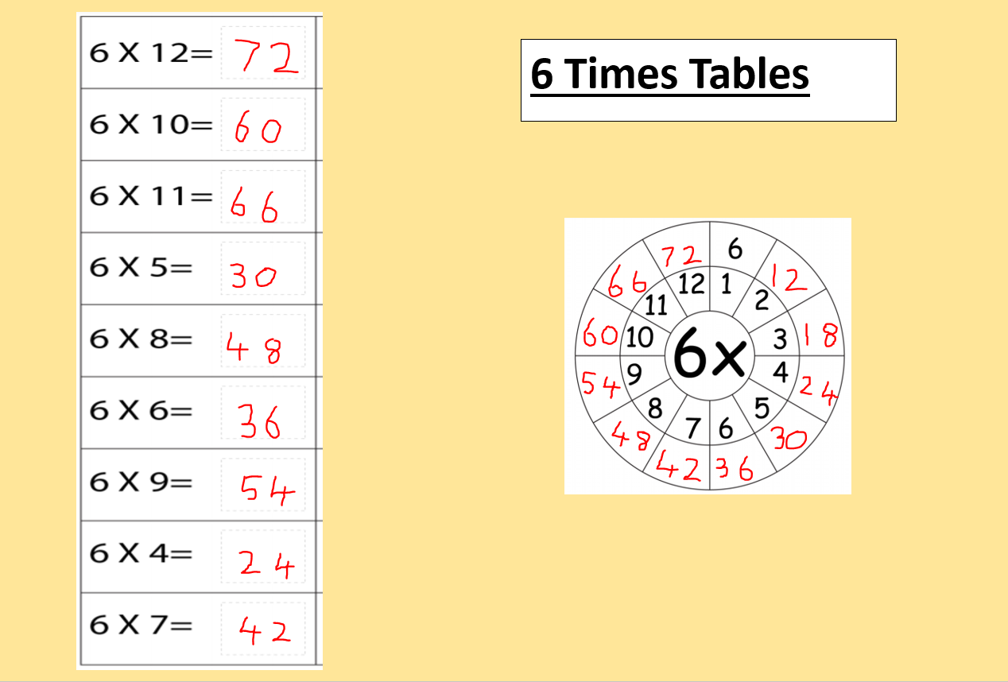

Slide 9

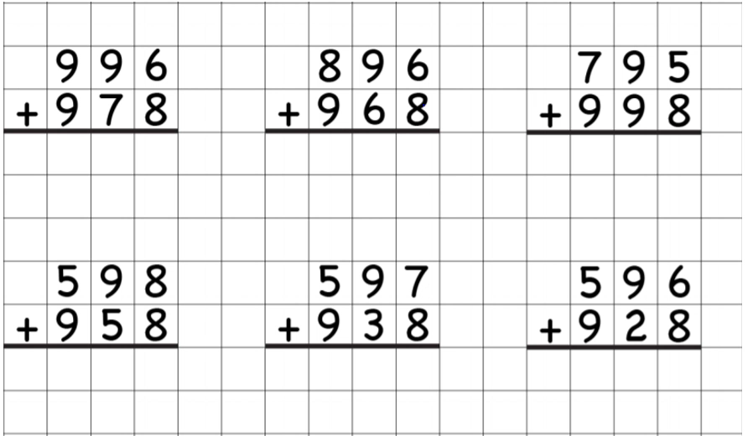
Adding 3 digit numbers
Click First
Method
Click on the image on the right to hear the audio
Click 2nd

Slide 10
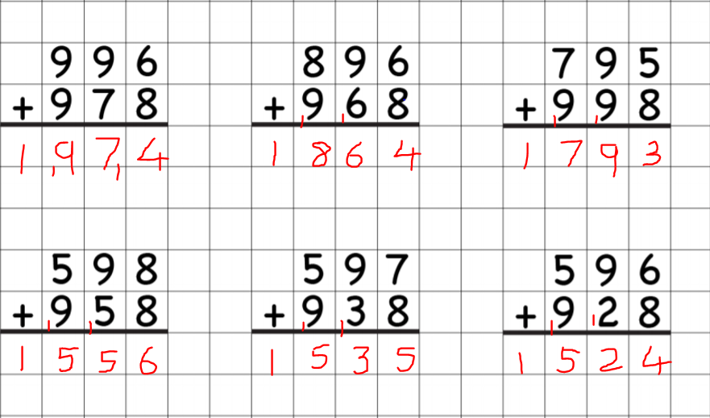
Adding 3 digit numbers

Slide 11
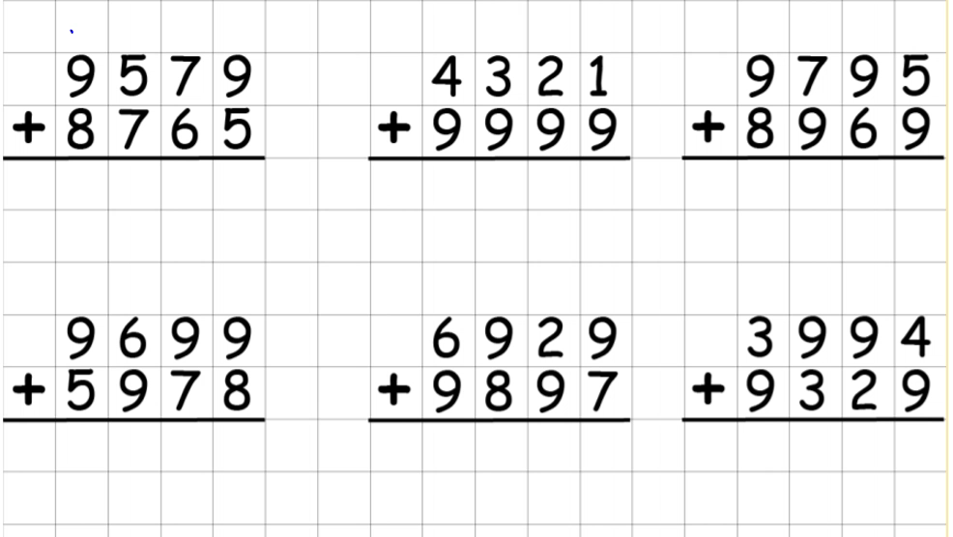
Adding 4 digit numbers
Click First
Method
Click on the image on the right to hear the audio
Click 2nd

Slide 12
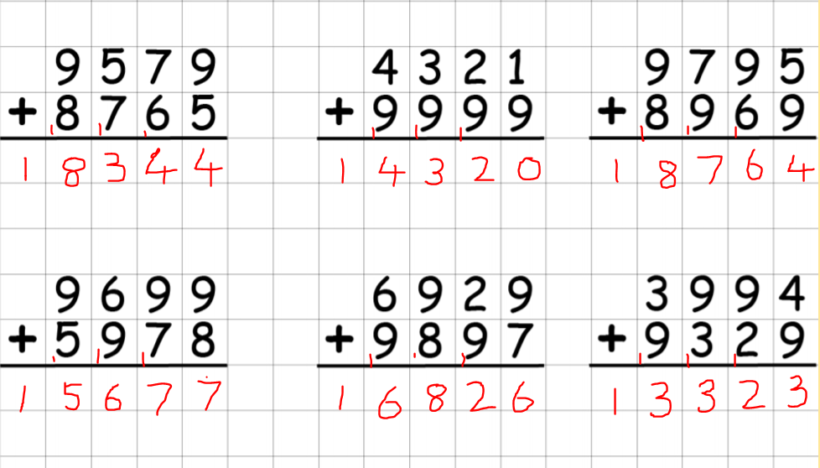
Adding 4 digit numbers

Slide 13
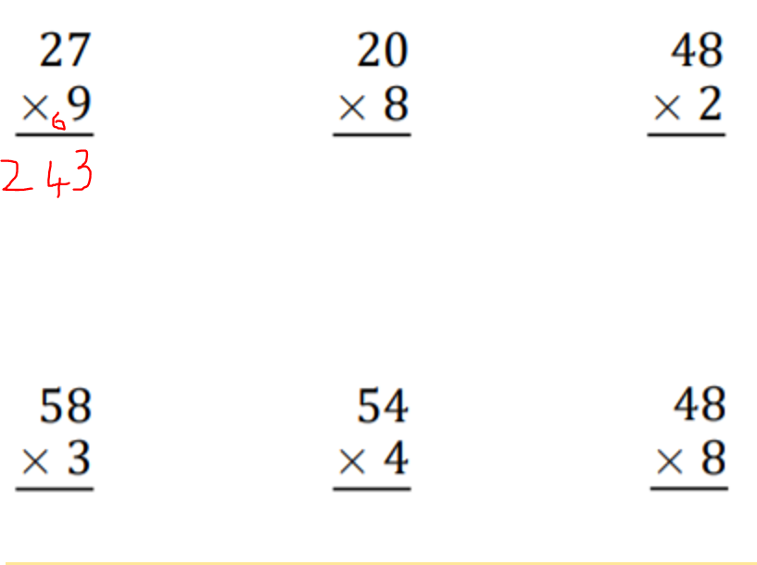
Multiplying 2 digits by 1 digit

Slide 14
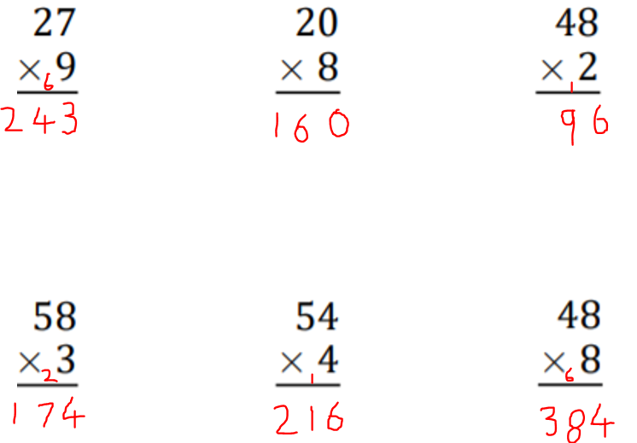
Multiplying 2 digits by 1 digit

Slide 15
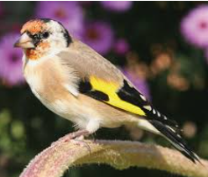
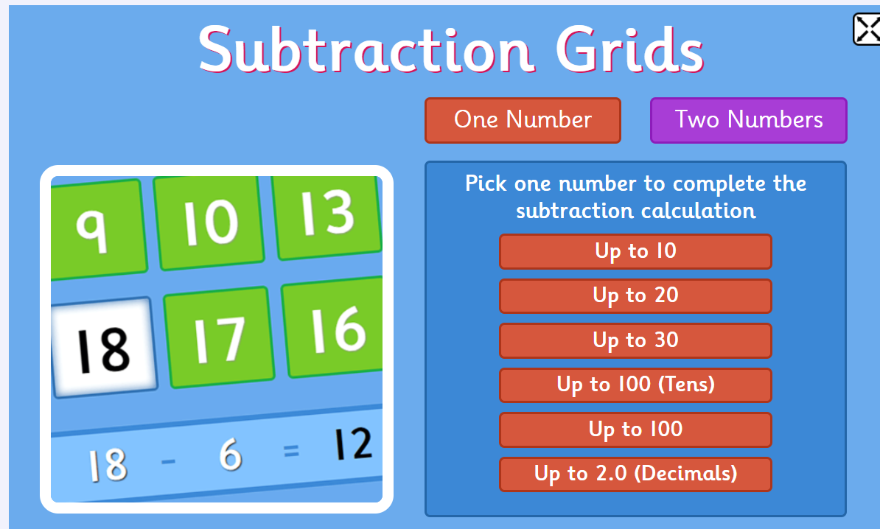
Next Week
Arithmetic test, just like we do in class and we will go through the answers together.
Now have a go at this game Subtraction Facts – choose your own level
https://www.topmarks.co.uk/maths-games/subtraction-grids

