Slide 1
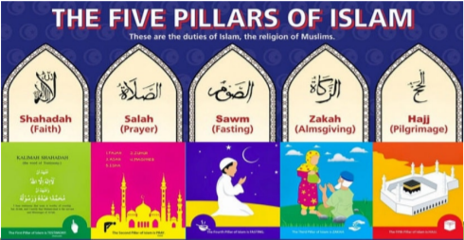

Islam
How do Muslims show community is important in practice? - 5 Pillars of Islam

Slide 2
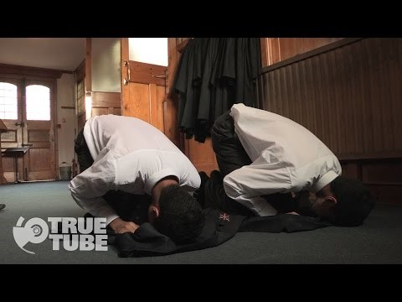
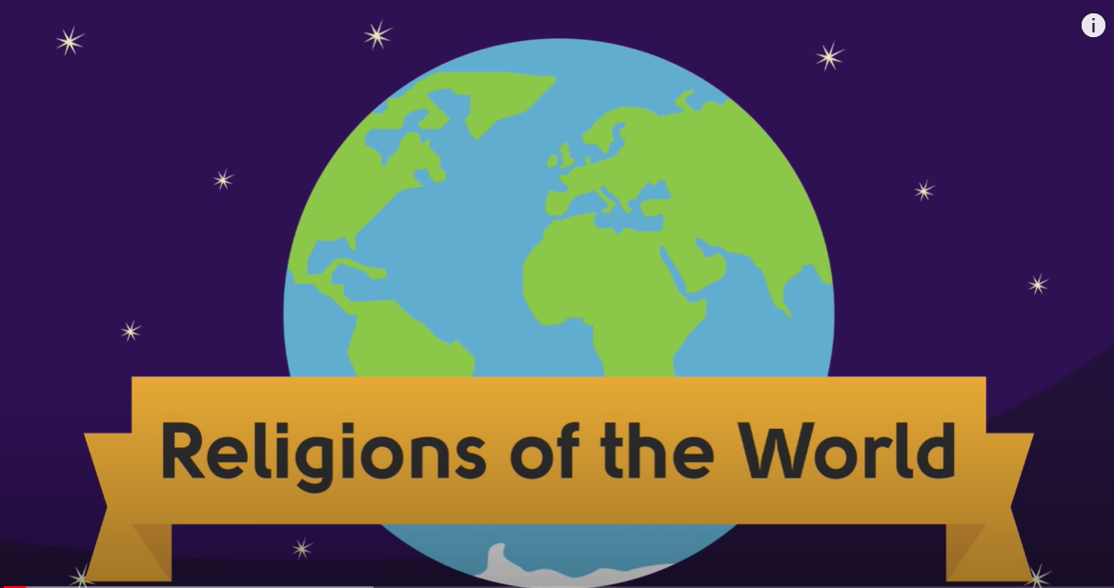
5 Pillars of Islam
Take a look at this video to remind yourself of the 5 Pillars of Islam and see what daily life is like for a Muslim teenager
https://www.youtube.com/watch?v=H9U8T8x1AhQ

Slide 3
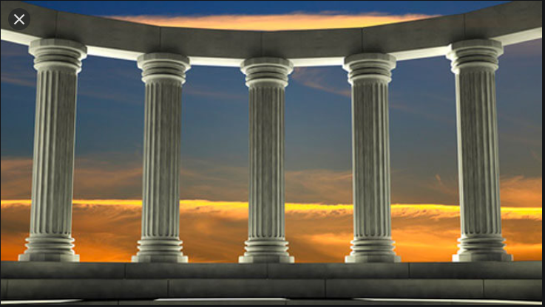
5 Pillars of Islam
Muslims believe there are 5 duties or pillars that hold their community together and their whole way of life is supported by them and they help bind the Umma (Islamic Community) together

Slide 4
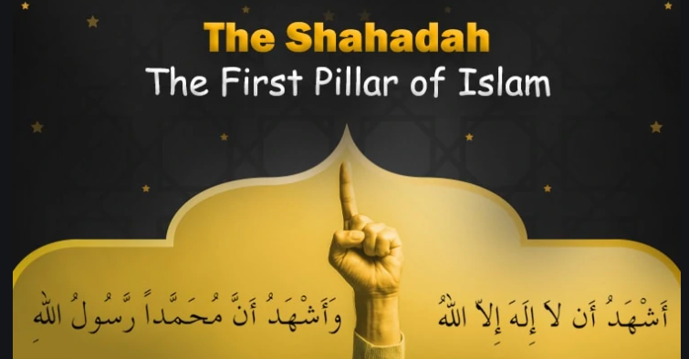

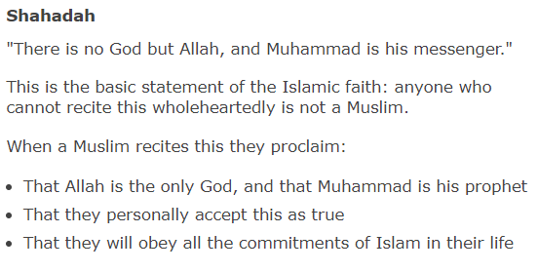
1.
It expresses the belief that there is no god but Allah and that Muhammad is the messenger of Allah.

Slide 5

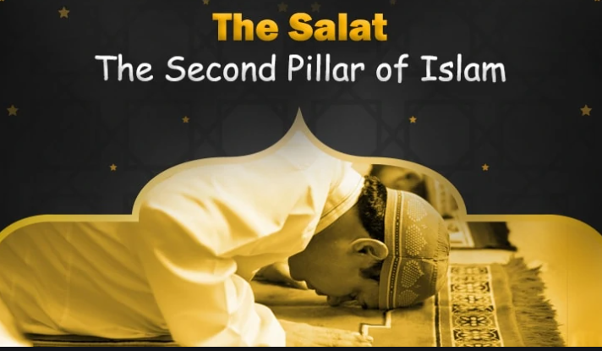
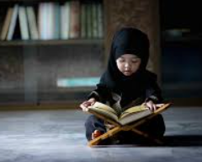
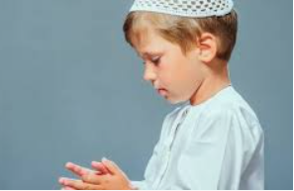
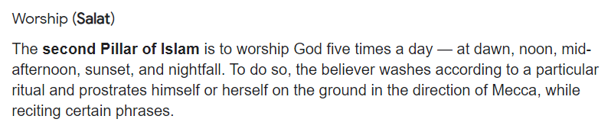
2.

Slide 6
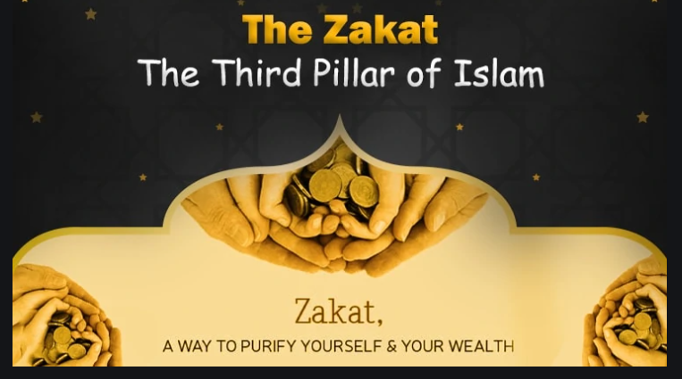
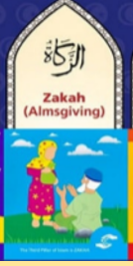
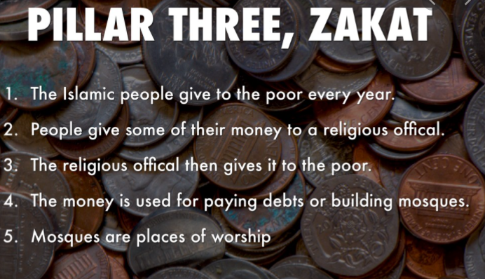
3.
Muslim practice of giving 2.5% of income

Slide 7
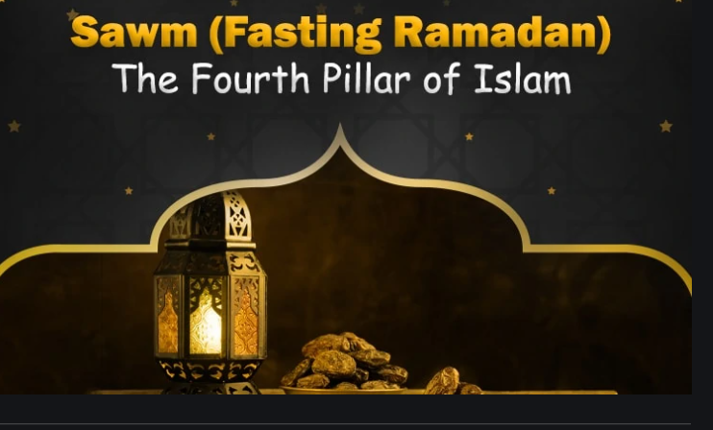
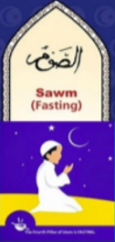
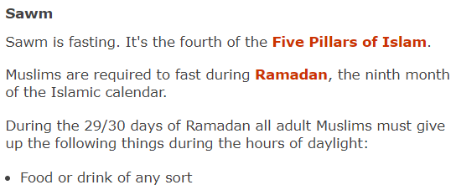
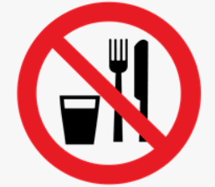
4.
http://www.bbc.co.uk/programmes/p02mwdxf

Slide 8
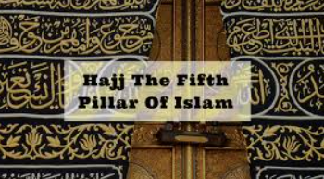
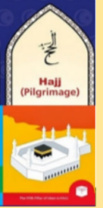
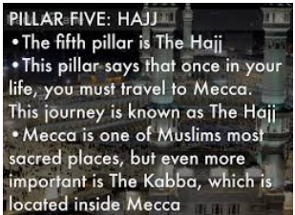
5.
Hajj is the annual pilgrimage made by Muslims to the holy city of Mecca in Saudi Arabia, in the Middle East.
It takes place during Dhu al-Hijjah, which is the final month of the Islamic calendar.
Every year, millions of Muslims from across the world make the journey to Mecca from wherever they live.
However, this year there are special rules as part of Saudi Arabia's attempts to control the spread of the coronavirus.

Slide 9
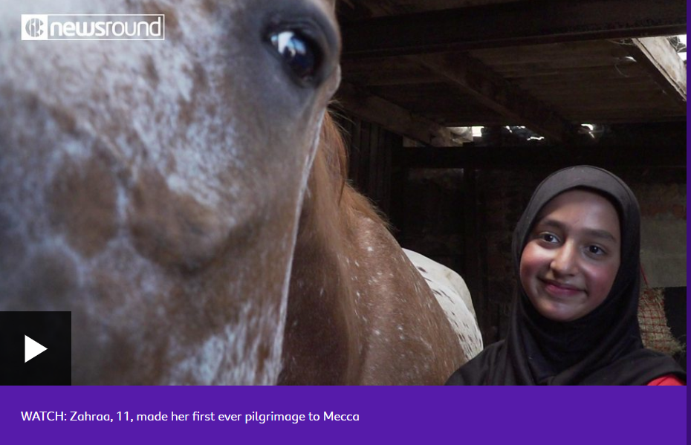
Hajj
Watch this video to learn more about Hajj
https://www.bbc.co.uk/newsround/24566691

Slide 10
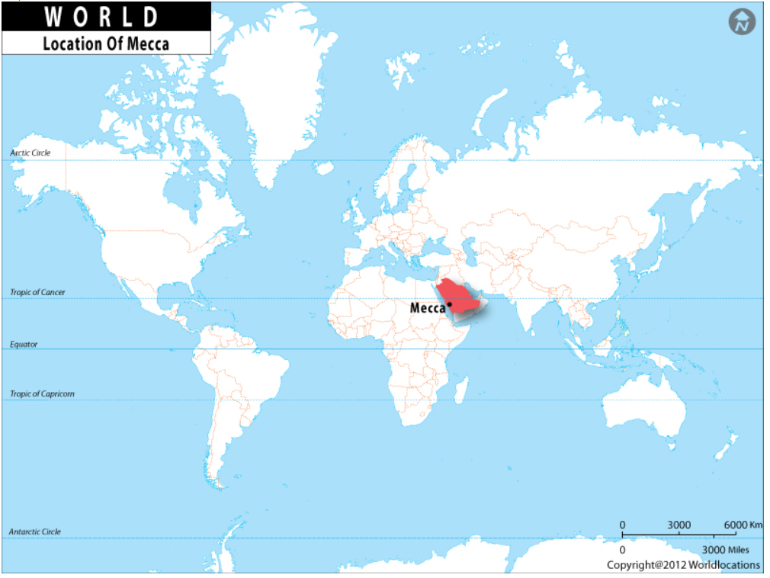
Mecca – birthplace of Islam
What do Muslims feel during Haij?
What must it be like to be in such a big crowd?
What must it be like to not think of worldly goods and be dressed similarly to others?

Slide 11
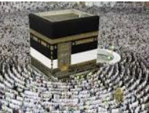
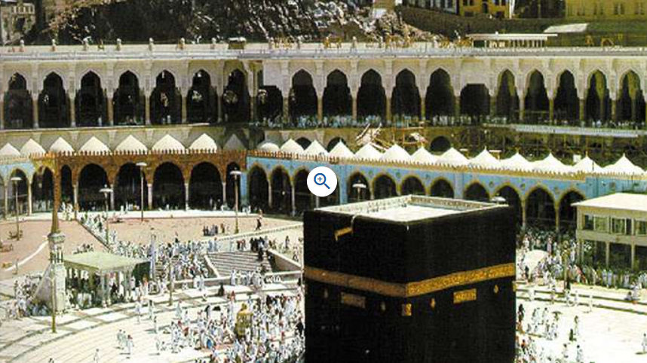
Hajj
Once a year, Muslims of every ethnic group, colour, social status, and culture gather together in Mecca and stand before the Kaaba praising Allah together.
It is a ritual that is designed to promote the bonds of Islamic brotherhood and sisterhood by showing that everyone is equal in the eyes of Allah.
The Hajj makes Muslims feel real importance of life here on earth, and the afterlife, by stripping away all markers of social status, wealth, and pride. In the Hajj all are truly equal.
The Hajjis or pilgrims wear simple white clothes called Ihram. During the Hajj the Pilgrims perform acts of worship and they renew their sense of purpose in the world.
Mecca is a place that is holy to all Muslims. It is so holy that no non-Muslim is allowed to enter.
For Muslims, the Hajj is the fifth and final pillar of Islam. It occurs in the month of Dhul Hijjah which is the twelfth month of the Islamic lunar calendar. It is the journey that every sane adult Muslim must undertake at least once in their lives if they can afford it and are physically able.

Slide 12
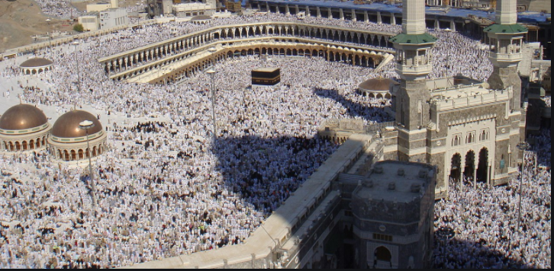
Crowds at Hajj

Slide 13
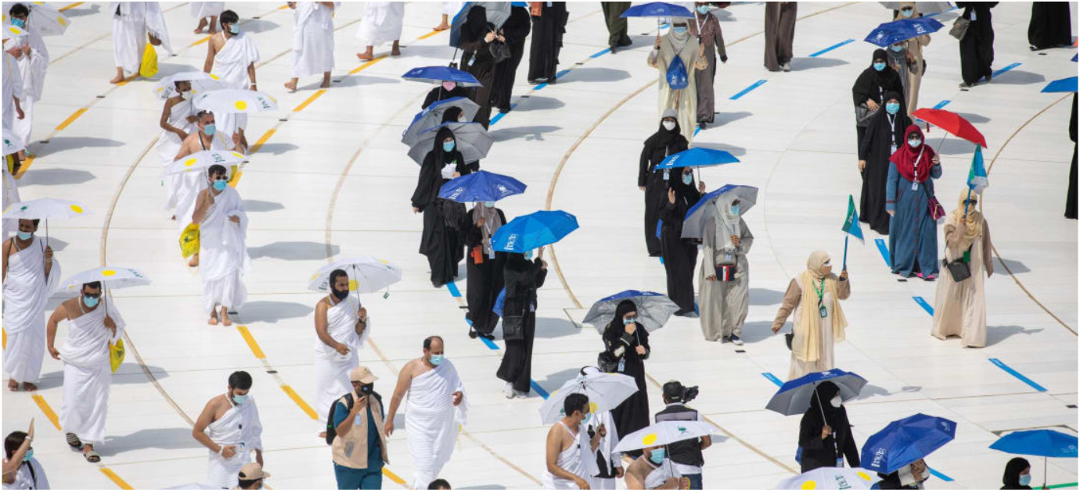
HAJJ 2020
- ' Hajj begins -- with 1,000 pilgrims, rather than the usual 2 million

Slide 14
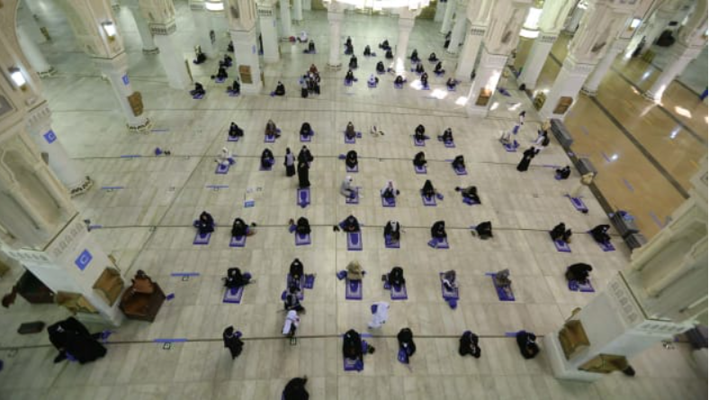

Slide 15
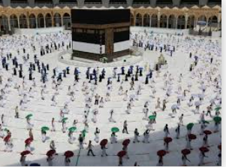
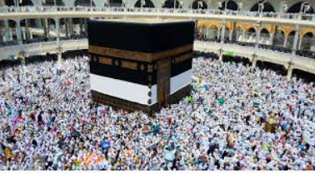
A year apart!

Slide 16
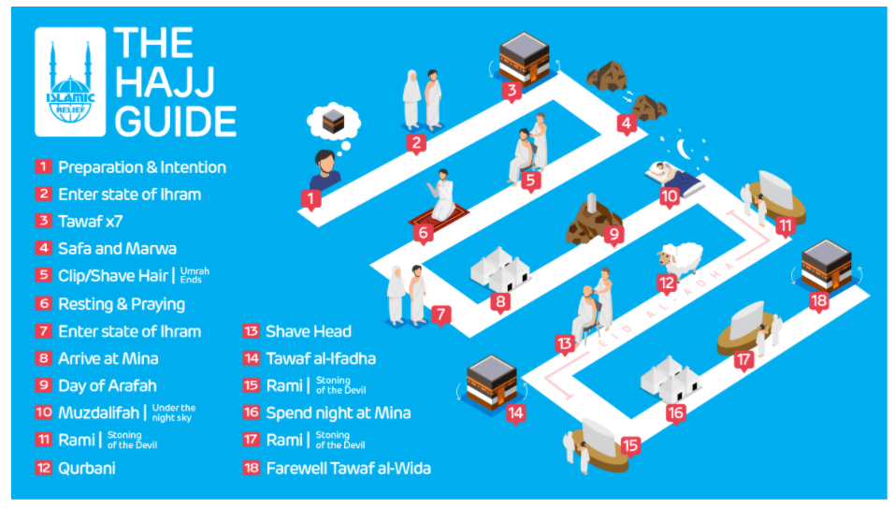

Slide 17
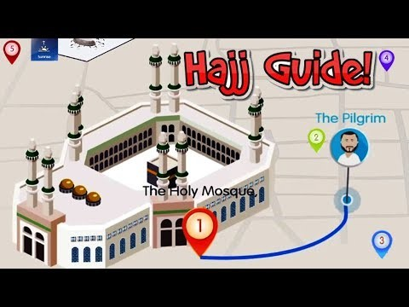
How to Perform Hajj-Step By Step Hajj Guide
Hajj 2021 will begin in the evening of
Saturday
, 17 July
and ends in the evening of
Thursday
, 22 July
https://www.youtube.com/watch/Hb-ngN7pVyw

Slide 18
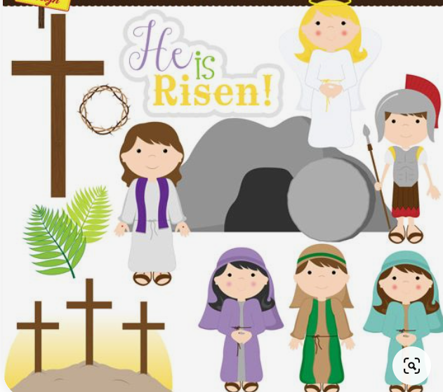
Next Lesson –
Explore the concept Salvation and look at the Easter Story in more detail

Slide 19
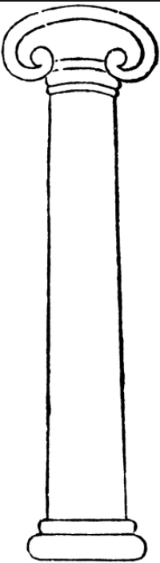
Activity
Draw/write about the last 3 Pillars of Islam – Zakat, Sawm, Hajj

