Slide 1

Starlings Science Home Learning
Friday 12th February2021

Slide 2
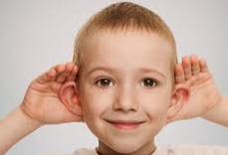

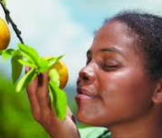
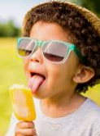
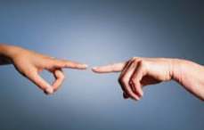

Lets get our brains working and see what we can remember?
Can you tell me what the five senses are?
hearing
ears
sight
Eyes
smell
taste
touch
nose
tongue
skin

Slide 3
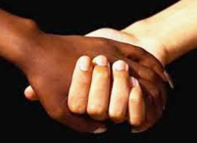
In today’s lesson, we will be learning about our sense of touch.
What happens when we touch something?
What is touch?
What feelings do we get when we touch something?
.
Is it only our hands that we touch with?

Slide 4
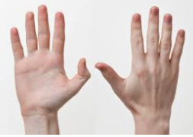
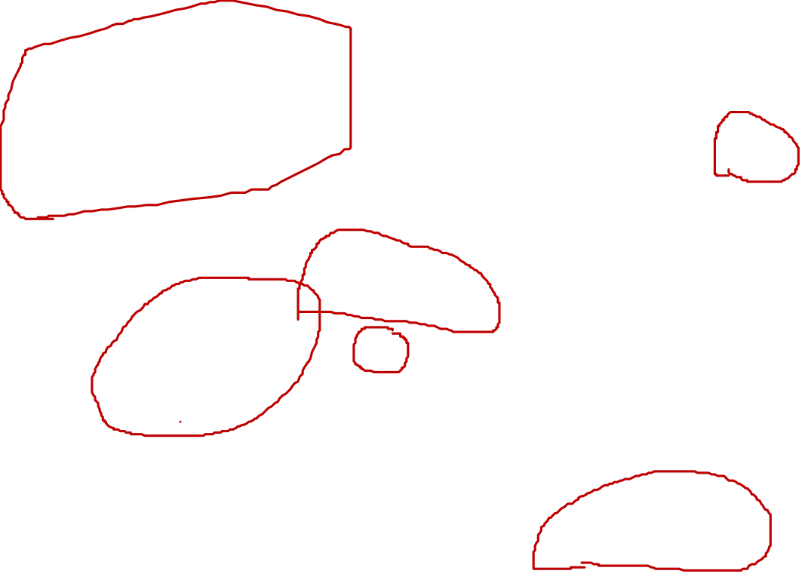
Can you name the different parts of your hand?
fingers
thumbs
nails
palm
wrists
knuckle

Slide 5
Message for parents
The next activity requires the children to have a number of items that they need to identify using their sense of touch. A box is great but the items can also be put under a blanket.

Slide 6
So starlings we are going to explore our sense of touch.
We are going to use only our hands and our sense of touch to identify different items that are hidden.

Slide 7
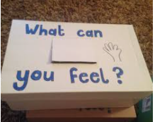
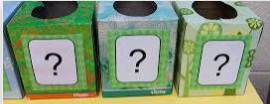
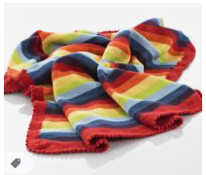
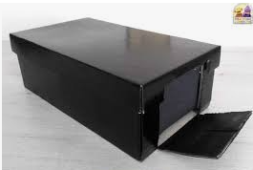
First of all, can you find a box that you can put your items in?

Slide 8
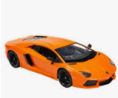
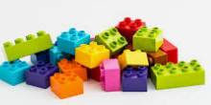
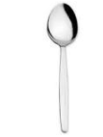
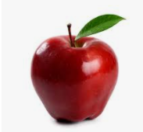

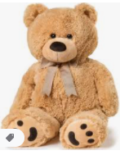
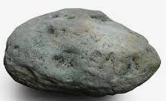
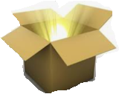
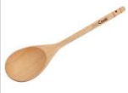
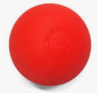
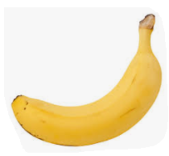

Slide 9
What can you feel?
Step 1 – Place your first object in your box
Step 2 – Put your hands into the box and tell your grown up what you can feel
Science words to use: soft or hard, smooth or rough, squashy, stretchy
Maths words: How many sides does your item have? Is it a sphere or has it got more sides?
What other questions could you ask to help you identify the item?
Step 3 – Swap with your grown up. Can they feel the object inside the box?
Step 4 – Change your object and start your describing work again.

Slide 10
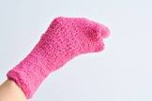
Challenge your senses
Can you put a sock over your hand and feel some of your objects again?
Is it harder or easier to feel and describe your object?
Why?

Slide 11
Well Done
Starling Superstars

