Slide 1

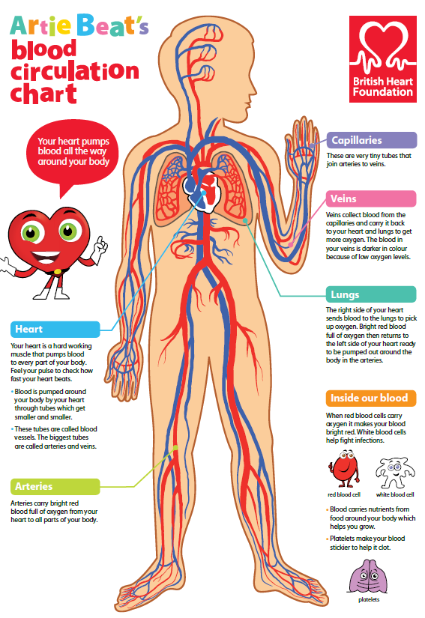


SCIENCE
Diet & Lifestyle
Lesson 4

Slide 2
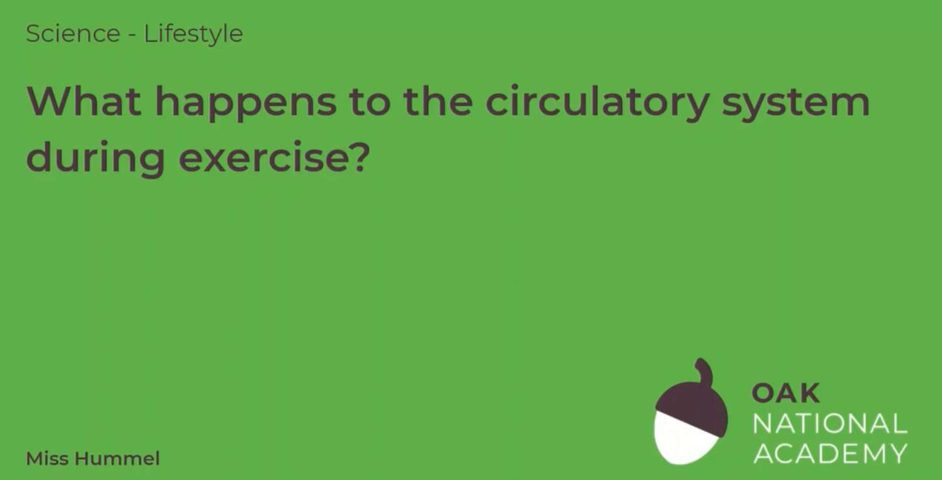
What happens to the circulatory system during exercise?
In today’s lesson, we will be learning all about the circulatory system and the effect exercise has on this system. First, we will discuss what the circulatory system is. Then, we will identify how the circulatory system connects to the muscles. We will then be measuring our own heart rate and conducting a small exercise experiment where we will compare our resting heart rate to our heart rate after completing an exercise.
Click on the following link to watch and take part in the following video lesson. Start with the quiz and the recap of last week’s learning.
https://classroom.thenational.academy/lessons/what-happens-to-the-circulatory-system-during-exercise-c8w62c
Play the audio first before clicking on the link to the lesson.

Slide 3
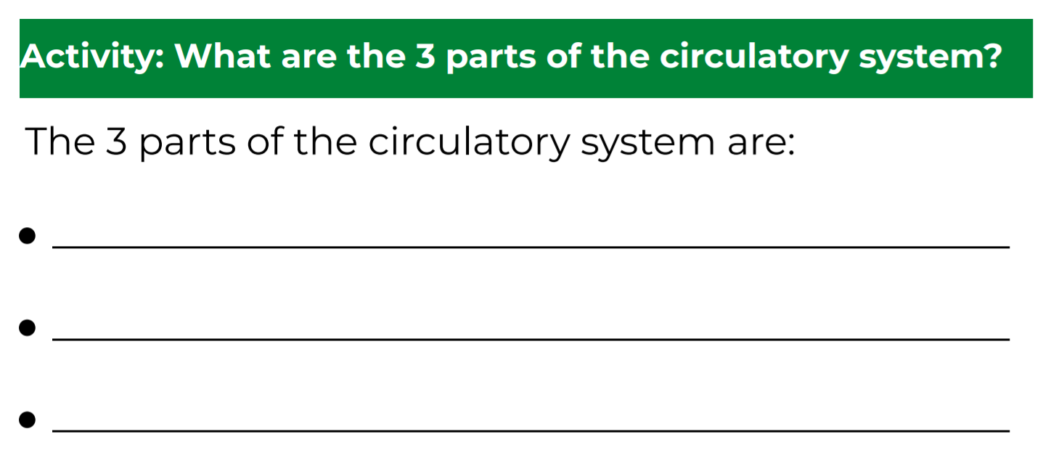
What happens to the circulatory system during exercise?
Click on the following link to complete the activities for today’s lesson:
https://classroom.thenational.academy/lessons/what-happens-to-the-circulatory-system-during-exercise-c8w62c?step=3&activity=worksheet

Slide 4
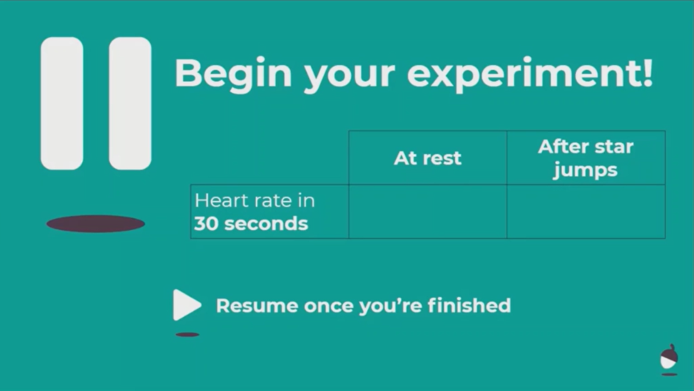
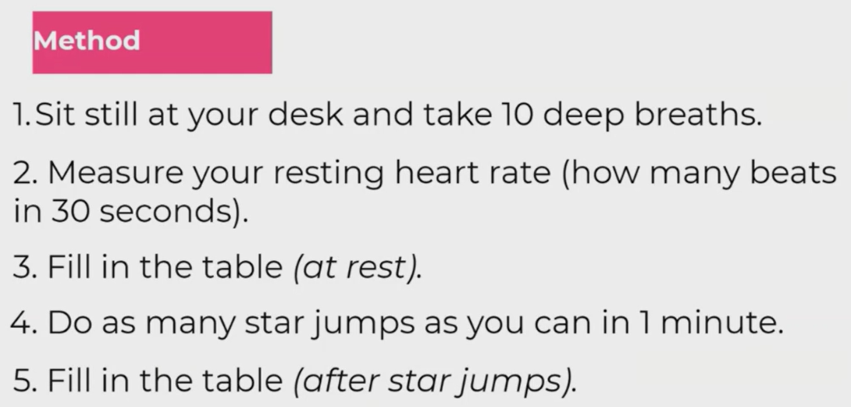
EXPERIMENT
Have a go at the experiment finish the lesson with the quiz at the end!

