Slide 1


Starlings Maths Home Learning
Thursday 11th February

Slide 2
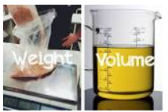
WEIGHT & VOLUME LESSON 3
Good Morning Starlings
In this lesson, we are still thing about weight and you are going to compare and order objects by their weight.
Remember that we have to use the same sized objects on one end of the scale to weigh correctly.

Slide 3
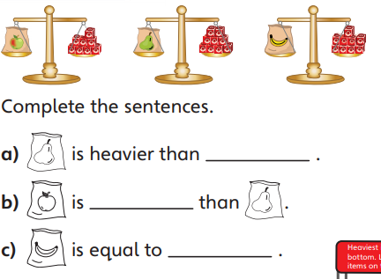

Slide 4
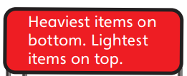
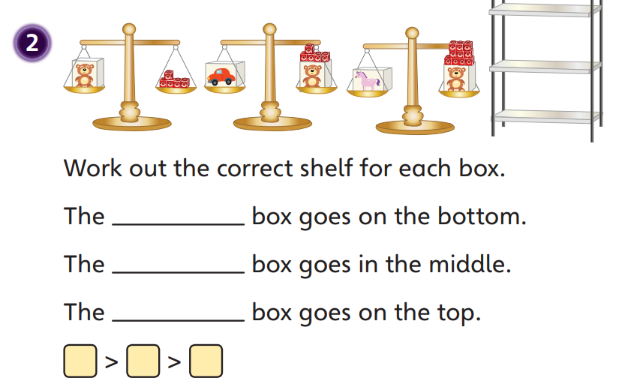

Slide 5
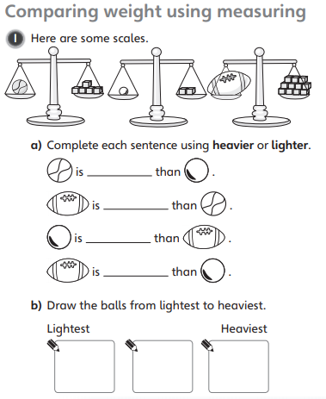
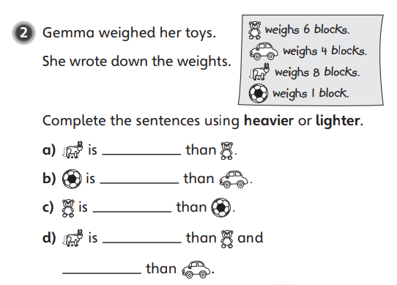
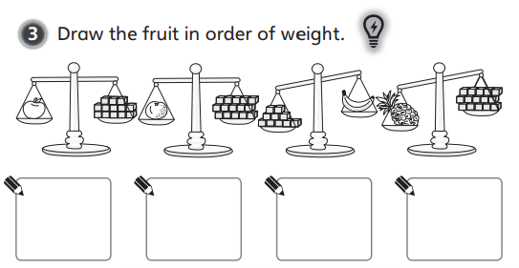

Slide 6
