Slide 1






English
Thursday 11th February 2021

Slide 2
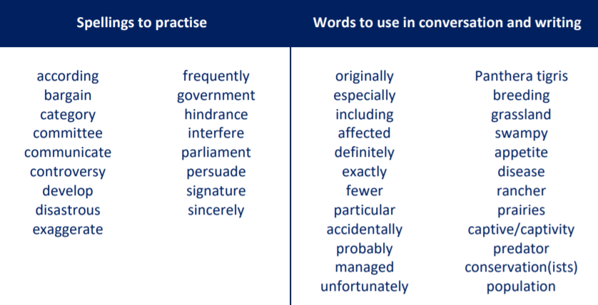
Main outcome of the session:
To make an informative poster which explains the problems faced by black rhinos.
These are the spelling words that go along with this unit of work exactly like when we’re in school.

Slide 3
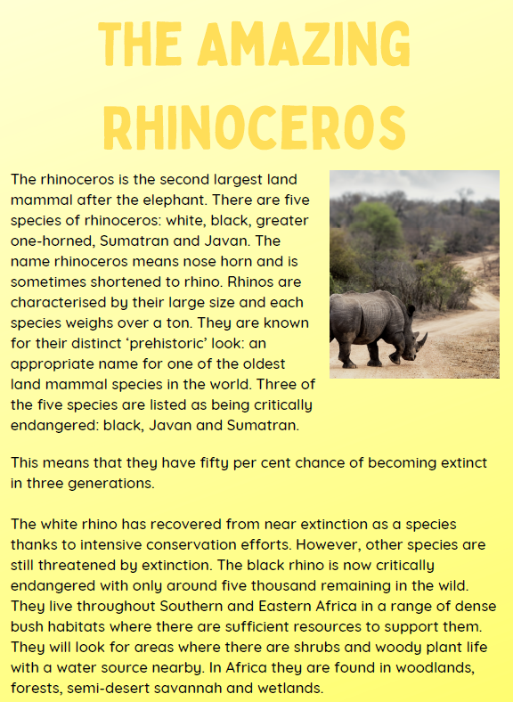
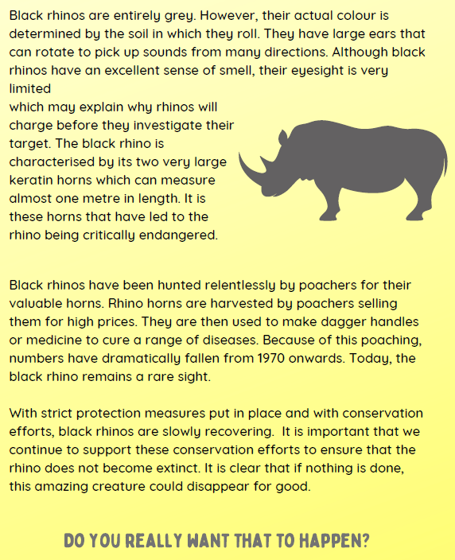
Activity 1
Highlight the important information about why rhinos have become endangered in paragraphs 4 and 5.

Slide 4


Activity 2
Practise writing sentences which use modal verbs and brackets or dashes about the problems rhinos face.
Remember…
Brackets are used to add extra information in a sentence – an informal comment, extra detail or a list of items
e.g. I loved France (especially the food!) and I’ll definitely visit again.
Dashes are used in a similar way but are useful for adding additional comments at the end of the sentence e.g. I visited the beach in Wales – it was stunning!

Slide 5
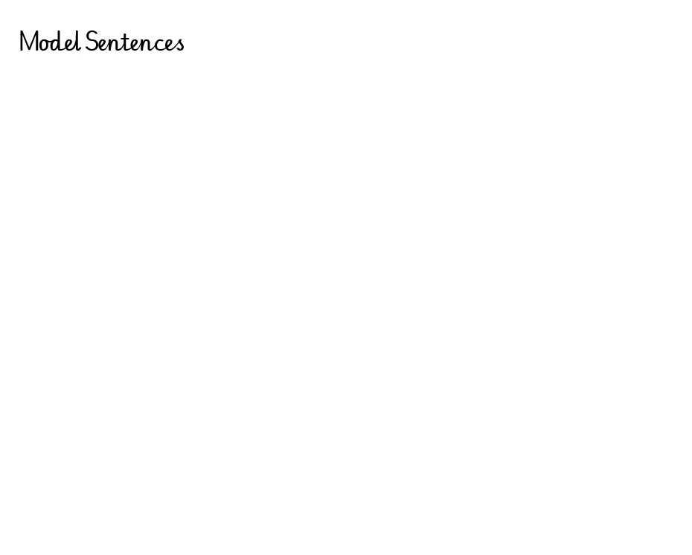
Activity 2
Practise writing sentences which use modal verbs and brackets or dashes about the problems rhinos face.

Slide 6

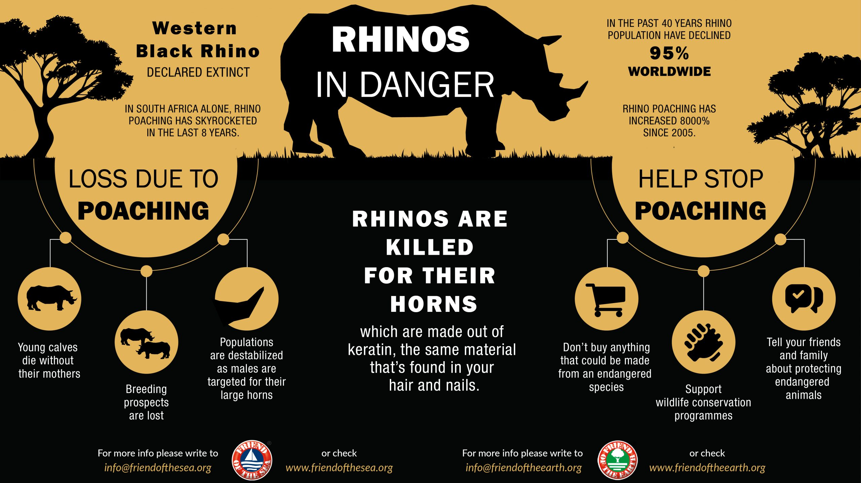

Activity 3
Use your sentences to create a poster about black rhinos and why people should protect them.
Audience: the audience for your poster is villagers in Southern Eastern Africa – it will be displayed on the community notice board.

Slide 7

‘The Explorer’ by Katherine Rundell, read by Mrs Whittingham
Please follow this link to see Mrs Whittingham read our new class novel.
https://youtu.be/88nR2JM9oC8

