Slide 1


English
Date: 11.02.21
Week 6 – Lesson 4
The Curiosity Shop

Slide 2
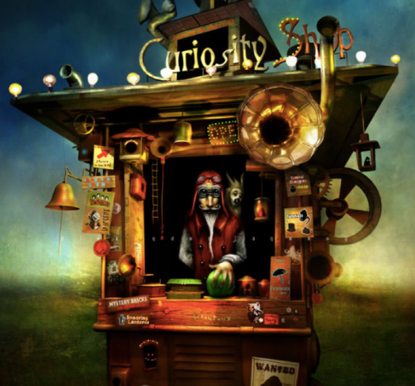

Click on the sound button to hear this slide read to you.
Let’s read the story of the Curiosity Shop again:
He drummed his long, wiry fingers on the counter, waiting for his next customer.
The Curiosity Shop attracted the strangest of visitors. There was certainly more to the shop that met the eye, and people travelled from far and wide to see the bizarre collection.
Mr. Obadiah (the owner) had resided behind the counter of this wondrous shop for as long as anyone could remember.

Slide 3
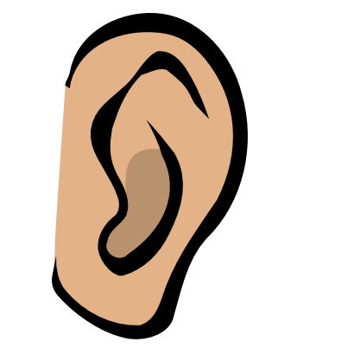

Click on the sound button to hear activity 1 read to you.
Activity 1:
What can you see?
What sounds might you hear at the shop?
Jot down some ideas for the above questions. You might want to split your page in two and record what you can see on one side and what you might hear on the other.

Slide 4
Click on the sound button to hear activity 2 read to you.
Activity 2:
Imagine you are out walking one day (maybe in a forest or somewhere deserted), and you come across the Curiosity Shop. Write a diary entry describing what you saw. Think about the following:
Set the scene
Describe what you first saw/heard while out walking
Describe what you saw/heard as you got closer to the Curiosity Shop
Did Mr. Obadiah (the shop owner) say anything to you?
What was he selling? Did you see anything strange?
Did you buy anything?
WAGOLL on the next slide

Slide 5

Click on the sound button to hear this slide read to you.
Include:
Set the scene
Describe what you first saw/heard while out walking
Describe what you saw/heard as you got closer to the Curiosity Shop
Did Mr. Obadiah (the shop owner) say anything to you?
What was he selling? Did you see anything strange?
Did you buy anything?
Dear Diary…
You won’t believe what happened to me yesterday! I was out walking in the forest (like I always do) when I could hear the faint sound of bells chiming. My instinct was to follow the noise so that’s exactly what I did.
I felt like I had been walking forever, when all of a sudden I saw a small, wooden hut through a gap in the trees. At first I thought it was abandoned but as I got closer, I could see flashing lights surrounding the roof and the sound of trumpets and bells became clearer and louder. I cautiously made my way to the front of the hut and that’s when I saw one of the most peculiar sights I have ever set my eyes on…

Slide 6
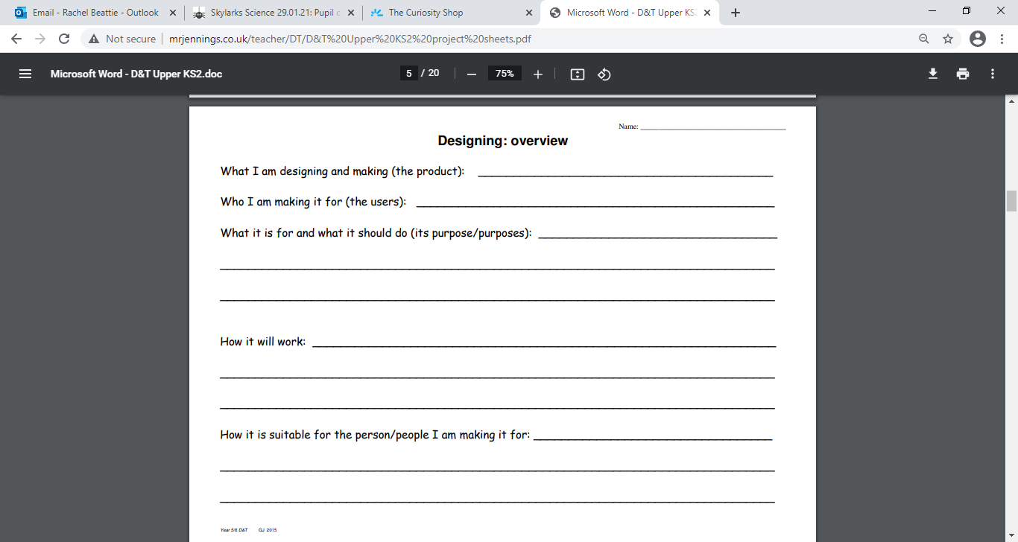
Click on the sound button to hear activity 3 read to you.
Activity 3 (Optional):
Design a new product for the curiously shop.
Draw and label it
Name the product
Describe what it is for
Describe how it will work
You can download and print this template from our blog or you can simply draw out your own poster.

Slide 7

Click on the sound button to hear the spellings for this week’s quiz.

Slide 8
Answers:
confidence
evidence
silence
independence
Click on the sound button to hear the spelling quiz answers.

