Slide 1






English
Wednesday 10th February 2021

Slide 2
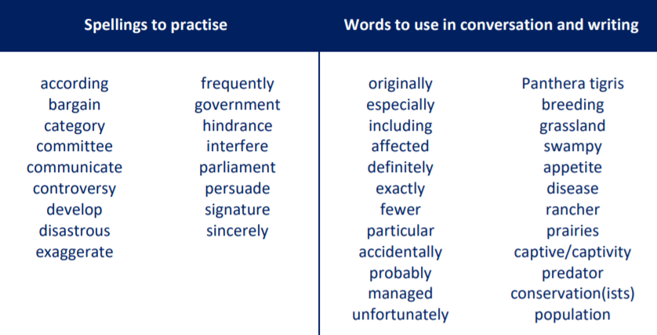
Main outcome of the session:
To be able to understand the information in the text and answer key questions.
These are the spelling words that go along with this unit of work exactly like when we’re in school.

Slide 3
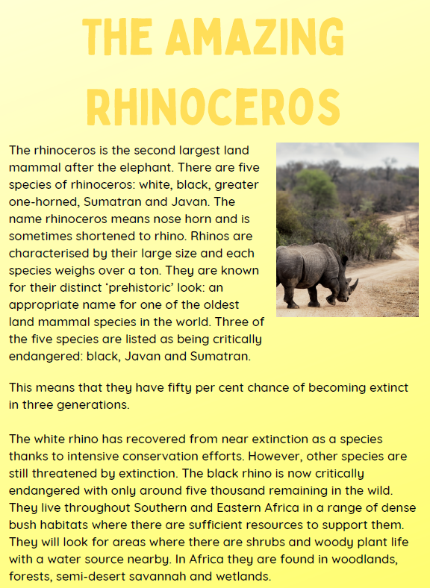
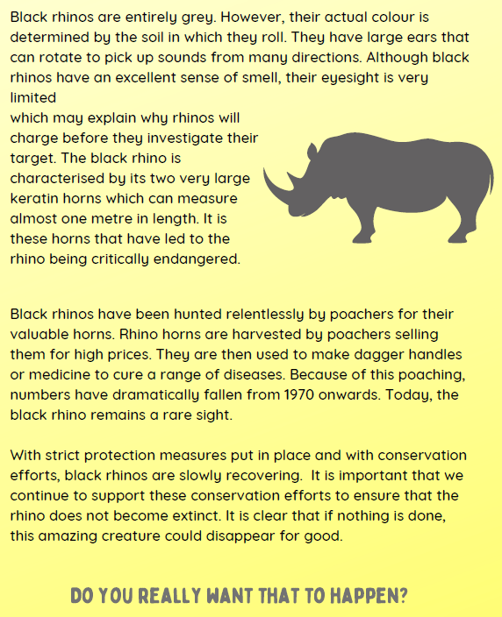
Activity 1
Read ‘The Amazing Rhinoceros’ text on this slide – I have also attached this to our class blog.

Slide 4
Activity 2
Highlight or underline any tricky words that you don’t know the meaning of.
Discuss with an adult, or on our class discussion or just simply look then up in the dictionary or an online dictionary:
https://www.dictionary.com/browse/online-dictionary

Slide 5
Activity 3
Go back through ‘The Amazing Rhinoceros’ text and summarise five key facts about black rhinos.
Top tips for summarising:
• Highlight key words
• Don’t copy out whole sentences
• Read for meaning and then write your own fact
• Set yourself word limits e.g. summarise paragraph 1 to ten words

Slide 6
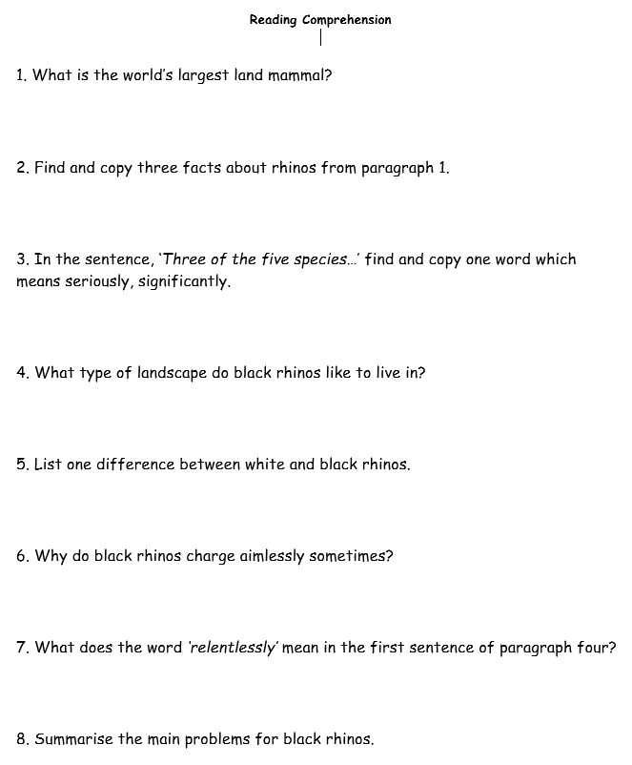
Activity 4
Complete the reading comprehension questions about black rhinos.
I have also attached this document to our class blog.
Once you have completed the questions continue on to the next slide/move along the video to hear me go through the answers.

Slide 7
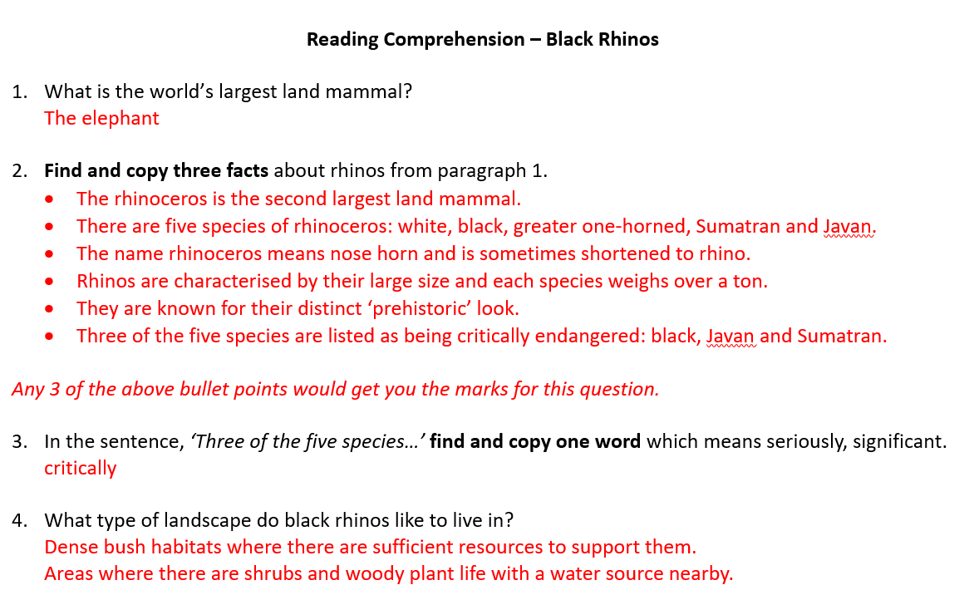
Answers

Slide 8
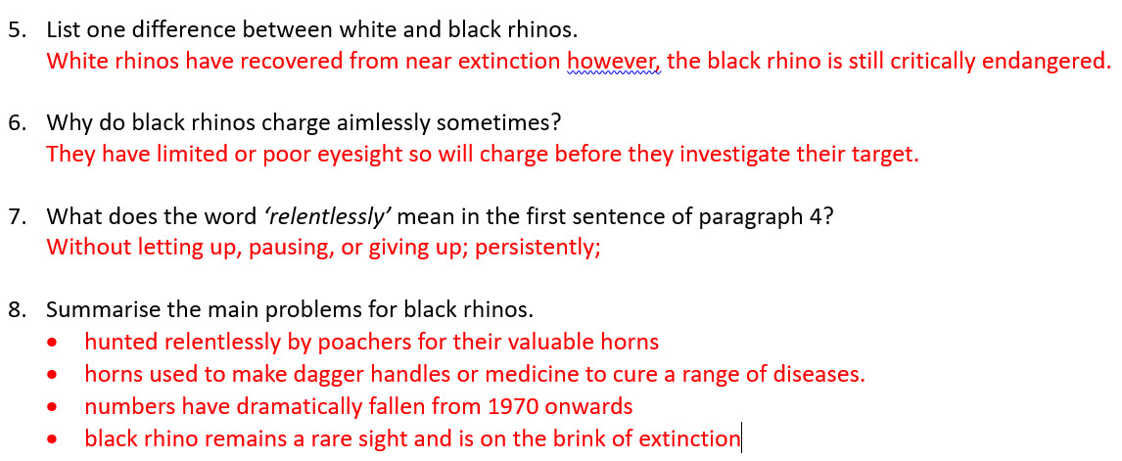
Answers

Slide 9

‘The Explorer’ by Katherine Rundell, read by Mrs Whittingham
Please follow this link to see Mrs Whittingham read our new class novel.
https://youtu.be/AySCXXHUtNo

