Slide 1

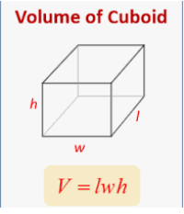

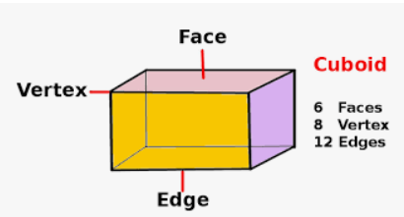

Mathematics
Date: 10.02.21
Volume of a Cuboid

Slide 2
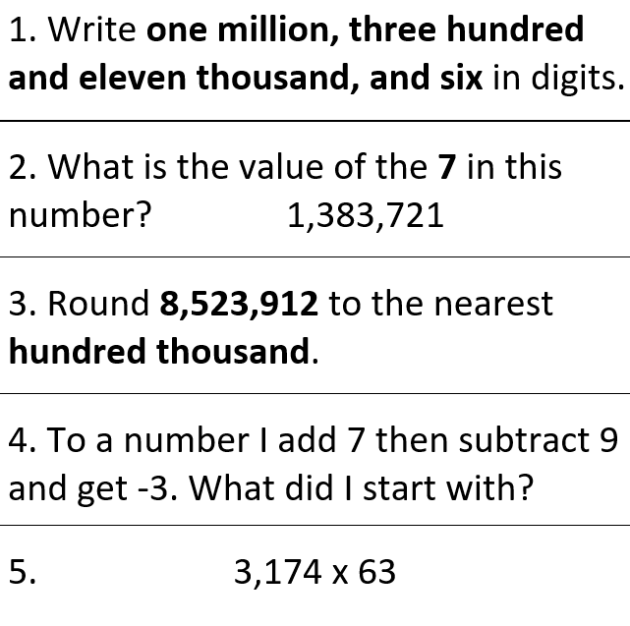

Starter Activity
? + 7 – 9 = minus 3

Slide 3

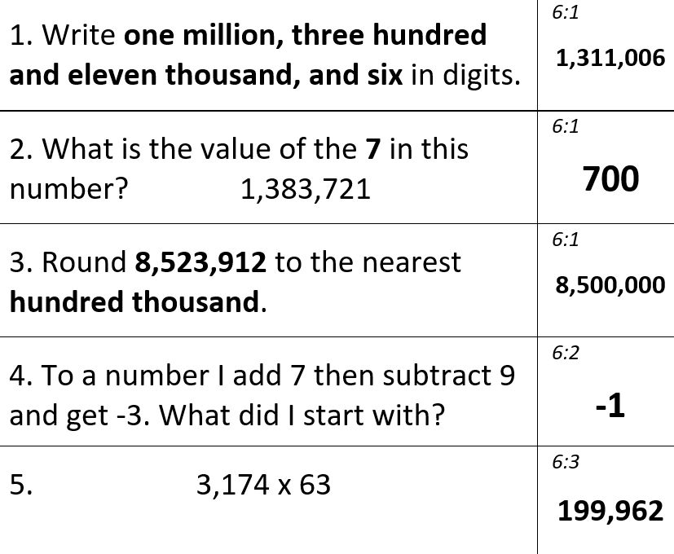
Starter Activity

Slide 4
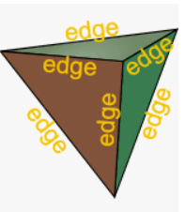
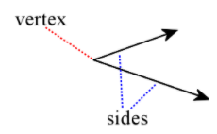
Vertex = where 2 lines/rays meet
Edge = where 2 faces meet
What is a cuboid?

Slide 5

Method/Formula

Slide 6
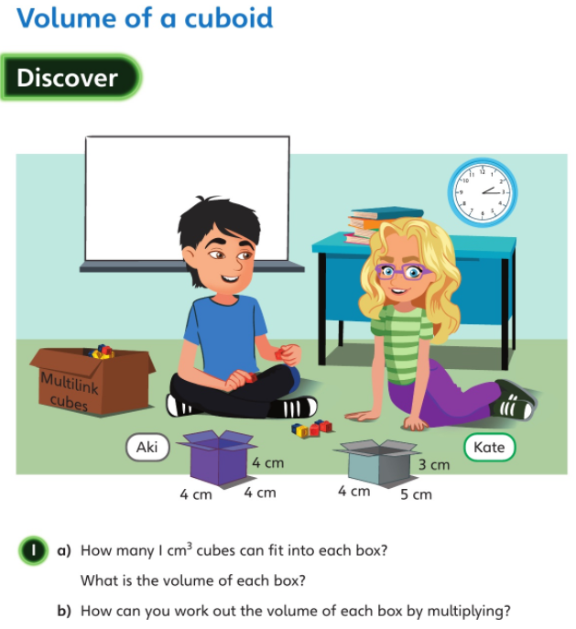


Slide 7
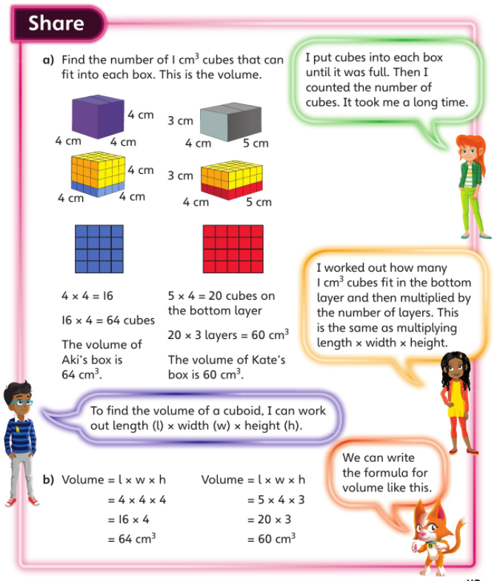

Slide 8
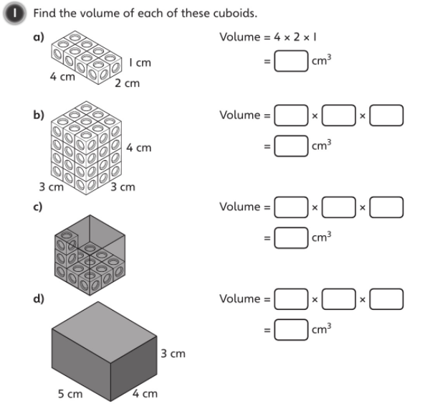


Slide 9

Think about the 2 methods used in our Discover/Share part of the lesson.

Slide 10
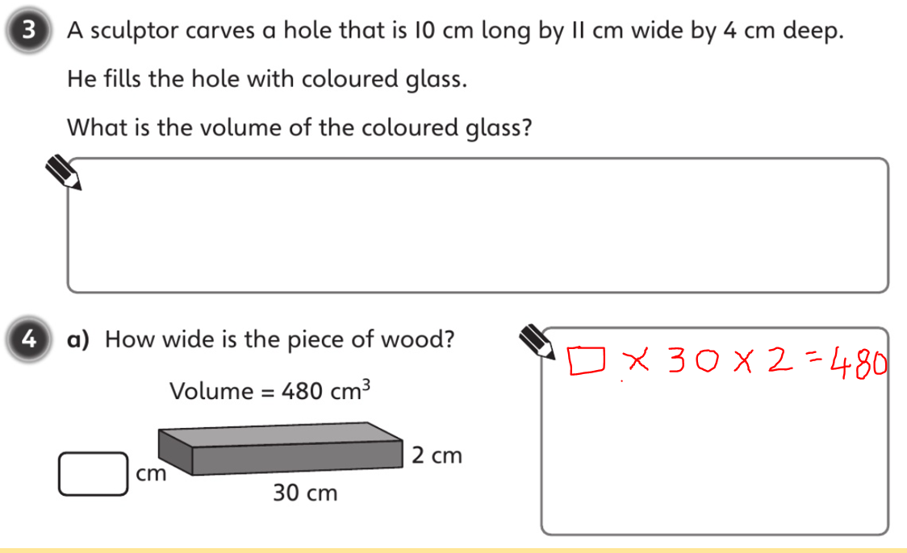

Slide 11
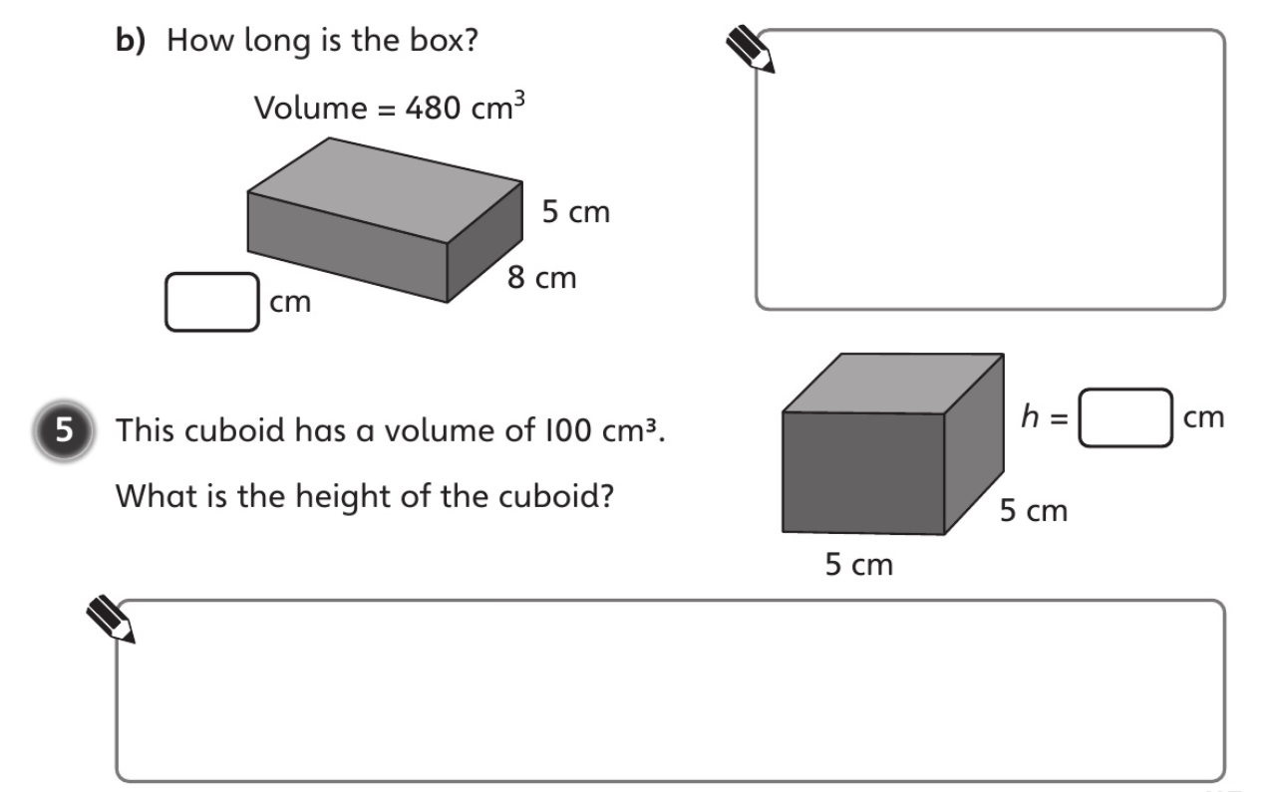

Slide 12
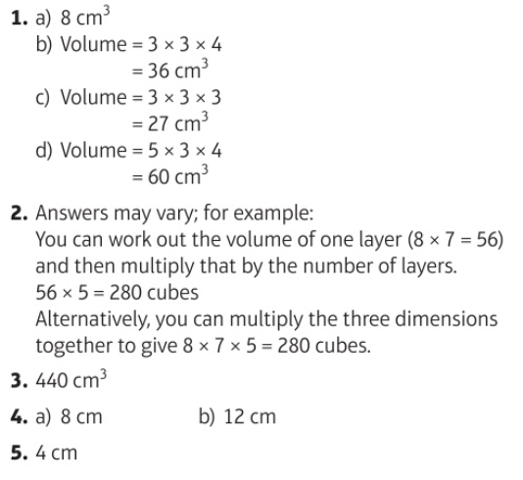

Slide 13
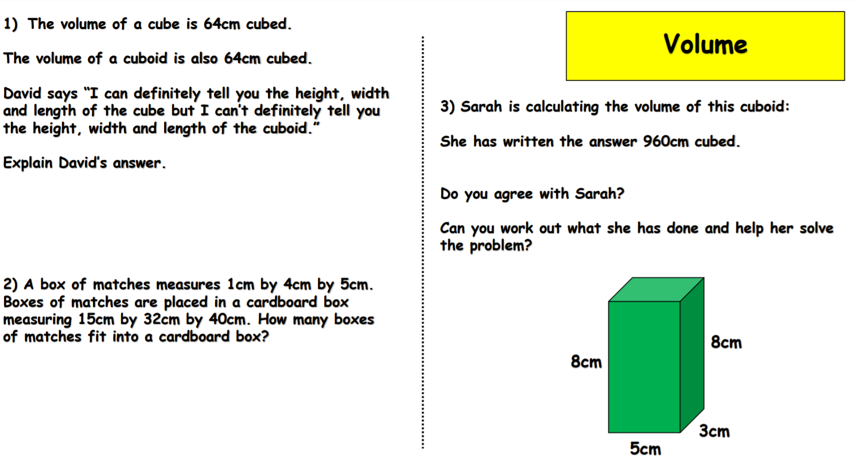
Challenge

Slide 14
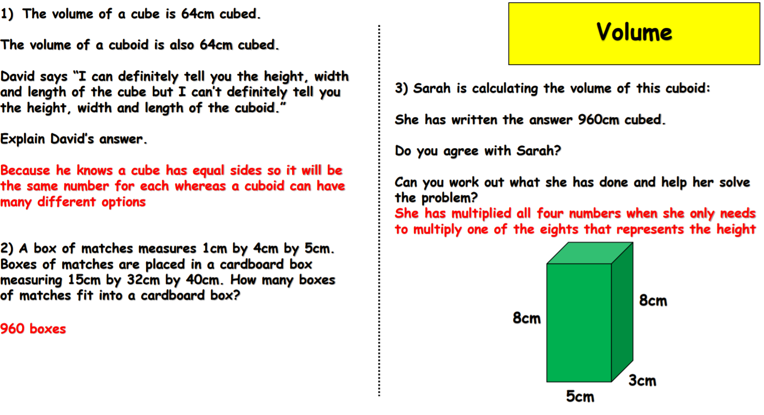
Challenge

