Slide 1


English
Date: 10.02.21
Week 6 – Lesson 3
The Curiosity Shop

Slide 2
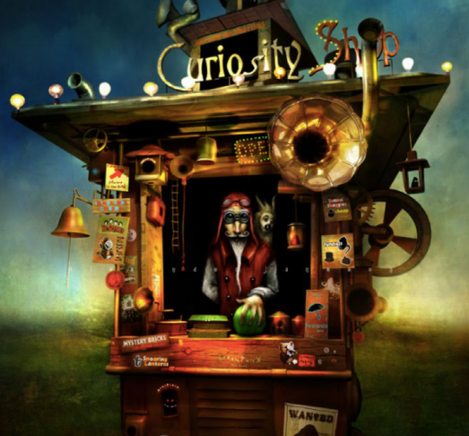

Click on the sound button to hear this slide read to you.
Story starter:
He drummed his long, wiry fingers on the counter, waiting for his next customer.
The Curiosity Shop attracted the strangest of visitors. There was certainly more to the shop that met the eye, and people travelled from far and wide to see the bizarre collection.
Mr. Obadiah (the owner) had resided behind the counter of this wondrous shop for as long as anyone could remember.

Slide 3
Click on the sound button to hear this slide read to you.
Question Time:
What kind of man do you think Mr. Obediah is?
What do his clothes tell you about him?
Why does he hold one hand behind his back?
What do you think the Curiosity Shop is? Is it just a shop?
What do you think the shop has inside?

Slide 4

Activity 1:
Click on the sound button to hear activity 1 read to you.
Here is a short paragraph about Mr. Obadiah and his curiosity shop. The paragraph is not very exciting – it doesn’t use any fronted adverbials, detailed descriptions or figurative language devices (e.g. simile, alliteration, personification).
Can you up-level this paragraph to include some of these things?
You can change the vocabulary, or even the order of the sentences, if you need to.
Mr. Obadiah was a tall man. He wore a jacket and some goggles. He tapped on the counter. He sold many things. On his shoulder was a creature. There were ladders in his shop. Lots of people came to his shop.
Mr. Obadiah was a tall man with long, skinny fingers and a moustache framing his face. He wore a crimson, sleeveless jacket and some round goggles which made his eyes look as small as pebbles. As he waited for customers, he tapped patiently on the counter.

Slide 5



