Slide 1


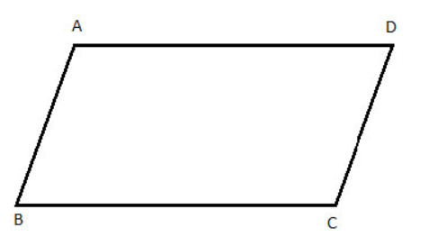
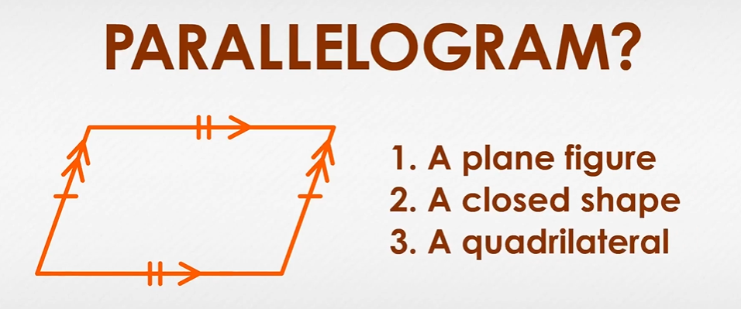

Mathematics
Date: 09.02.21
Area of a Parallelogram

Slide 2
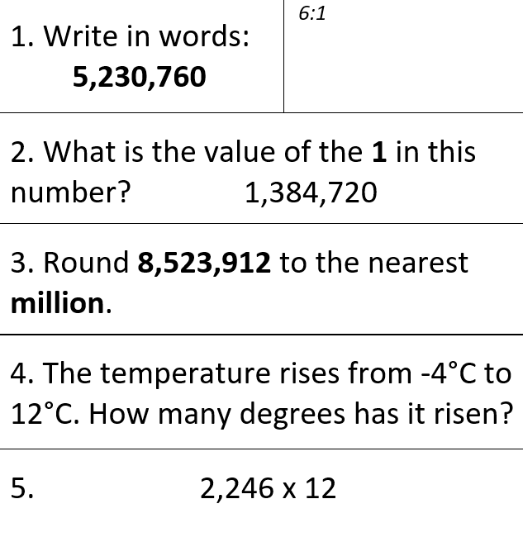
Starter Activity

Slide 3

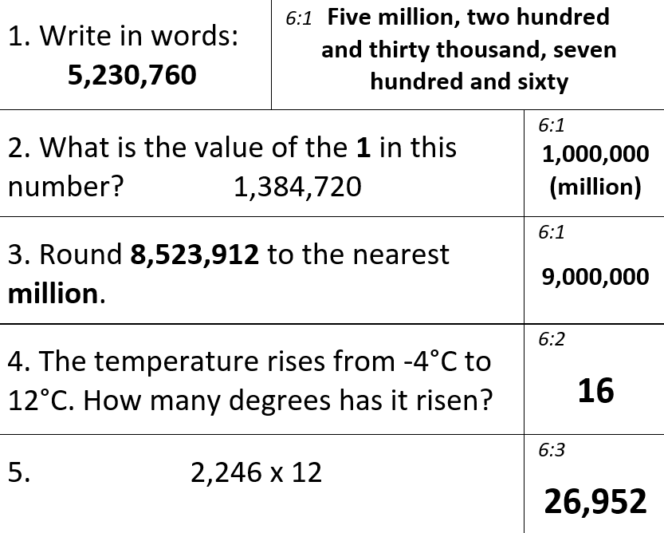
Starter Activity

Slide 4
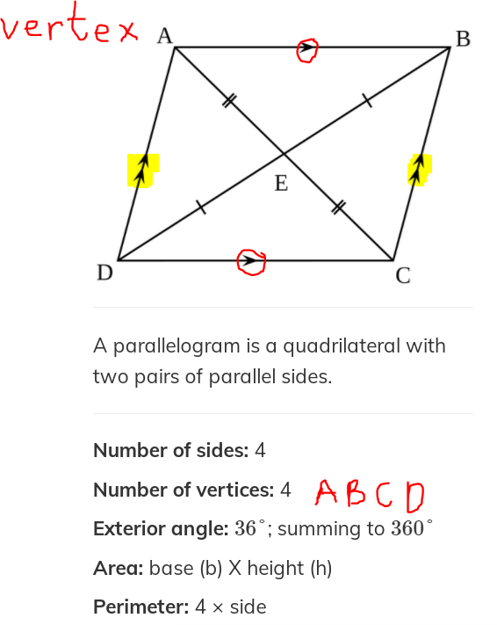
What is a parallelogram?
AB, BC, CD, DA
Objective today

Slide 5
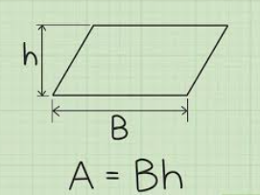
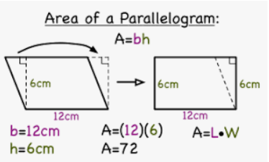
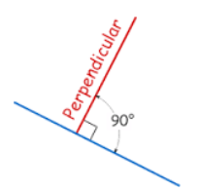
Method/Formula
A = area
h = perpendicular height
b = base

Slide 6
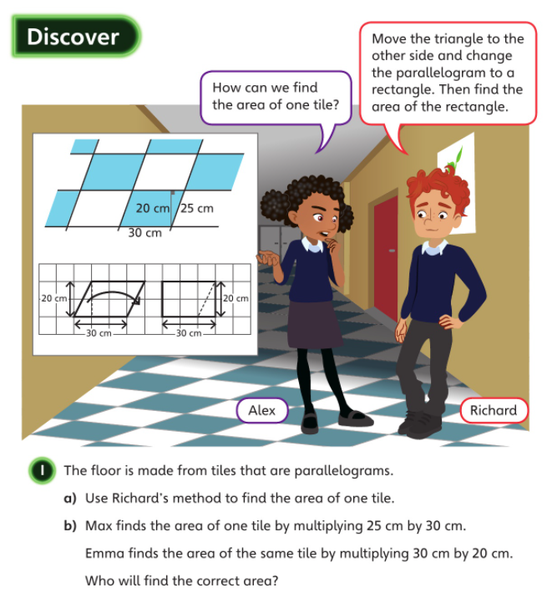

Area of a parallelogram
Base x height

Slide 7
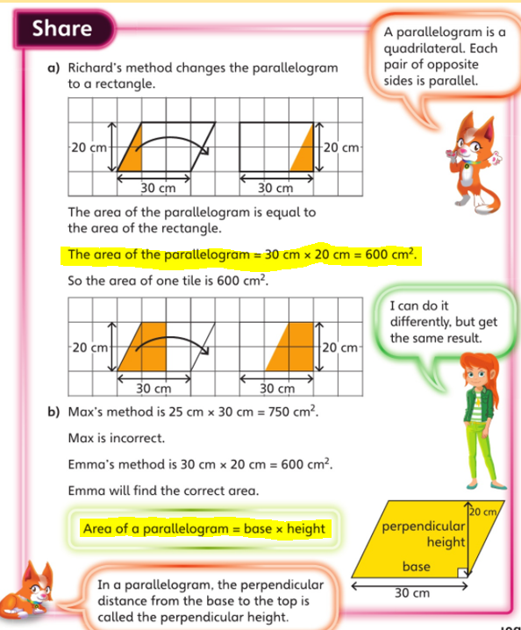
Area of a parallelogram
Base x height

Slide 8
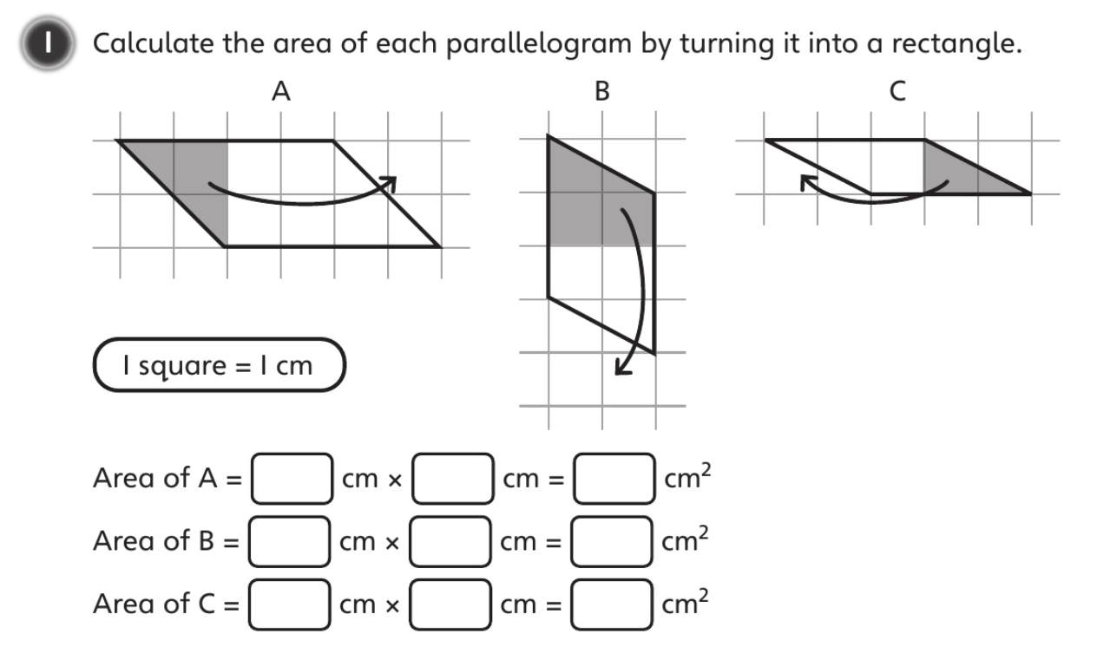



Slide 9
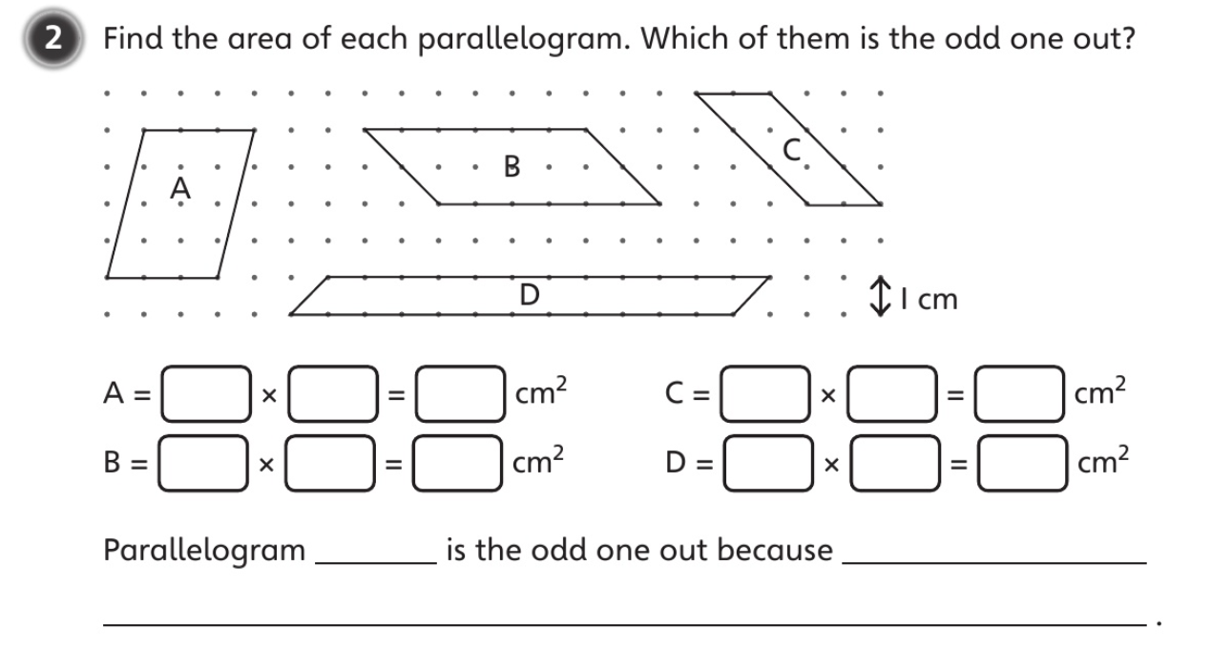
Area of a parallelogram
Base x height

Slide 10
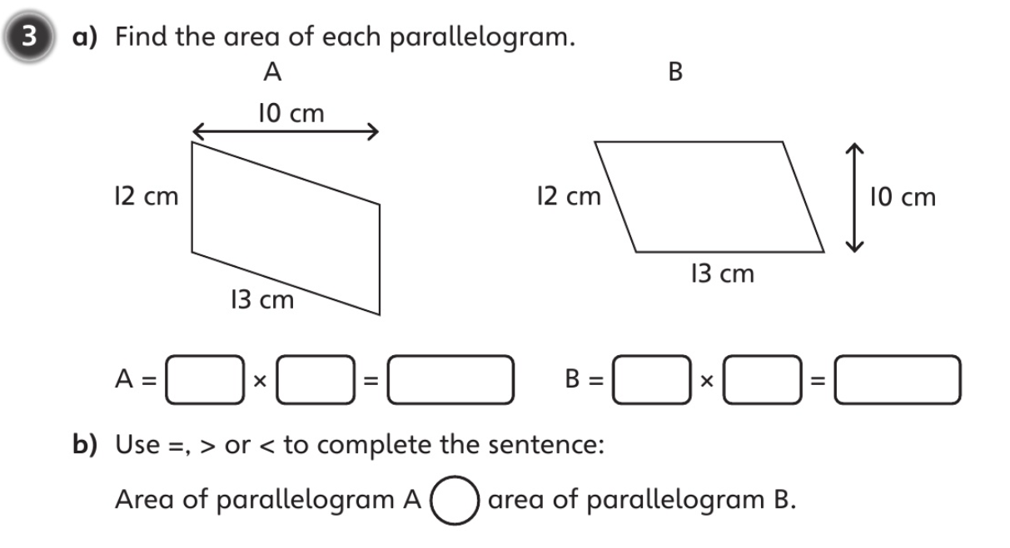
Area of a parallelogram
Base x height

Slide 11
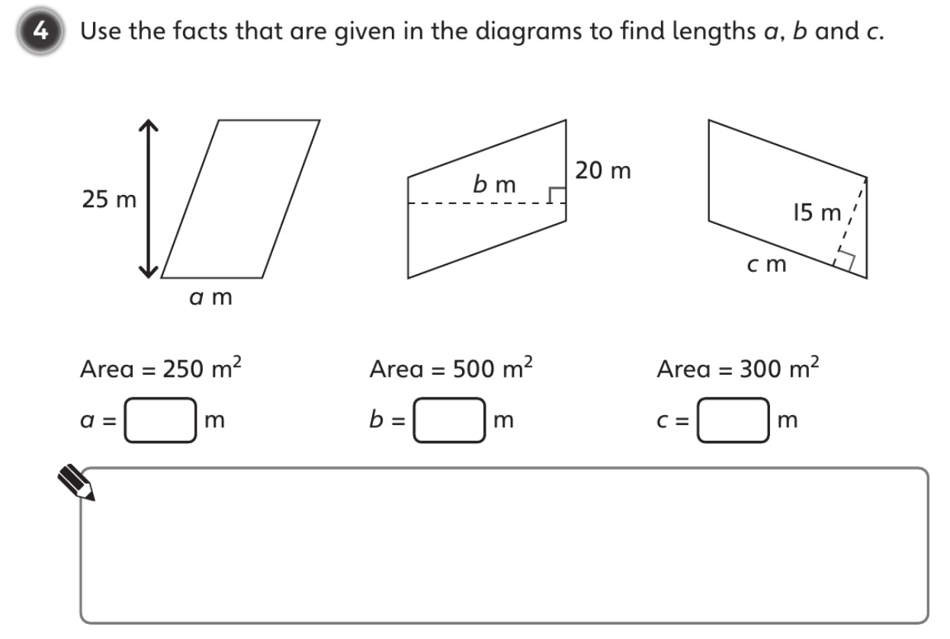
Area of a parallelogram
Base x height

Slide 12
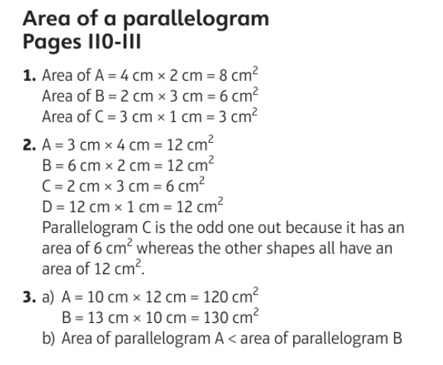

Slide 13
Question 4
a = 10m
b = 25m
c = 20m

Slide 14
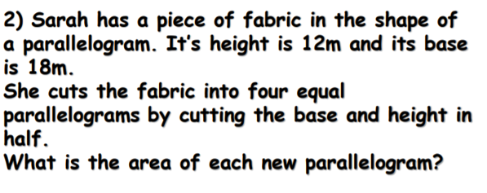
Challenge from yesterday
Area of a parallelogram
Base x height

Slide 15

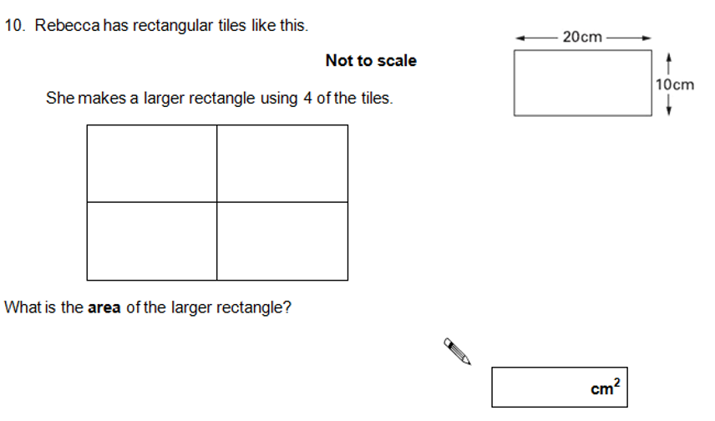
Answer to yesterday’s challenge Q2
Challenge A

Slide 16
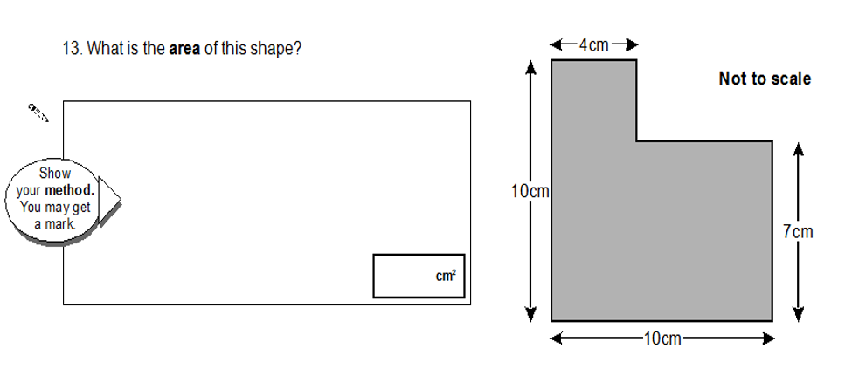
Challenge B

Slide 17
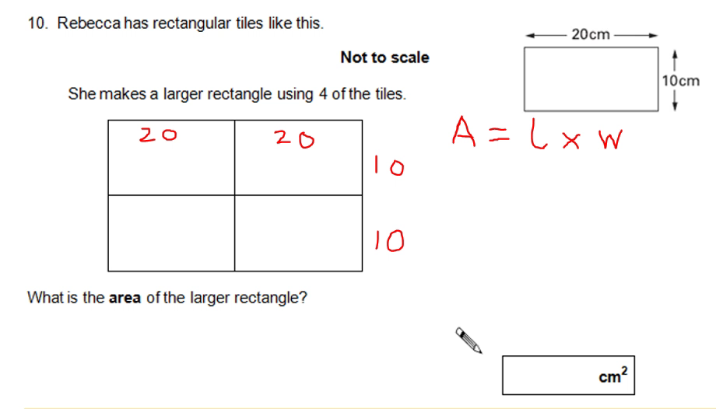
Challenge A
Please watch the video recording of how to get the answer if needed.
You might have completed different working outs than me, which is fine as long as you got the answer 800cm squared

Slide 18
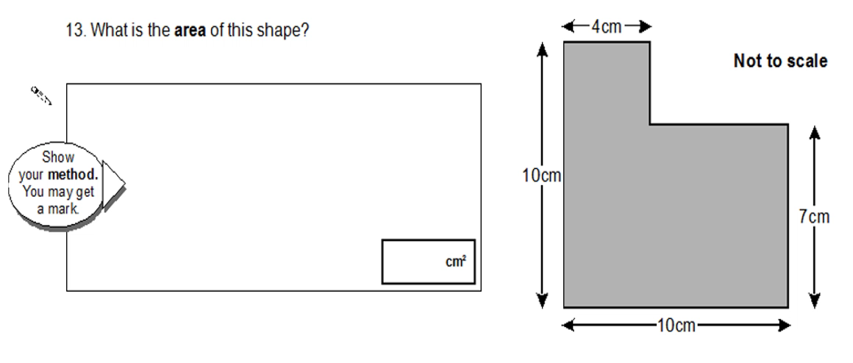
Challenge B
Please watch the video recording of how to get the answer if needed.
You might have completed different working outs than me, which is fine as long as you got the answer 82cm squared

