Slide 1






English
Tuesday 9th February 2021

Slide 2
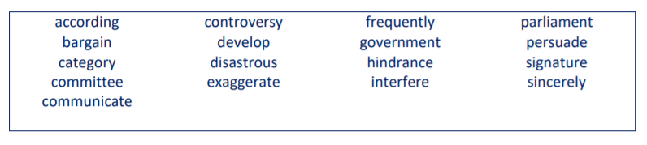
Main outcome of the session:
To improve spelling of words from the Year 5/6 spelling list.
Activity 1
Take each word in turn from the list below. Have a good look at it, read it and then say it out loud.
Underline the tricky part to spell with a colour. For example,
exaggerate
Create words or graffiti or a spelling scribble with the words you find the hardest to spell.

Slide 3
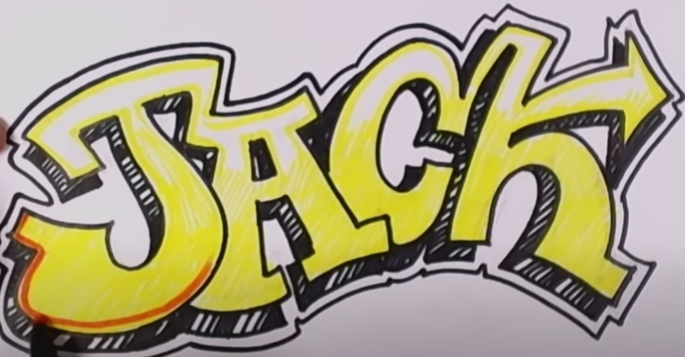
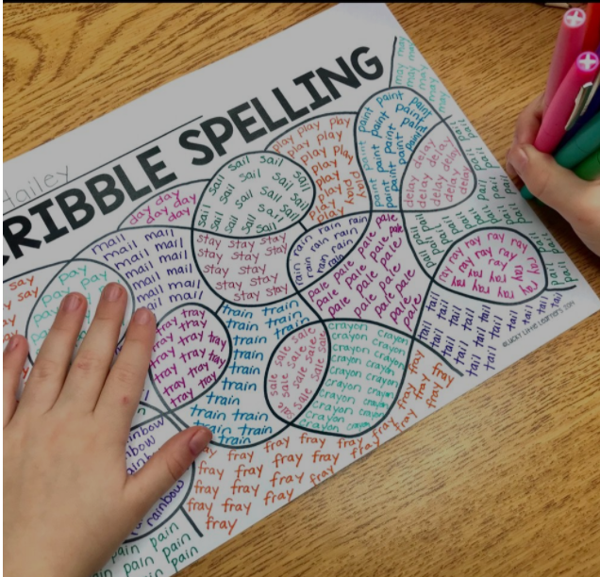
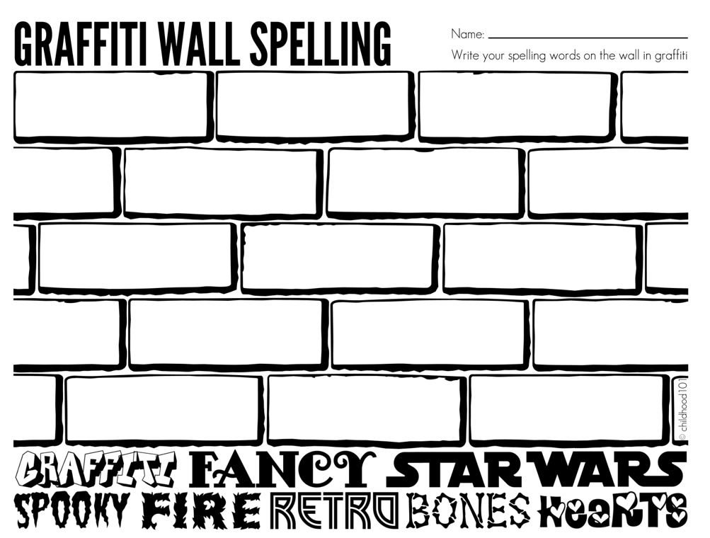

Slide 4
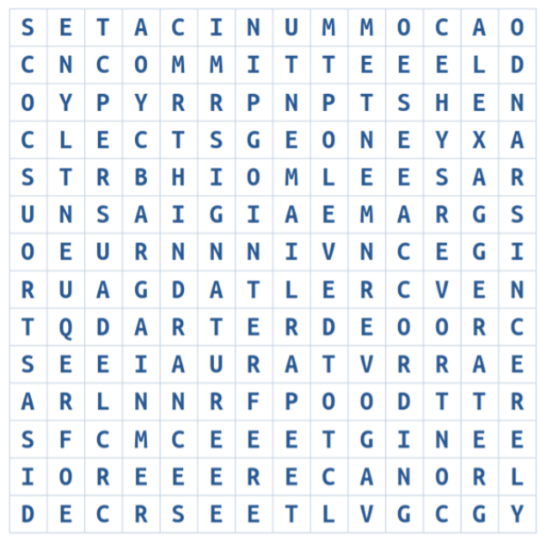
Activity 2
Now find the words in the word search.
How quickly can you do this? Maybe challenge yourself by setting a timer!

Slide 5
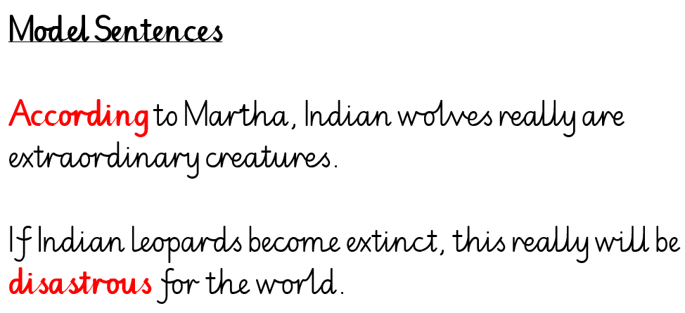
Activity 3
Choose 5 of these words to write in sentences about animals. Check your spelling of these words as you go – they’re tricky!

Slide 6
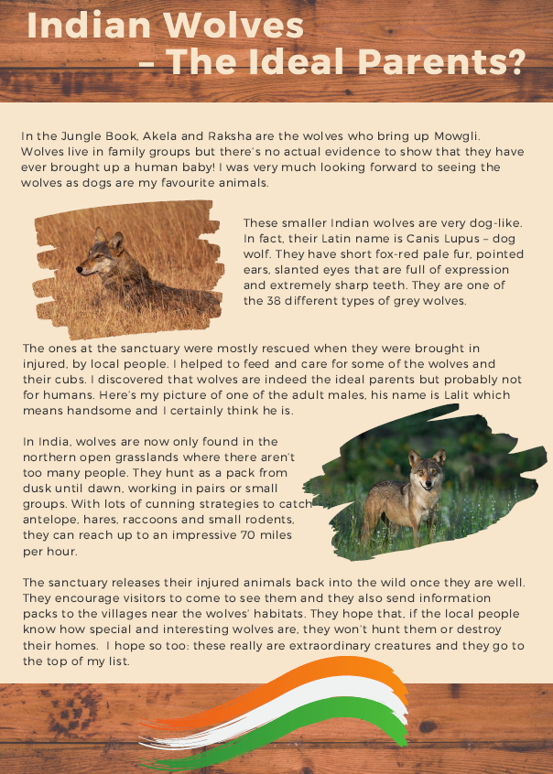
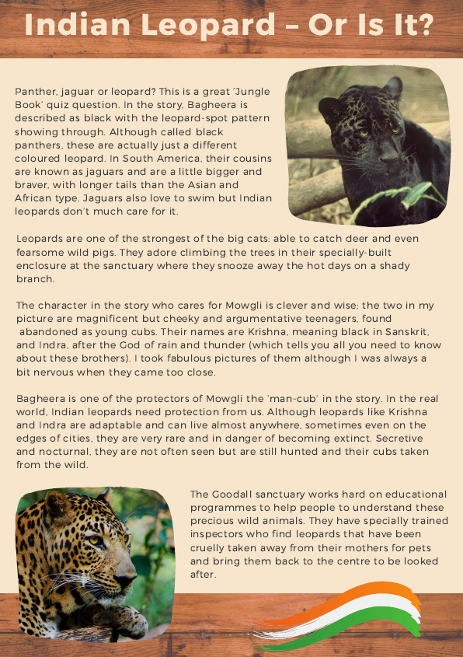
I have left these here just in case you would like to use these texts to help write your sentences this morning – I certainly used them for my model sentences!

Slide 7

‘The Explorer’ by Katherine Rundell, read by Mrs Whittingham
Please follow this link to see Mrs Whittingham read our new class novel.
https://youtu.be/FtN1th66PcE

