Slide 1


Starlings Maths Home Learning
Wednesday 10th February

Slide 2
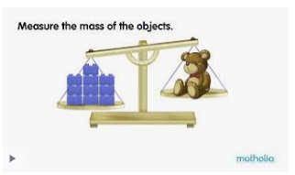
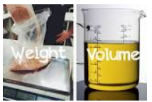
WEIGHT & VOLUME LESSON 2
Today you are going to ‘weigh’ objects using a variety of non-standard units (which means using cubes, marbles, bricks etc. to measure the weight)

Slide 3
Watch this video to see how scales work. Remember down for heavy and up for light:
https://www.youtube.com/watch?v=ybEU-6U7s8k

Slide 4
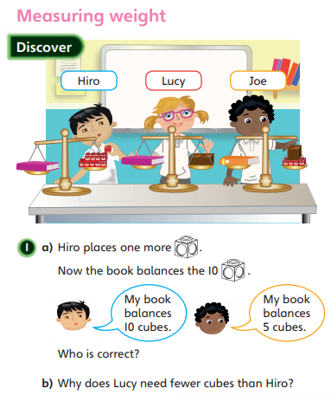
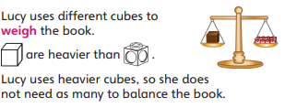

Slide 5
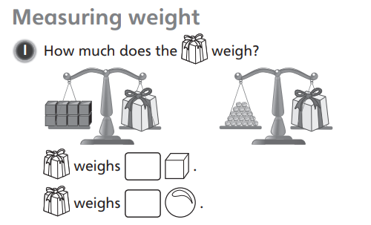
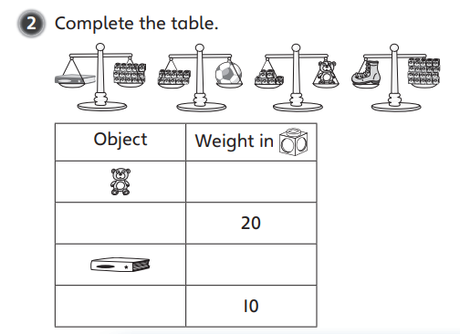
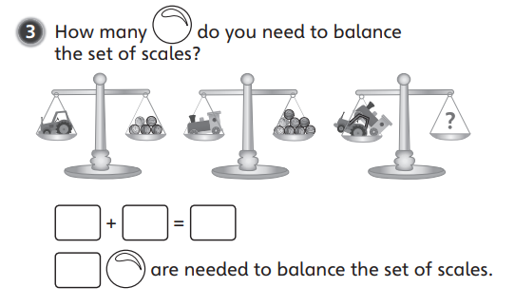

Slide 6
