Slide 1

Starlings English Home Learning
Wednesday 10th February

Slide 2
Can I end sentences with ? ! and .
Know that . is used at the end of simple sentence called a statement.
Know that ? is used at the end of a question.
Know that ! is used at the end of an exclamation, for example show a strong emotion.

Slide 3
. ! ?

Slide 4


. ! ?

Slide 5
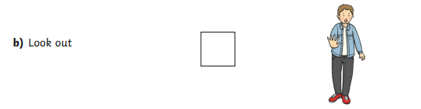
. ! ?

Slide 6
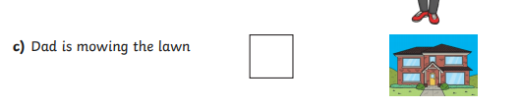
. ! ?

Slide 7
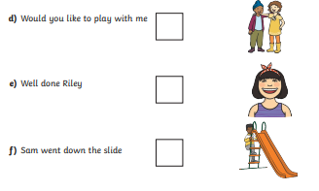

Slide 8
?
!
.

Slide 9
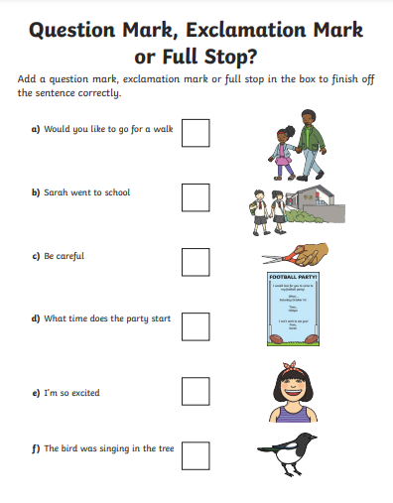

Slide 10
?
.
!
?
!
.

Slide 11
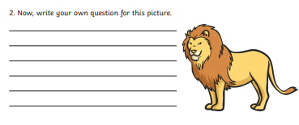

Slide 12
What is the name of this animal?

Slide 13
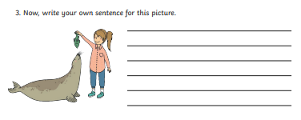

Slide 14
Sally the zookeeper is feeding the sea lion.

Slide 15
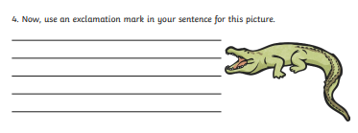

Slide 16
Beware of the crocodile!

Slide 17
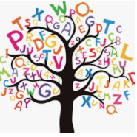
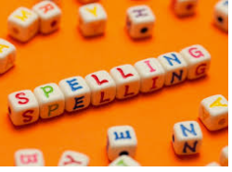




Words of the day!
fourteen fifteen sixteen
Can you write the word fourteen 5 times in different colours?
Can you write the word fifteen 5 times in a squiggle?
Can you write the word sixteen 5 times as small as you can?

