Slide 1

Starlings English Home Learning
Tuesday 9th February

Slide 2
Can I use capital letters?
Can I recognise capital letters and match capital letters to lower case letters?
Can I explain when we need to use capital letters?
Can I become a capital letter detective to find and correct missing capital letters?
Can I complete a writing task by using capital letters correctly?

Slide 3
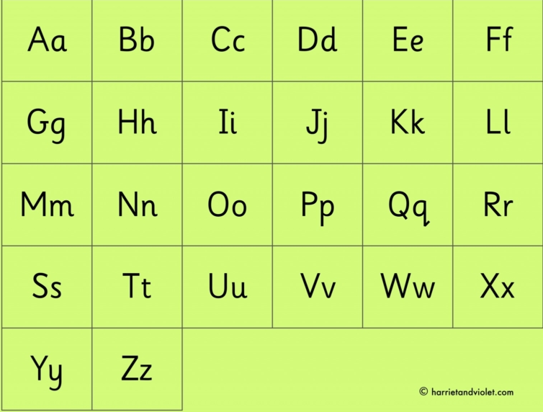
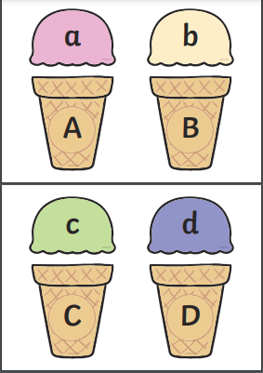

Slide 4
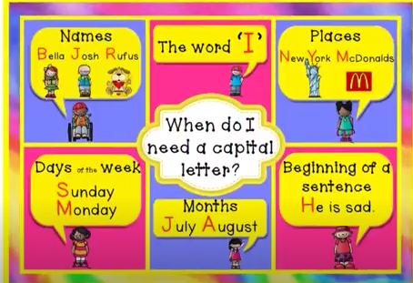

Slide 5
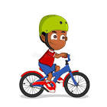
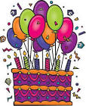



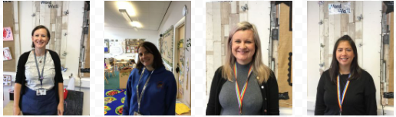
1.
2.
3.
Today i am going on a bike ride.
It is my sister’s birthday this friday.
The queen lives in Buckingham Palace in london.
My school is called Lostock Gralam Primary, my teachers are mrs judge, Mrs. Esling, mrs. Southern and Mrs o’marah.
6.
4.
5.
Today it is tuesday.
When i am 7, i will be in swallows class.

Slide 6
Sentence writing task
Write a sentence all about something you will do today. Use the pronoun I.
2. Write a sentence about a place in the country or in the world. Maybe it can be somewhere you have been on holiday or are going on holiday.
3. Write a sentence to tell us which month your birthday is in.
4. Write a sentence that uses a day of the week. Perhaps you could write about something you will do on one of the days in half term.
5. Write a sentence about your friends, or write a list of all the people in our class.
6. Challenge – Can you write a sentence that uses 2 or more words with capital letters?

Slide 7
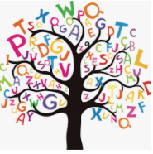
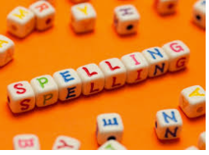
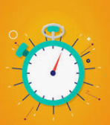



Words of the day!
eleven twelve thirteen
Can you write the word eleven as many times as you can in 30 seconds?
Can you write the word twelve 5 times inside a squiggle?
Can you write the word thirteen 5 times with your eyes closed ?

