Slide 1


Starlings Maths Home Learning
Tuesday 9th February

Slide 2
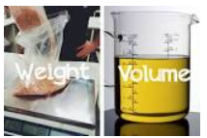
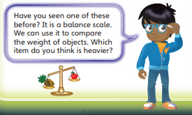
WEIGHT & VOLUME LESSON 1
Good Morning Starlings and welcome to our new topic all about Weight (how light or heavy an object is) and Volume (the amount of space an object takes up)
Today, we are going to compare the weights of familiar objects (things we can find around our house).
.

Slide 3
You know how Mrs Judge loves a song to start a new topic! Let’s dance around pretending to have heavy and light objects in our hands like scales – hands down for heavy and up for light :
https://www.youtube.com/watch?v=qUOQrXmfwDM

Slide 4
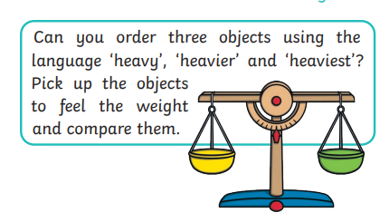
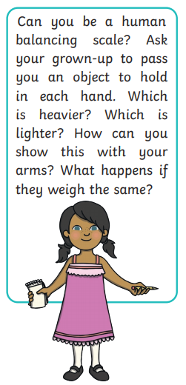
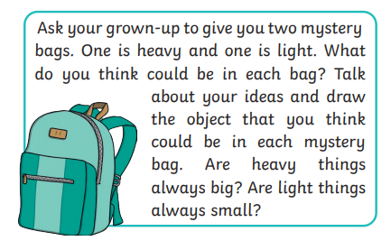
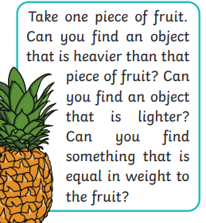

Slide 5
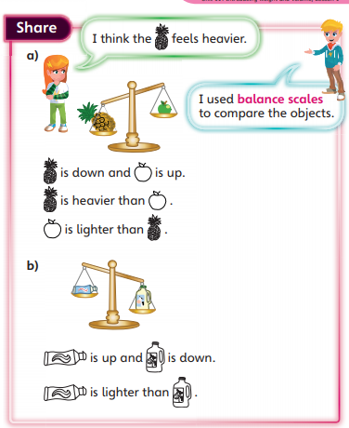
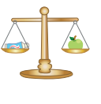
If the scales are balanced then the objects have equal (the same) mass (weight)

Slide 6
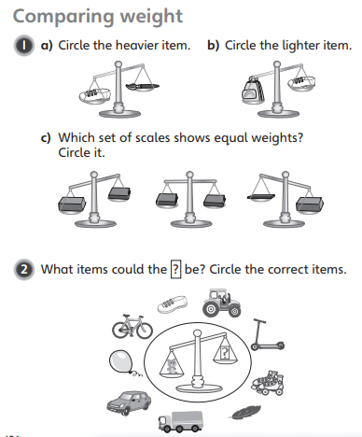
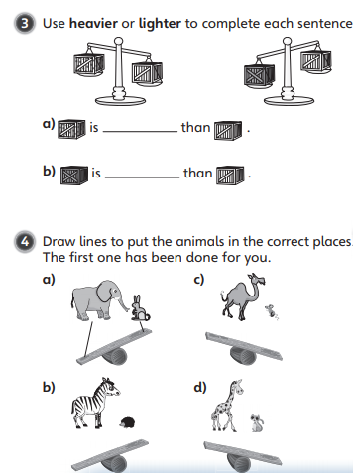

Slide 7
