Slide 1

Starlings English Home Learning
Monday 8th February

Slide 2
Today we will be
Finding and using different nouns with the help of pictures
Identifying singular and plural
Adding the suffix s and es to make a noun plural

Slide 3

What is a noun?

Slide 4

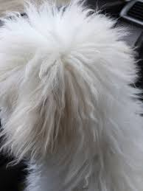

What is a noun?
Crown
fluffy
running

Slide 5









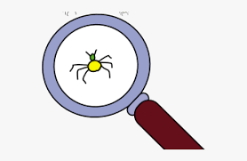
Can you find the nouns?
Cat | Round
Shiny | Ball
Pan | Sad
Sing | House
Egg | Small

Slide 6

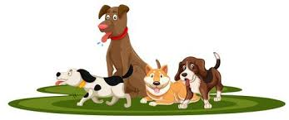
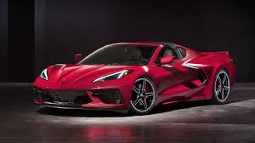
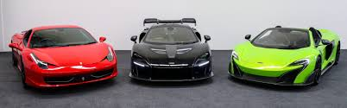

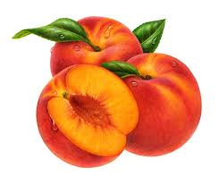
Singular or Plural

Slide 7
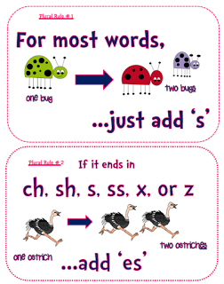

Slide 8
Singular or Plural

Slide 9





Make these nouns plural
Write the noun to match the picture
Write the word again, this time adding the suffix s or es to make the word plural

Slide 10
Singular | Plural
Cat | Cats

Slide 11






Words of the day!
eight nine ten
Can you write the word eight 5 times in your prettiest handwriting?
Can you write the word nine 5 times using your other hand?
Can you write the word ten 5 times sticking your tongue out?

Slide 12

Red group – Please have a look at the separate RWI PowerPoint for set 1. We have added some special friends work for you.
Green group you need to look out for set 2 videos on the link below:
https://www.youtube.com/channel/UCo7fbLgY2oA_cFCIg9GdxtQ
We would like you to watch 4 videos: set 2 speed sounds, set 2 spelling, red words 1, and read and hold a sentence 1
Pink, yellow and blue groups you need to look out for set 3 videos on the link below.
https://www.youtube.com/channel/UCo7fbLgY2oA_cFCIg9GdxtQ
We would like you to watch 4 videos: set 3 speed sounds, set 3 spelling, red words 2 and read and hold a sentence 2

