Slide 1


Starlings Maths Home Learning
Monday 8th February

Slide 2
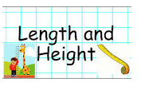

LENGTH & HEIGHT LESSON FIVE
Good Morning Starlings
You’ve worked so hard last week on measuring length and height so today we have one final lesson and we are going to solve some word problems.

Slide 3
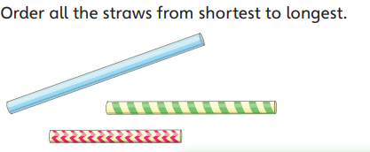
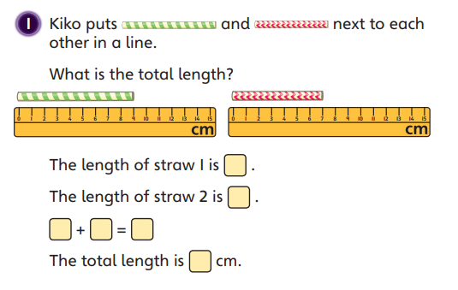
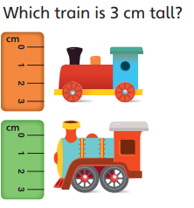

Slide 4
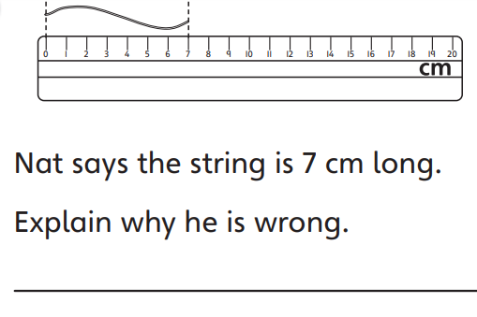
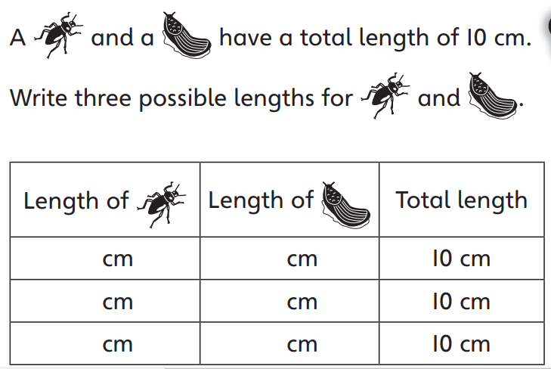
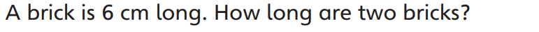

Slide 5

