Slide 1
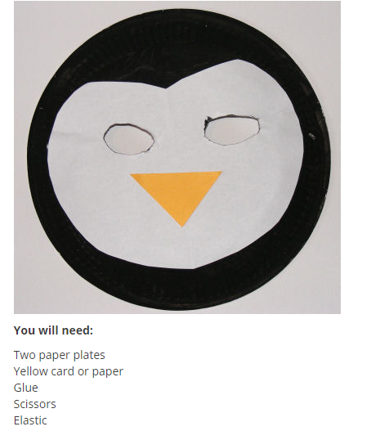

Make a paper plate penguin mask and record a special e-safety message video using your learning from today.
Or
Paint or draw a penguin to make a poster
On your poster write a message that you learned from watching Smartie’s video.

