Slide 1






English
Monday 8th February 2021

Slide 2
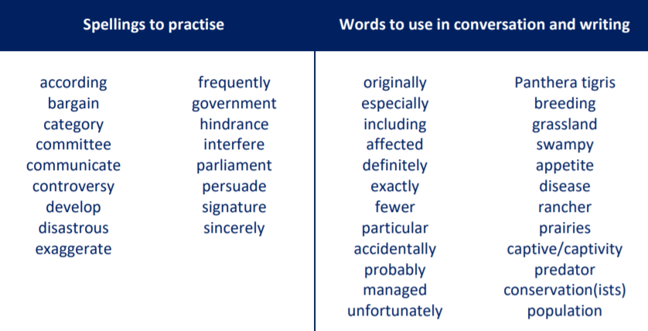
Main outcome of the session:
To write a paragraph to explain what is special about these animals and why humans should protect them.
These are the spelling words that go along with this unit of work exactly like when we’re in school.

Slide 3
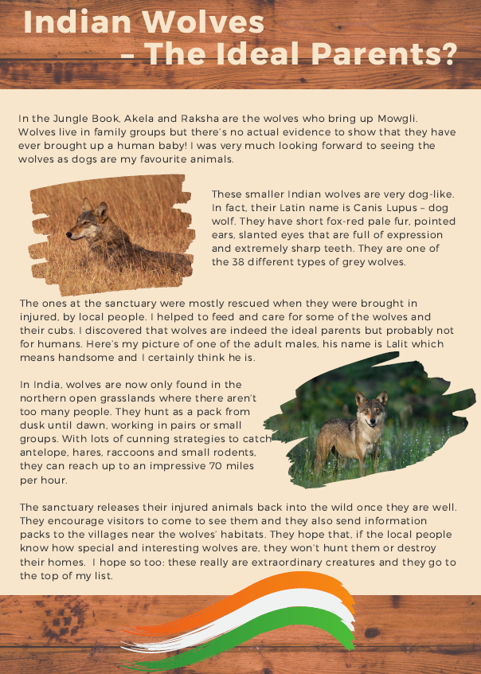
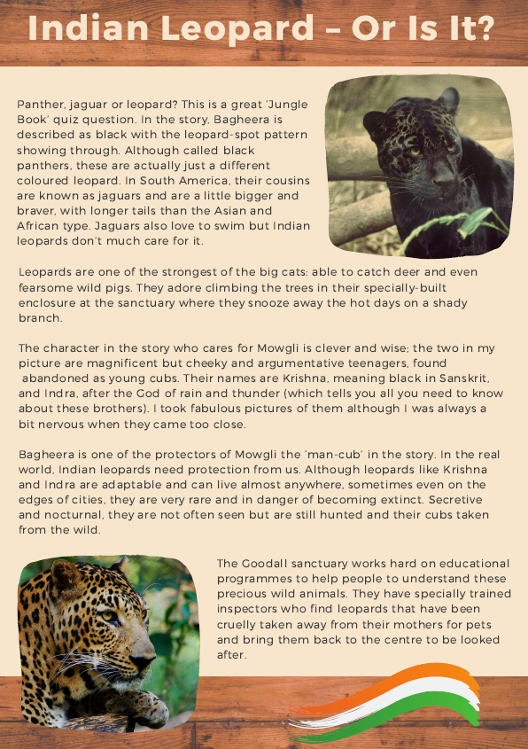
Activity 1
Re-read one of the pages: ‘Indian Wolves’ or ‘Indian Leopards’.
We are going to play the game ‘Just a Minute’ on the next slide!

Slide 4

Can you tell me everything you know about your chosen animal: either the Indian Wolves or the Indian Leopards?
Set a 1 minute timer – you have one minute to tell me everything you know!
https://www.online-stopwatch.com/full-screen-stopwatch/

Slide 5
Activity 2
What problems does your animal face?
Why should your animal be protected?
Take some time and have a think about the above questions. Jot down some ideas.

Slide 6

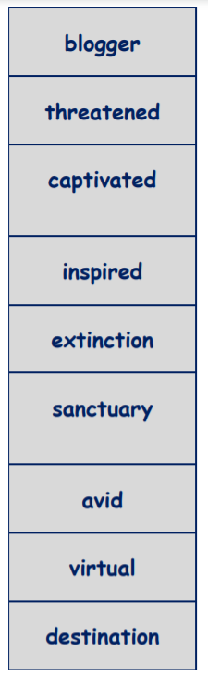



Activity 3
Write a paragraph about your chosen animal (either the Indian wolves or the Indian leopards) explaining why they should be protected. Please include modal verbs.
Things to help you:

Slide 7


Slide 8

‘The Explorer’ by Katherine Rundell, read by Mrs Whittingham
Please follow this link to see Mrs Whittingham read our new class novel.
https://youtu.be/N4aXdv3JBR4

